Slide 1


Parent Information Evening – 16.10.24
Notes:
Good evening and welcome to our Phonics and handwriting information evening.
It is very encouraging to see so many of you. It is essential that we partner together to provide the best education for your children and your support is greatly appreciated.
I am Mrs Bendzulla. I am currently a Year 1 teacher and am the Phonics Lead in the school.

Slide 2
PHONICS AT PATHFINDER
What is Phonics?
What is written language?
What is Sounds Write?
Sounds-Write is a quality first phonics programe.
Its purpose is to provide a comprehensive system to teach reading, spelling and writing.
Notes:
Phonics is a way of teaching children how to read and write.
It helps children hear, identify and use different sounds that distinguish one word from another in the English language.
Written language can be compared to a code, so knowing the sounds of individual letters and how those letters sound when they’re combined will help children decode words as they read.
(National Literacy Trust)
Sounds-Write is a quality first phonics programme.
Its purpose is to provide a comprehensive system to teach reading, spelling and writing.

Slide 3
WHY SOUNDS-WRITE?
Speaking and listening comes naturally.
What doesn’t come naturally is learning to read and write.
This needs to be explicitly taught.
Notes:
Because every one of you has a child who can already listen and speak.
No-one has to send their child to school to learn what comes naturally –speaking.
Learning to read and write does not come naturally. It needs to be taught explicitly. It is at Pathfinder. All our teachers that teach Sounds-Write have undergone intensive training and continued CPD and support.

Slide 4
LEARNING TO READ AND WRITE
Segmenting –pull the word apart into sounds.
Blending –putting the sounds/parts together.
Notes:
So, what does Phonics involve? Being able to read and write requires the ability to segment a word (to break it up into its sounds) and to blend a word (putting the sounds / parts together. For example play segmented into p/ l/ ay and then blended p/l/a/y play

Slide 5
HOW DOES THE ENGLISH ALPHABET CODE WORK?
To become fluent readers and spellers children need to know:
1. Letters are used to spell individual sounds (one at a time, from left to right across the page).
2. Each sound may be spelled by one or more letters.
cat ship night weight
3. Many spellings represent more than one sound.
e.g. the spelling <ea> can represent the sounds:
sea thread break
4. Sounds may be written in more than one way:
play rain great *gate
ay ai ea a
4.
Notes:
In the past a word like gate would be taught as a slit spelling g ae t. As an update from Sounds-Write we now no longer teach the split spelling. This is to make it simpler for teachers and learners. So, in the word gate we now say g, a, te. Children are familiar with this spelling as have learned ve as in glove in reception.
Show more words

Slide 6
WHAT DO WE THINK READING IS ABOUT?
What skills need to be practiced and perfected to become a fluent reader?
Segmenting
Blending
Code knowledge know how to spell the sounds in the language.
Phoneme manipulation the ability to change the sounds in words by adding, deleting, or substituting phonemes.
We practice these skills daily in our phonics sessions.
Notes:
Phoneme manipulation is the ability to change the sounds in words by adding, deleting, or substituting phonemes. This is practiced in the sound swap game. Show.
*Interventions

Slide 7
SAY THE SOUNDS CORRECTLY
When your children start to learn to read and write, we DO NOT use letter names.
We just say the sounds very precisely. https://video.link/w/IxS7d

Slide 8
SAY THE SOUNDS CORRECTLY
When your children start to learn to read and write, we DO NOT use letter names.
We just say the sounds very precisely. https://video.link/w/IxS7d

Slide 9
EXAMPLES OF SOME LESSONS IN SOUNDS WRITE
Word building
https://video.link/w/fvS7d
Sound Swap
Dictation
“Say the sounds and read the words.”
Notes:
Word building – lesson 6 examples on table.
Sound Swap – SHOW
Dictation – this is one of the ways we assess whether children can independently implement their phonetic knowledge.

Slide 10
WRITING
•Phonetically plausible attempts:
plai, lollee, duk
•In this word we spell /ae/ like this – ay
play
•Spellings in Year 1 and 2:
linking to previously taught units, assess through dictation.
Notes:
When children write, phonetically plausible attempts are accepted for example plai, lollee, duk.
By Year 2 children are expected to use the correct alternate spellings for sounds, but this is practised throughout Year 1 and Year 2.
To error-correct we’d say “In this word we spell /ae/ like this ay play”. SHOW

Slide 11
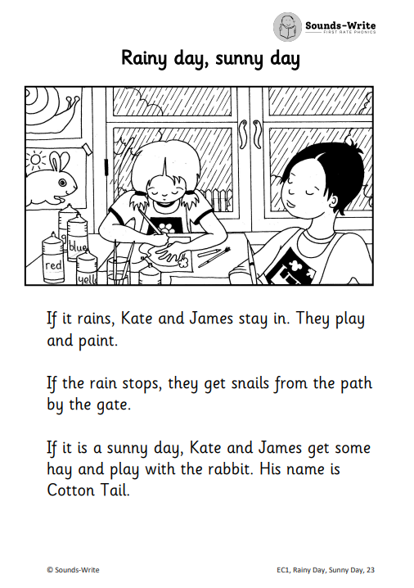
HOME READING BOOKS
These books will be focus on previous taught units so children can continue to rehearse the sounds and skills needed to read. The focus is to build fluency, children should be able to apply their code knowledge.
Please write in reading logs each time your child reads.
It may only be a few pages each night. Children need to read
multiple times to ensure for fluency and understanding.
Also work on expression, intonation and understanding.
Notes:
In terms of reading, books follow the Sounds Write scheme. We have some lovely books and also use Sounds Write decodable texts. Please see the examples on the tables. Children read books at home two units behind what they have been taught as a way of embedding the phonetic knowledge. It is essential that children are reading their Sounds Write books as this is consolidating their learning within Phonics. The focus is to build fluency.
Any other books can be read for pleasure. This can also be written into your Reading Records.

Slide 12
OTHER WAYS TO SUPPORT AT HOME
•Read, read and read some more to your child –it doesn’t have to be story books, TV guide, football results…
•Environmental print –cereal boxes, road signs
•Segment instructions – “Go to /b/e/d/.”
•Watch Alphablocks
•Write lists –shopping lists, Christmas lists, to do lists…

Slide 13

FURTHER WAYS TO SUPPORT AT HOME

