Slide 1
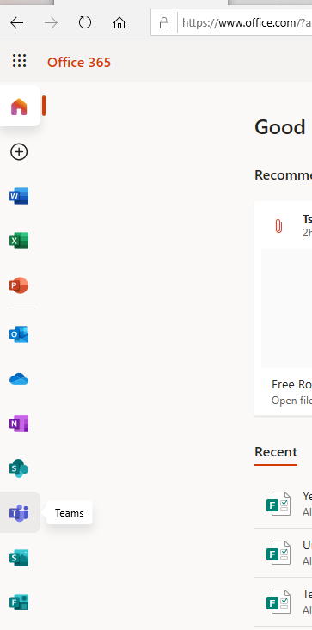

Accessing Teams from School or Home
Go to https://www.office.com
Enter your school username and password
  Username = 20381@sydneyrussellschool.com
You should see this screen:
Click on Teams on the left hand side

Slide 2
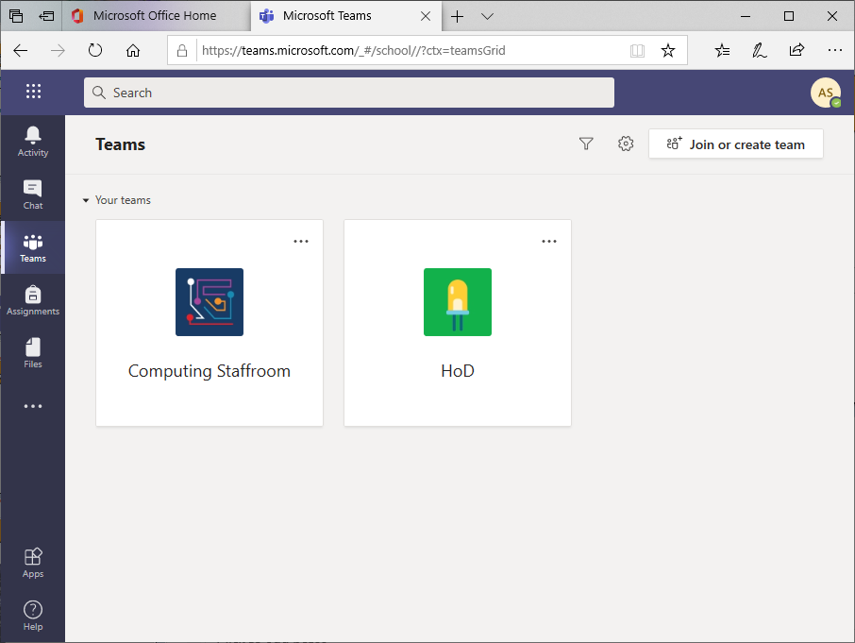
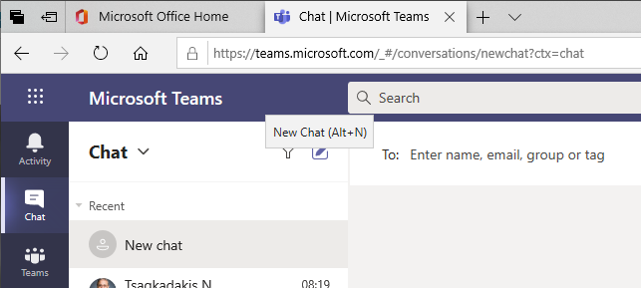
Using Teams
Click on Teams again on the left hand side
You will find all of your classes/subjects here.
The chat will allow you to communicate with your teachers

Slide 3
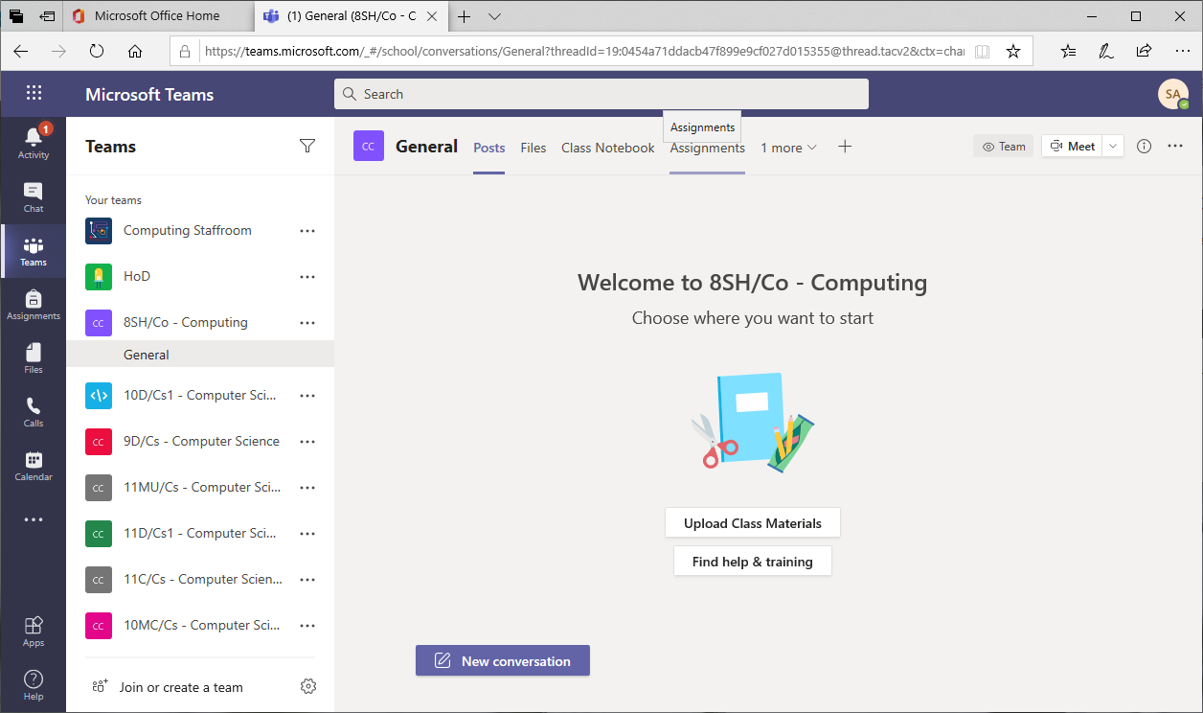
Accessing your classwork
Select a team/class and you will find the chat, work files, quizzes etc.
The File tab will show the class resources sent by your teachers.

Slide 4
Accessing assignments
The Assignments tab will show you the tasks your teacher has set for you to complete.
You are expected to finish and hand in the task in Teams by the deadline set.
Your teacher will mark it and will provide feedback in Teams.

Slide 5
Live Lessons
If your teacher is running a ‘live’ lesson they will schedule this for the time of your timetabled lesson.
You will receive an invitation to join at the time of your normal timetabled lesson. Be ready on Teams and WAIT for the invite.
Make sure your Mic and your Camera are OFF
Do not record the lesson
Your teacher will be available during the lesson in the chat function

Slide 6
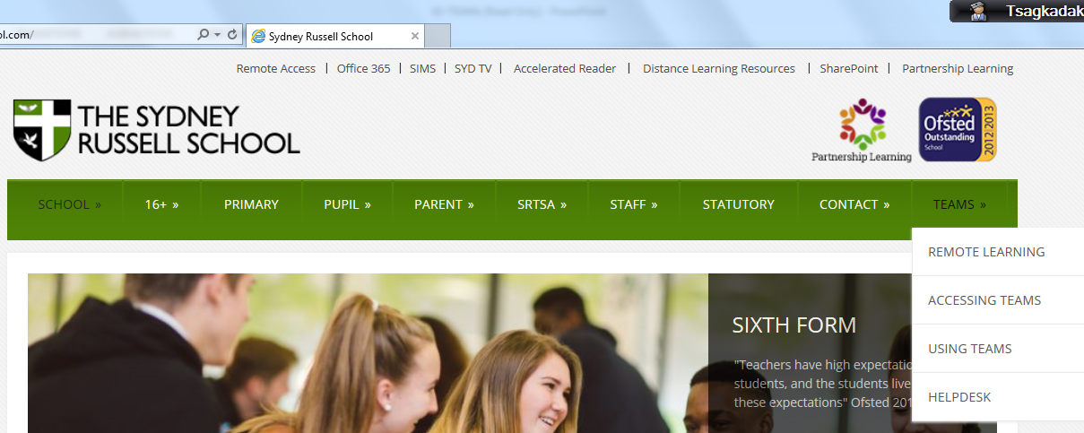
Teams Help
www.sydneyrussellschool.com

