Slide 1

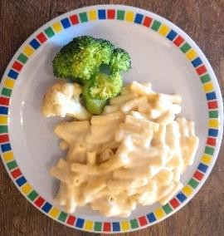

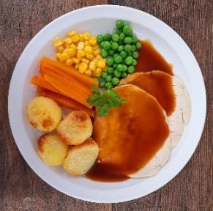
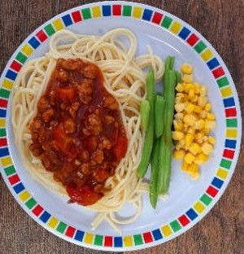
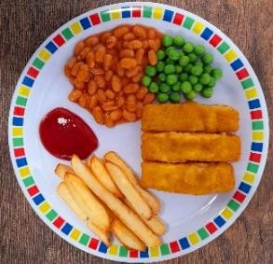
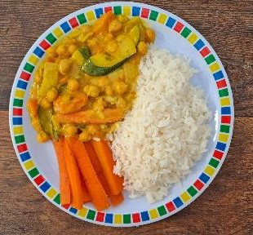
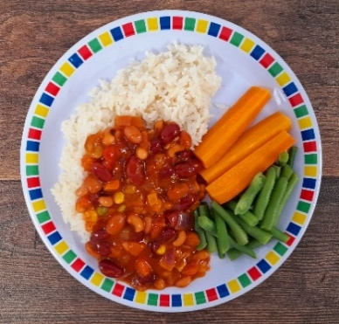
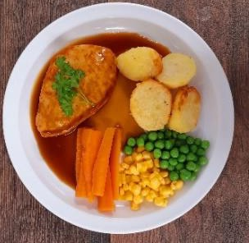
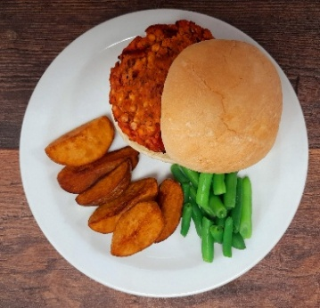
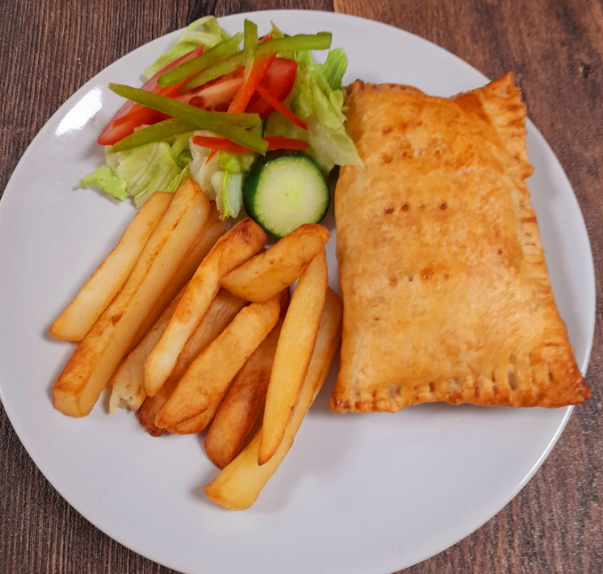
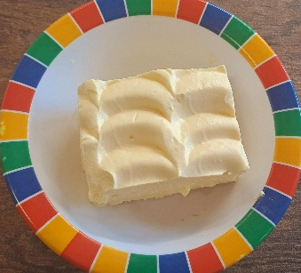
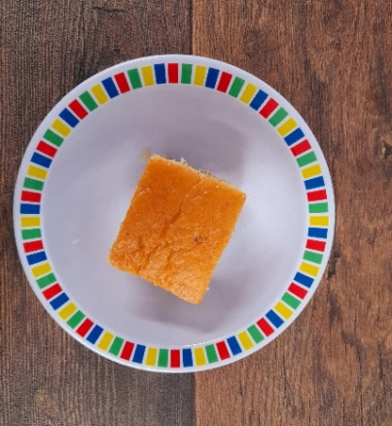
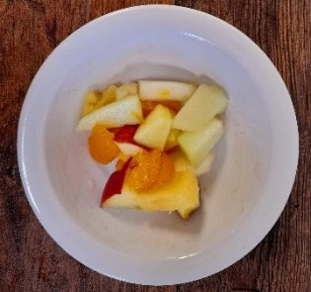
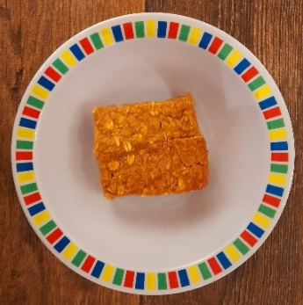
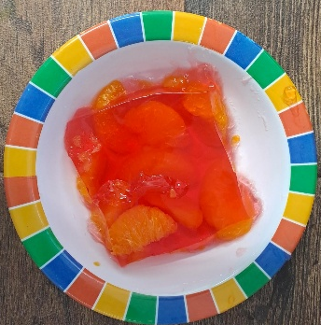
WEEK ONE
 | MONDAY | TUESDAY | WEDNESDAY | THURSDAY | FRIDAY
OPTION 1 | Macaroni Cheese | Phat Pasty Pork Sausage Roll with Potato Wedges | Roast Chicken, Stuffing, Roast Potatoes & Gravy | Spaghetti Bolognaise | Fish Fingers or Salmon Fish Fingers with Chips & Ketchup
OPTION 2 | Coconut Curry and Rice | Mild Mexican Chilli with Rice | Roast Quorn, Roast Potatoes & Gravy | Smokey Bean Burger with Wedges & Tomato Sauce | Cheese & Bean Pasty with Chips & Tomato Ketchup
DESSERT | Banana Mousse | Orange Drizzle Cake | Fruit Platter | Apple Flapjack | Jelly with Mandarins
*VEGETABLES AND SIDES MAY DIFFER THAN THOSE SHOWN

Slide 2

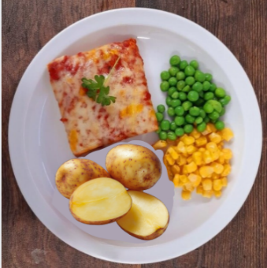
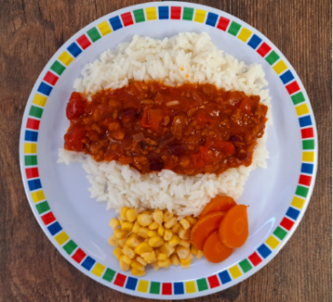
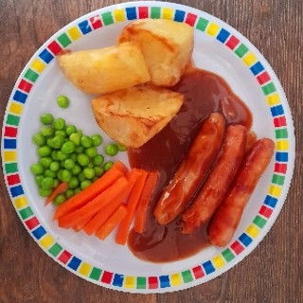
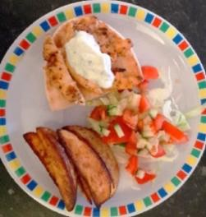
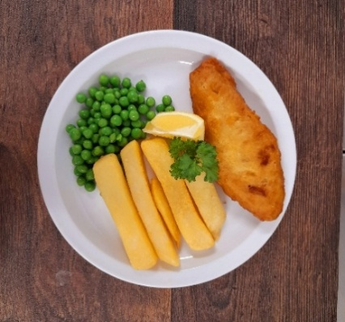
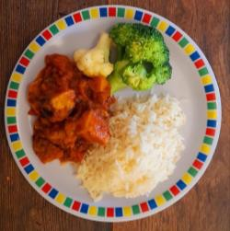
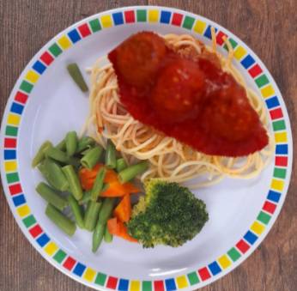
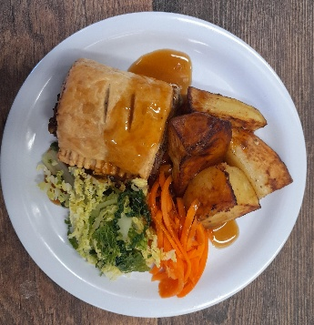
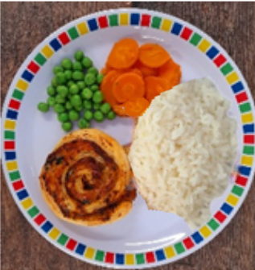
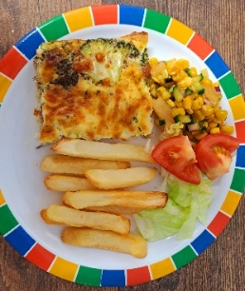
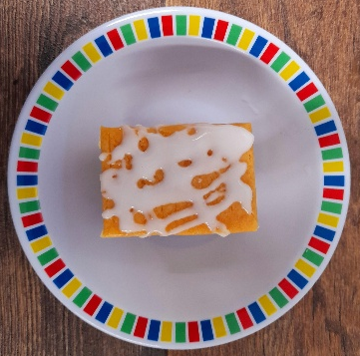
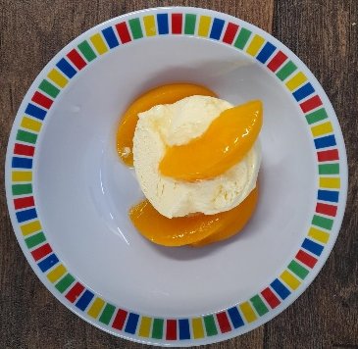
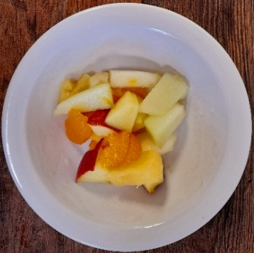
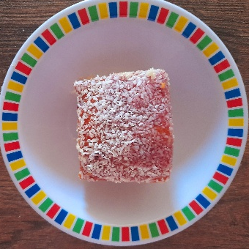
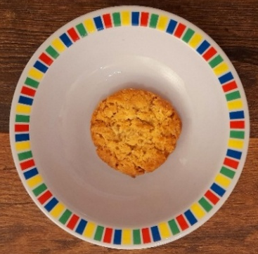
WEEK TWO
 | MONDAY | TUESDAY | WEDNESDAY | THURSDAY | FRIDAY
OPTION 1 | Summer Pizza with Mixed Summer Salad | Beef Chilli with Rice & Sweetcorn & Cucumber Salsa | Roast Pork or Chicken Sausage, Roast Potatoes & Gravy | Greek Chicken Pitta with Herby Rice & Tzatziki | Battered Fish with Chips & Tomato Ketchup
OPTION 2 | Lentil and Sweet Potato Curry with Rice | Spaghetti & Vegan Meatballs in a Tomato Sauce | Vegetarian Wellington, Roast Potatoes & Gravy | Spinach & Cheese Whirl with Herby Rice & Tzatziki | Cheesy Broccoli Frittata with Chips & Tomato Ketchup
DESSERT | Iced Vanilla Sponge | Peaches & Ice Cream | Freshly Chopped Fruit | Jam & Coconut Sponge with Custard | Oaty Cookie
*VEGETABLES AND SIDES MAY DIFFER THAN THOSE SHOWN

Slide 3

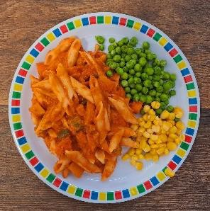
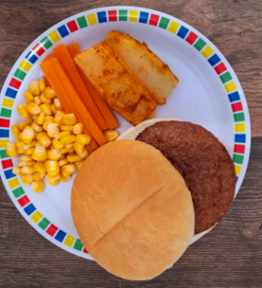
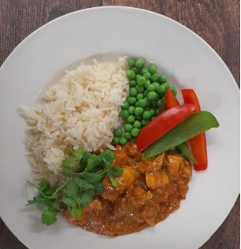
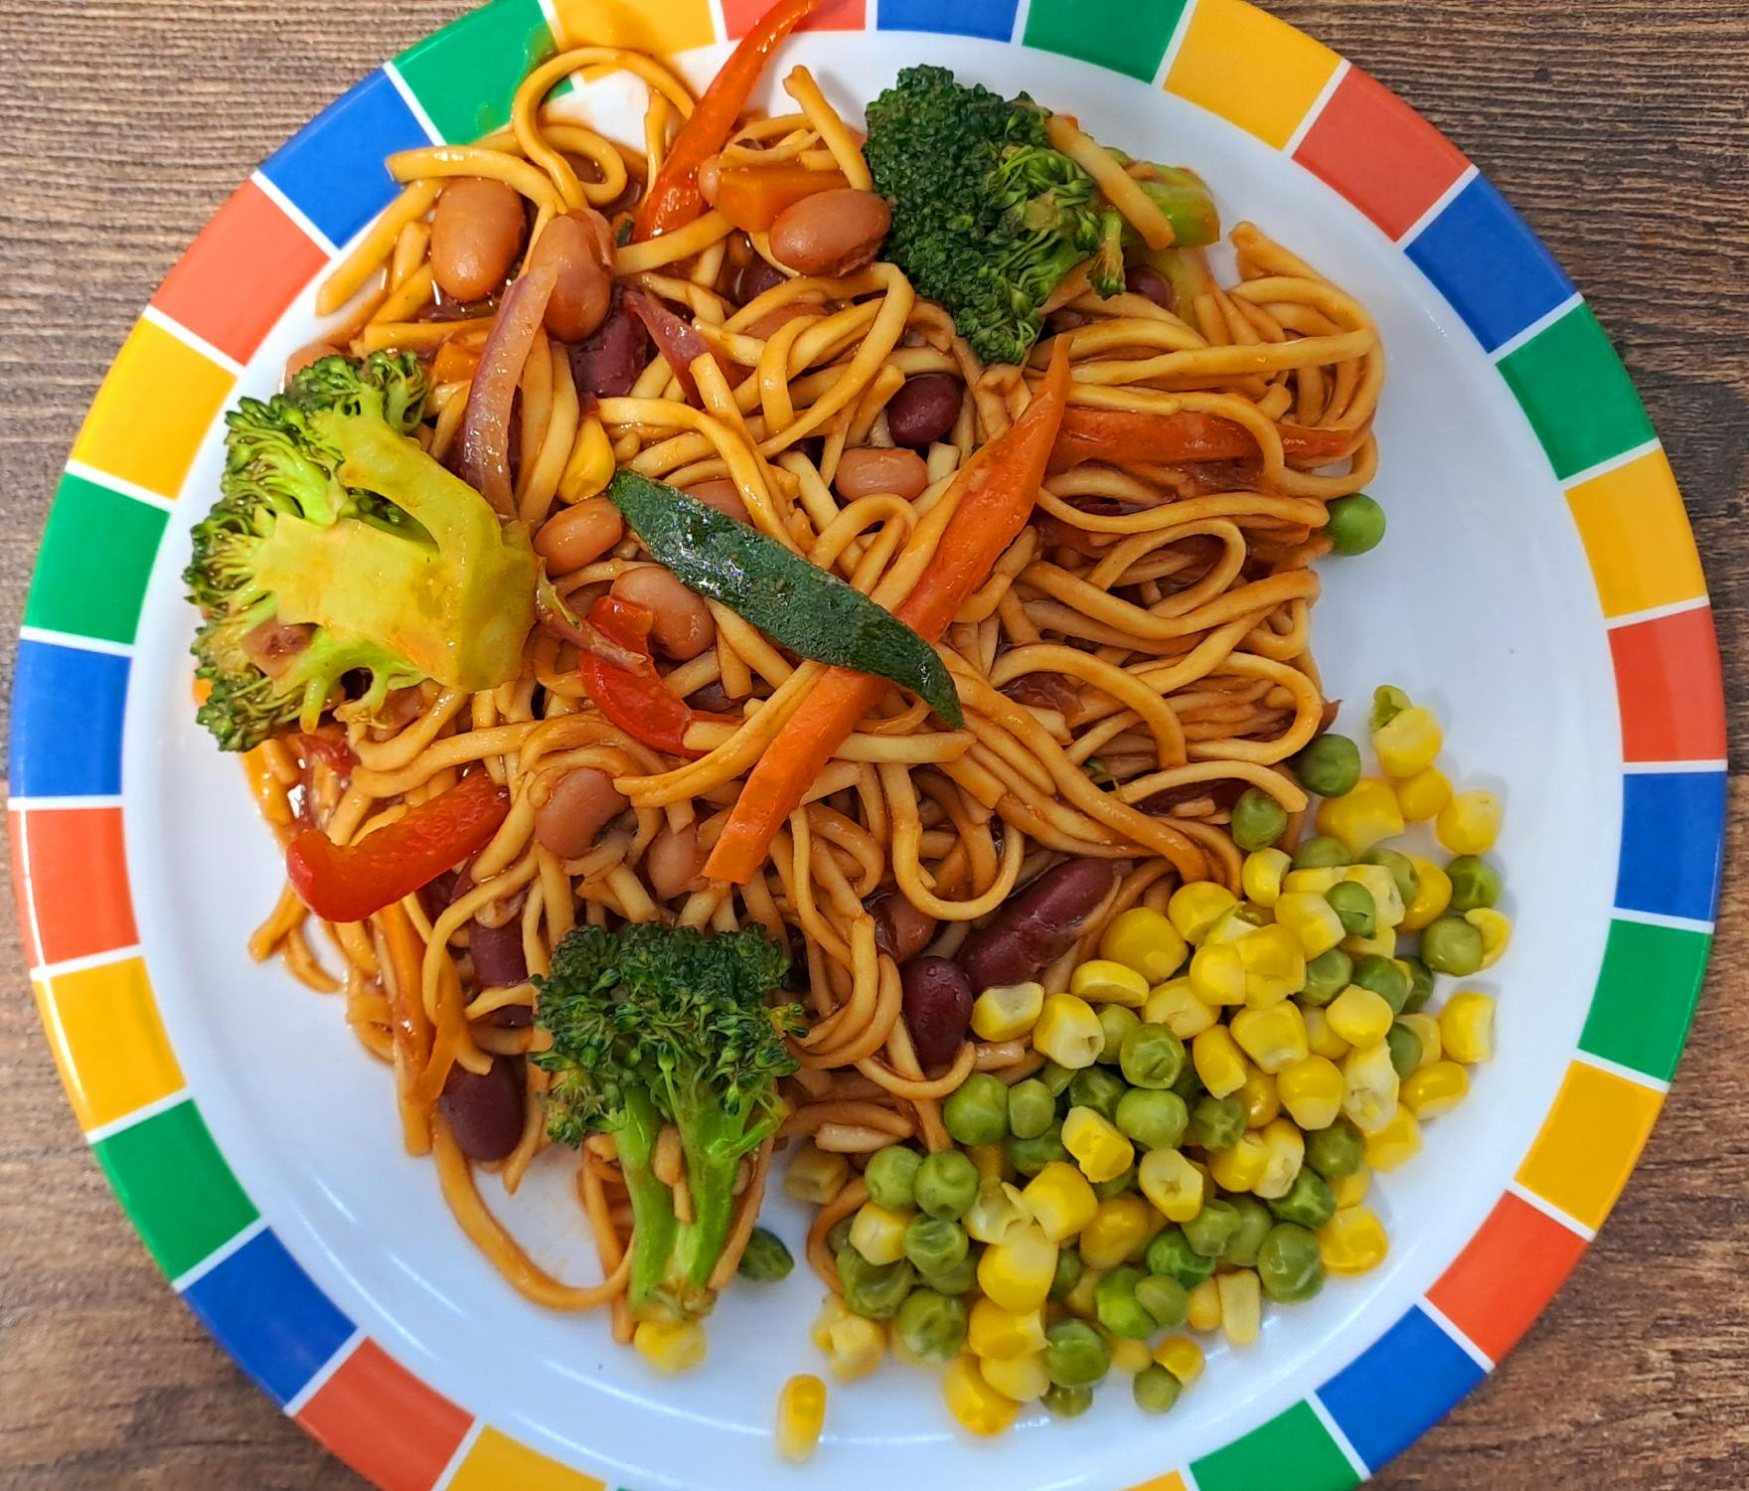
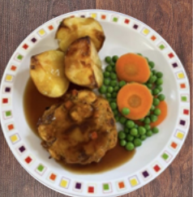
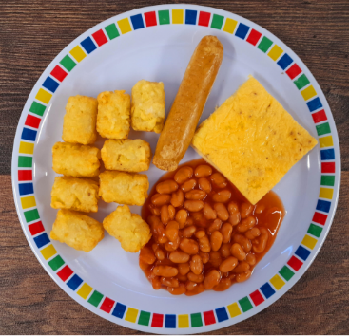
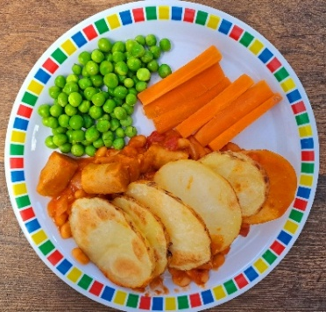
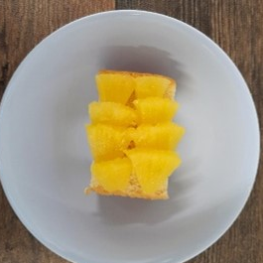
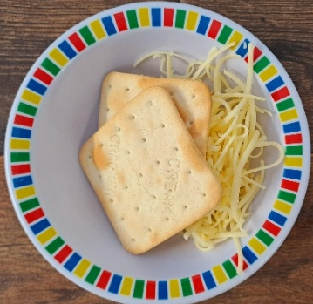
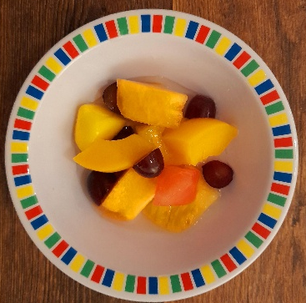
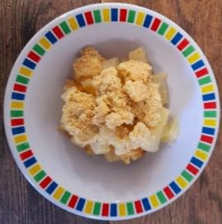
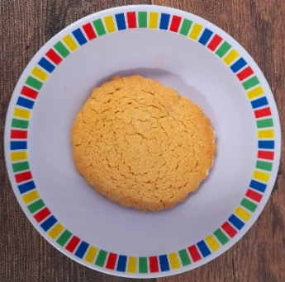
WEEK THREE
 | MONDAY | TUESDAY | WEDNESDAY | THURSDAY | FRIDAY
OPTION 1 | Tomato Pasta | Beef Burger with Potato Wedges & Rainbow Slaw | Roast of the Day, Mashed Potatoes & Gravy | Chef Shilpa’s Chicken Korma with Rice | Fish Fingers with Chips & Tomato Ketchup
OPTION 2 | Chinese Vegetable Noodles | Mexican Bean Roll with New Potatoes & Rainbow Slaw | Vegetable Loaf, Mashed Potatoes & Gravy | All Day Vegetarian Breakfast | Cowboy Sausage and Bean Hotpot
DESSERT | Pineapple Upside Down Cake | Cheese & Crackers | Fruit Medley | Strawberry & Apple Crumble with Custard | Vanilla Shortbread
*VEGETABLES AND SIDES MAY DIFFER THAN THOSE SHOWN

