Slide 1

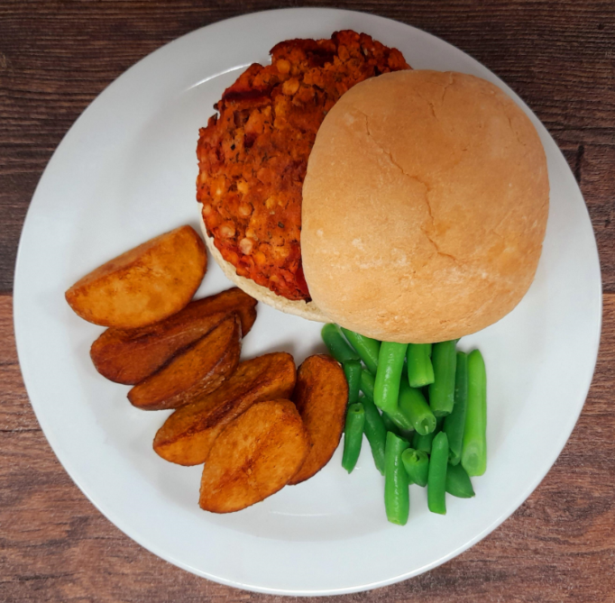
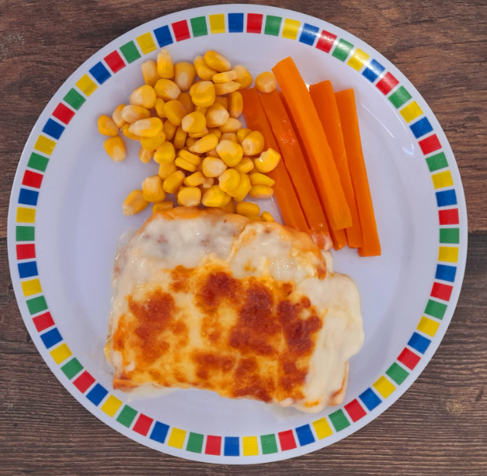
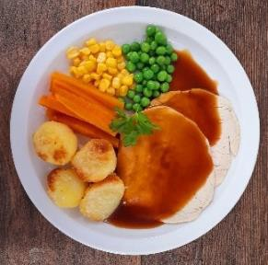
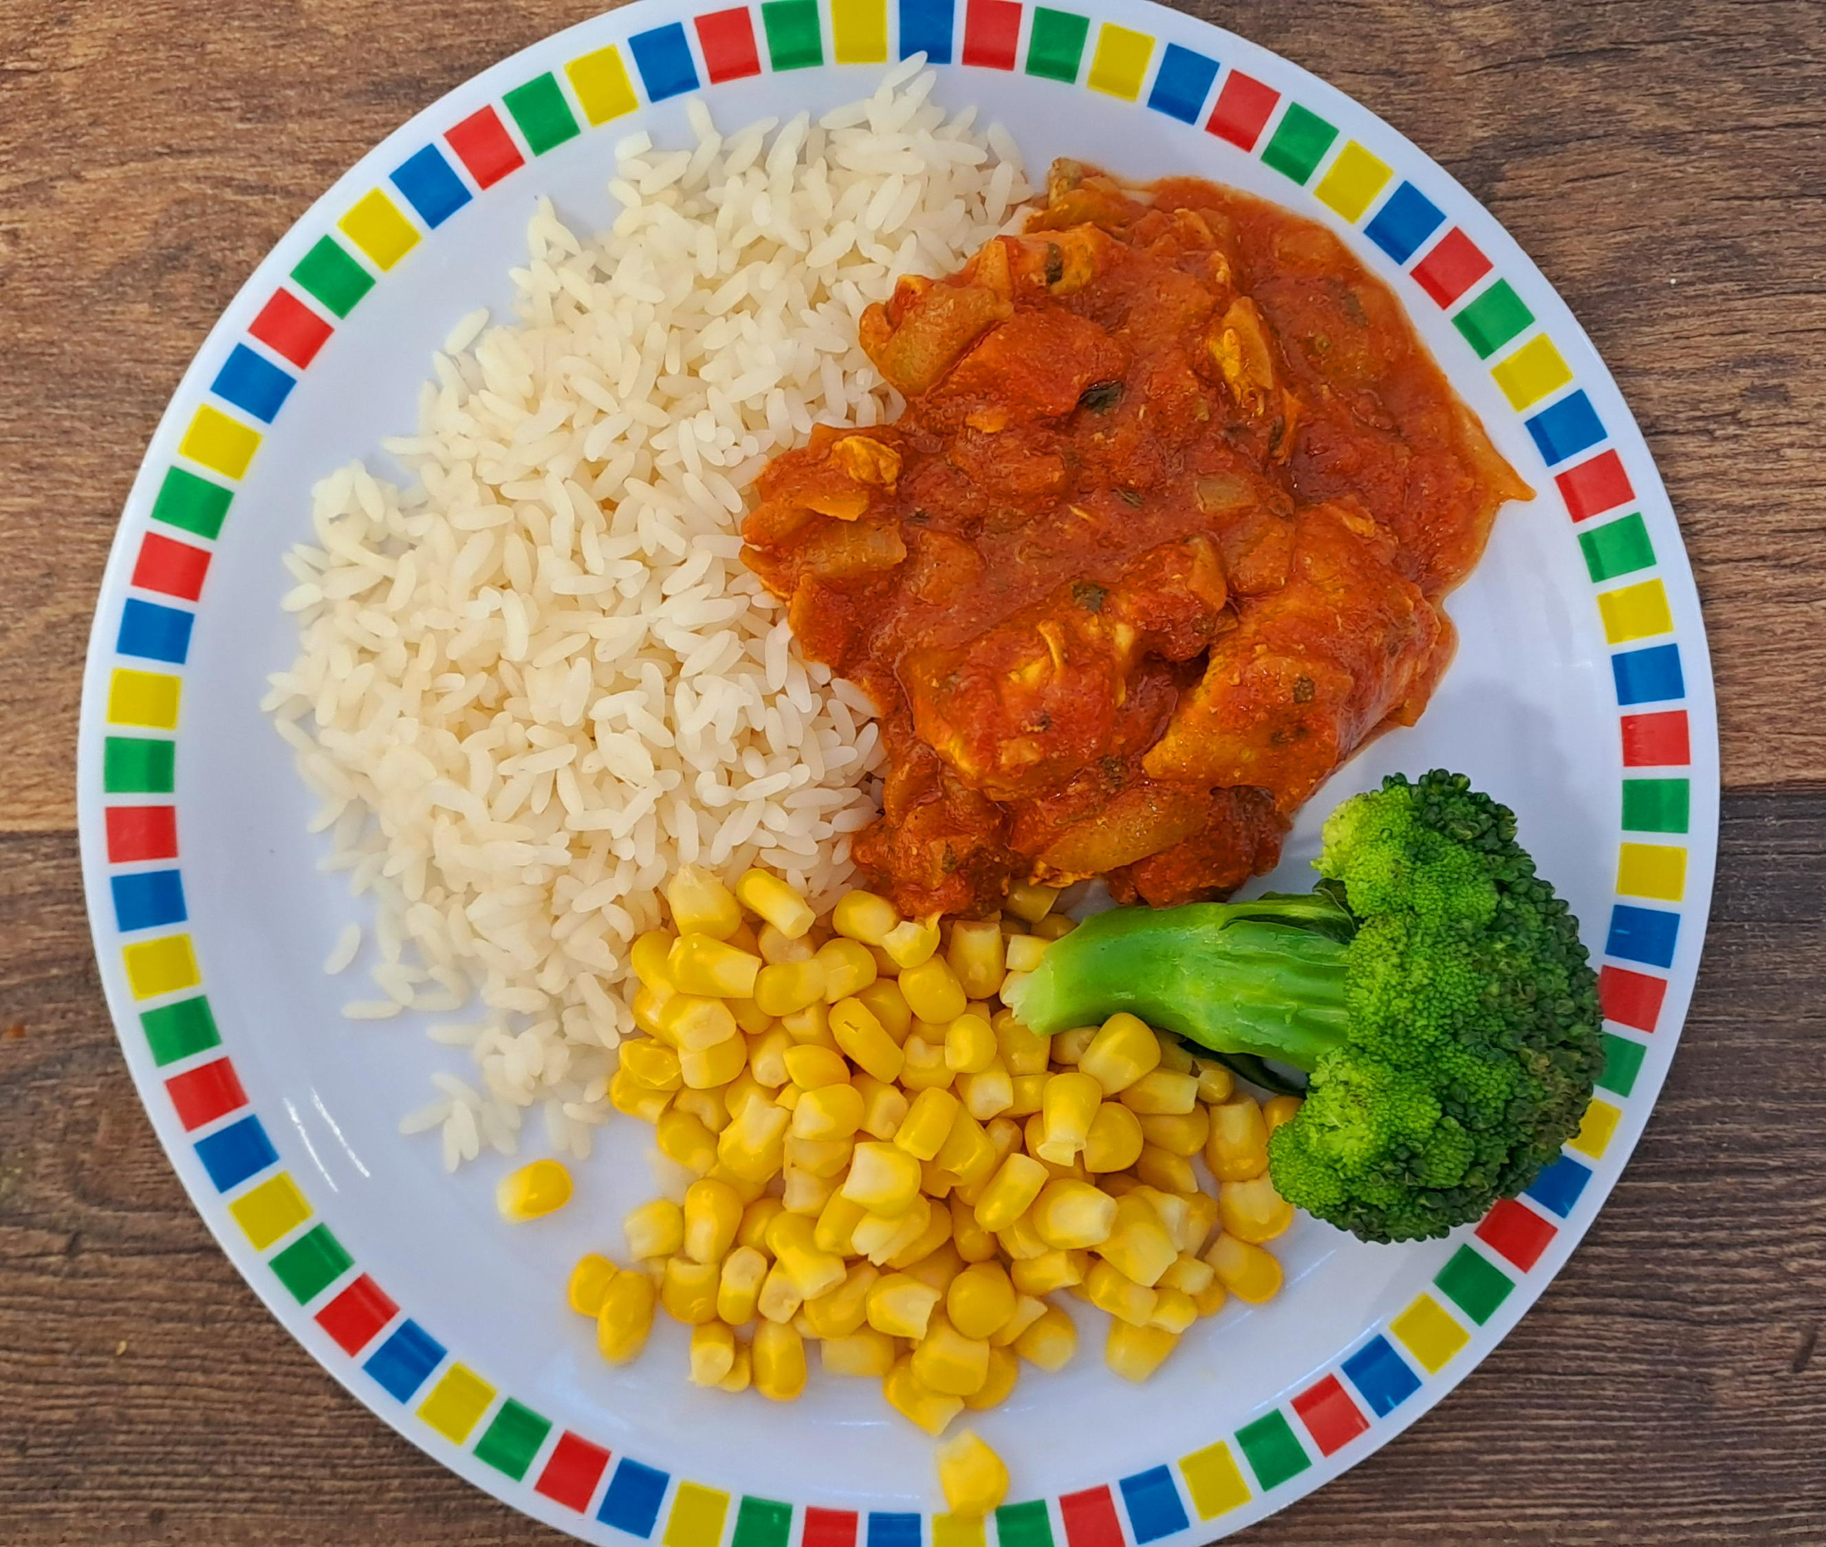
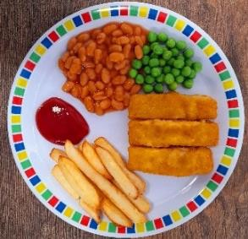
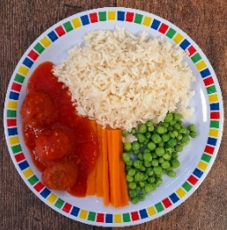
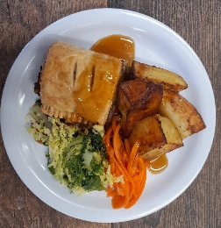
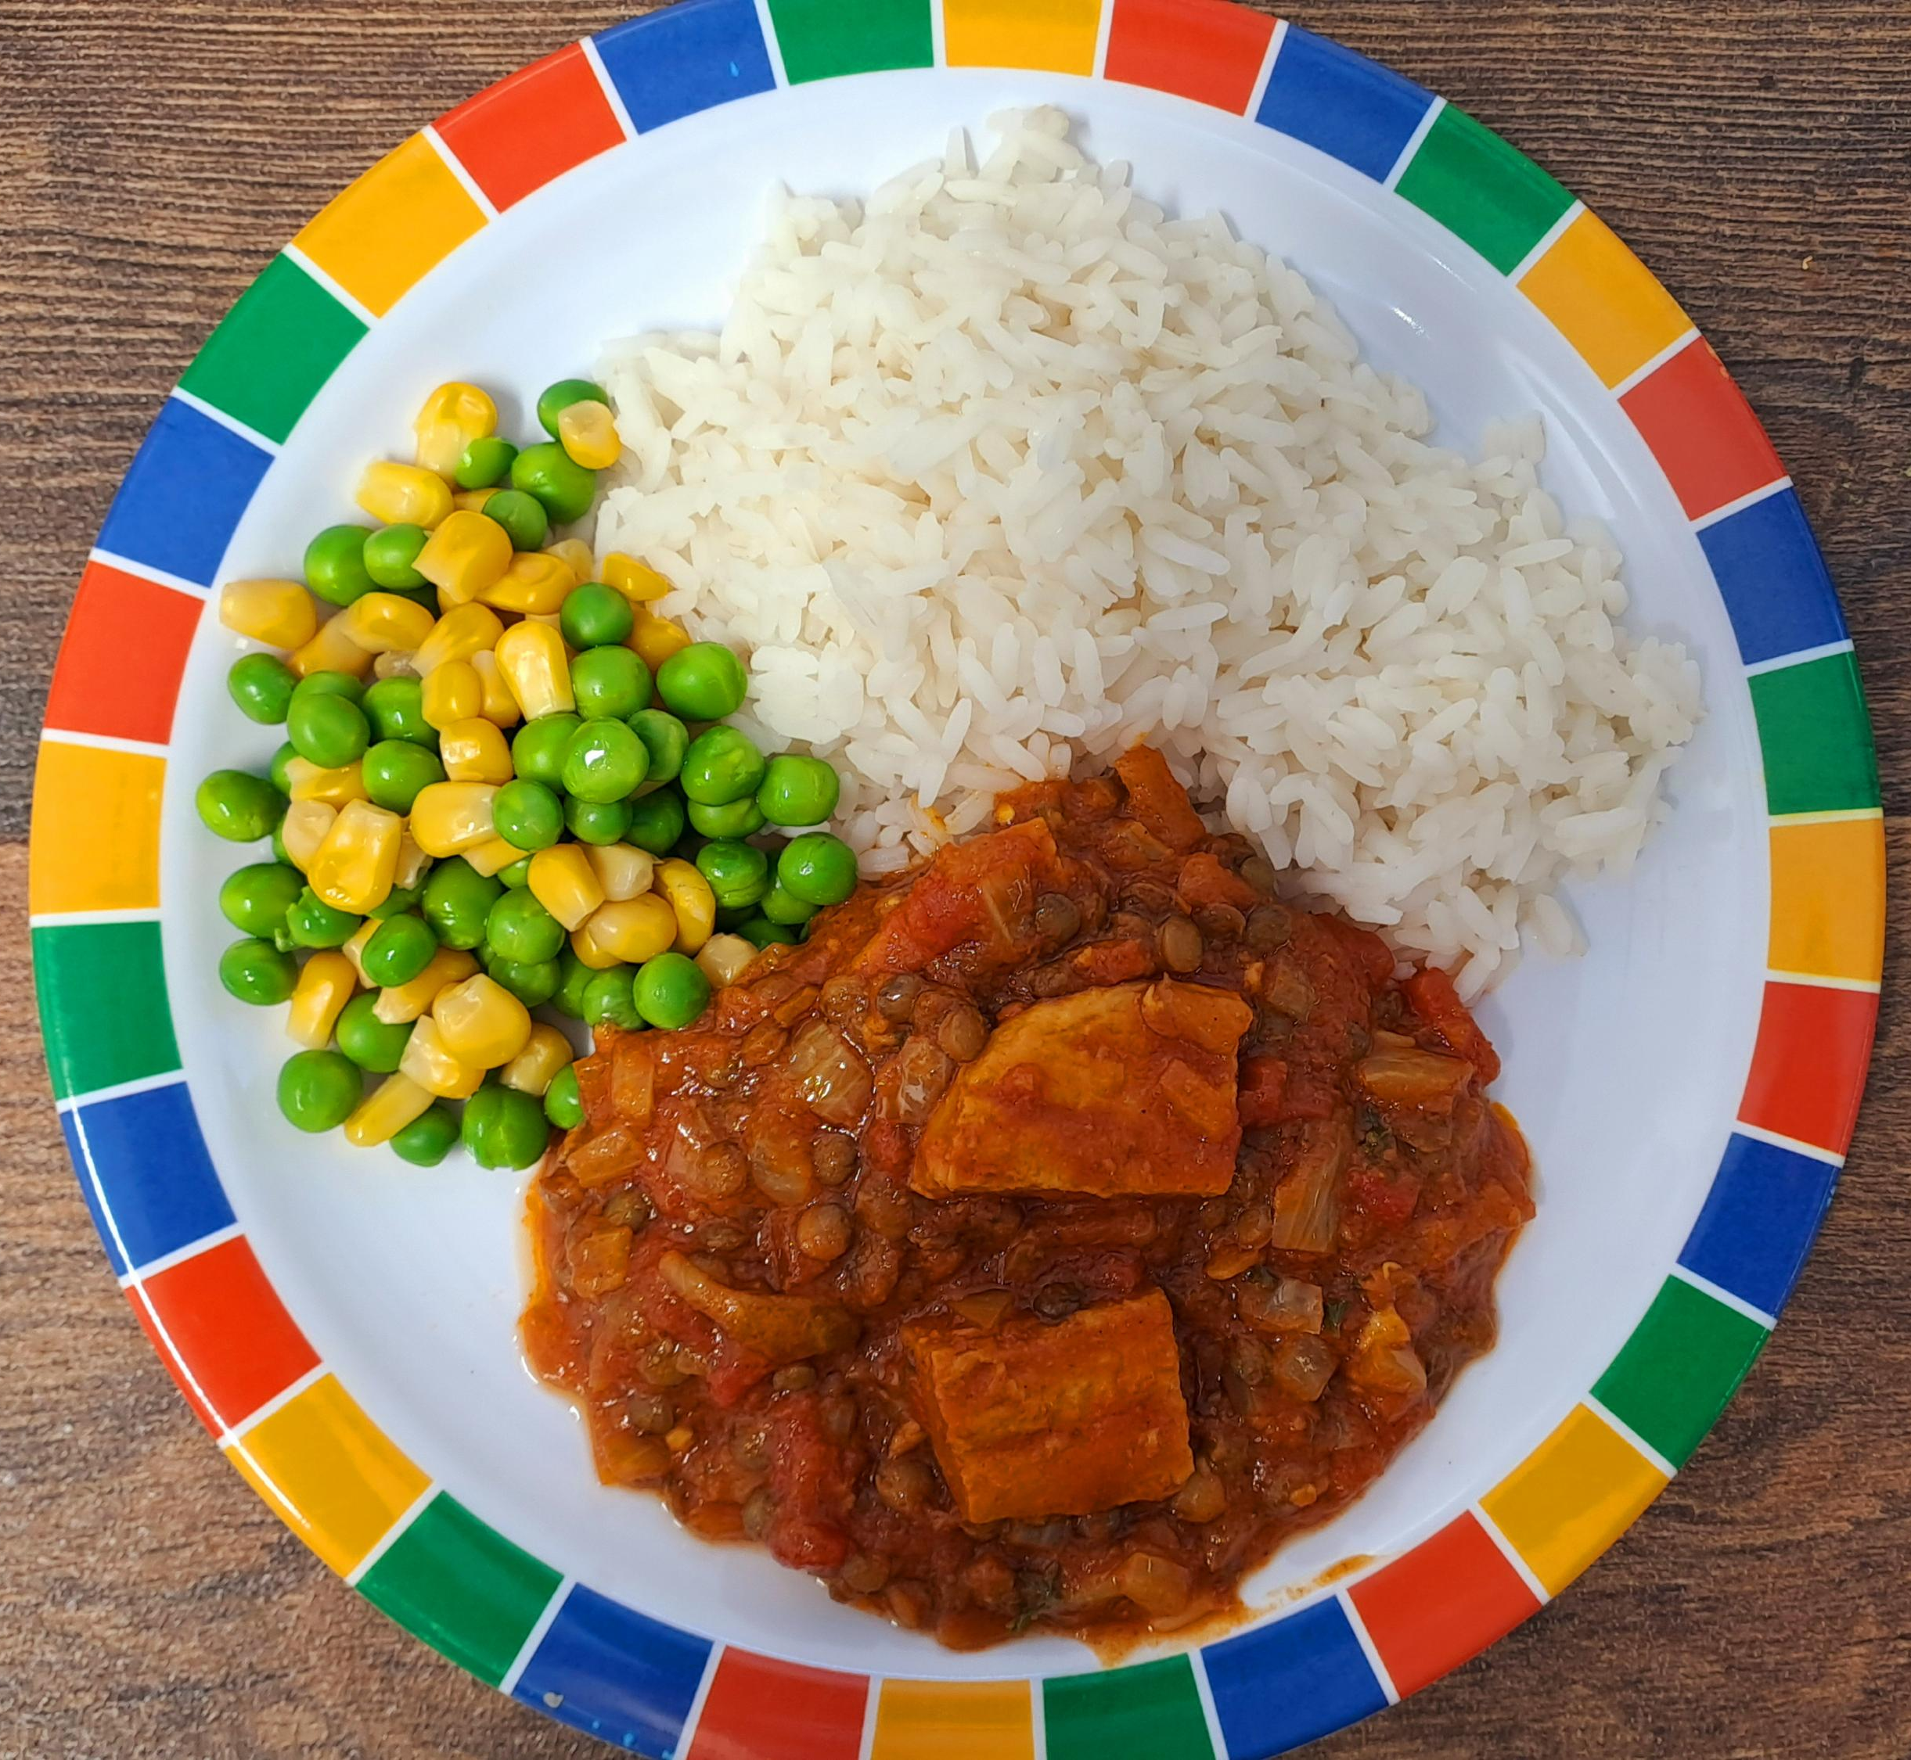
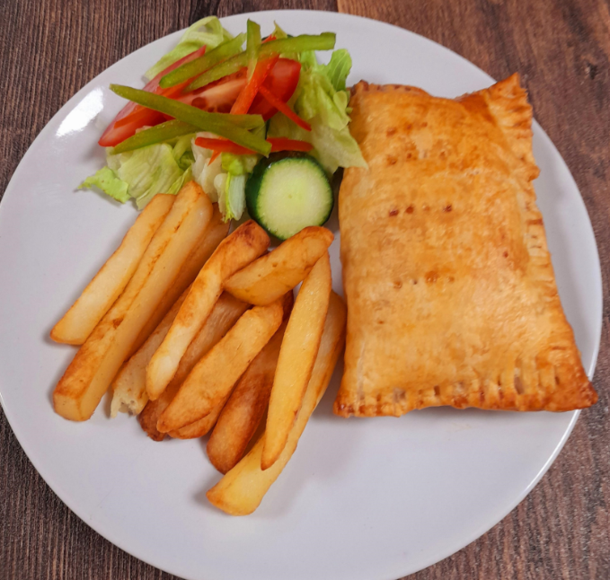
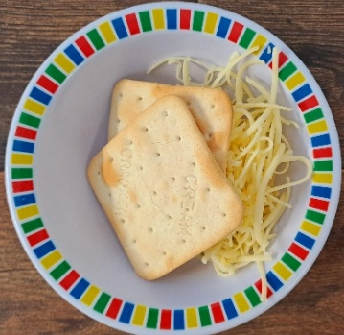
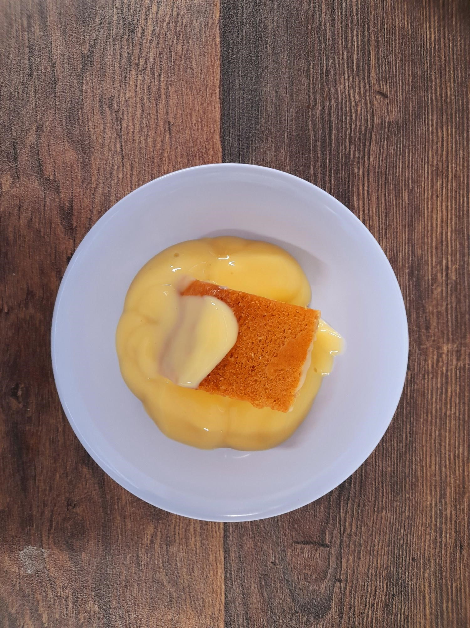
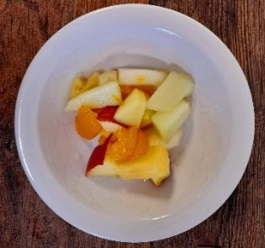
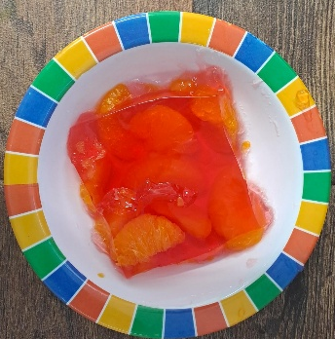
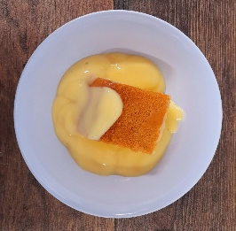
WEEK ONE
 | MONDAY | TUESDAY | WEDNESDAY | THURSDAY | FRIDAY
OPTION 1 | Beetroot and Lentil Burger in a Bun with Potato Wedges | Beef Lasagne with Garlic Bread | Roast Chicken, Stuffing, Roast Potatoes & Gravy | Chicken Tikka Masala with Rice | Fish Fingers or Salmon Fish Fingers with Chips & Ketchup
OPTION 2 | Soya Mince Lasagne | Plant Balls in Tomato Sauce with Rice | Vegetable Wellington, Roast Potatoes & Gravy | Quorn and Lentil Tikka Masala with Rice | Cheese & Bean Pasty with Chips & Tomato Ketchup
DESSERT | Cheese and Crackers | Apple Cake with Custard | Fruit Medley | Jelly with Mandarins | Syrup Sponge with Custard
*VEGETABLES AND SIDES MAY DIFFER THAN THOSE SHOWN

Slide 2

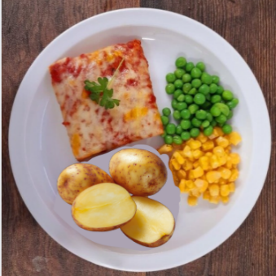
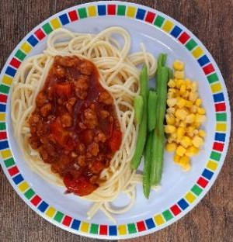
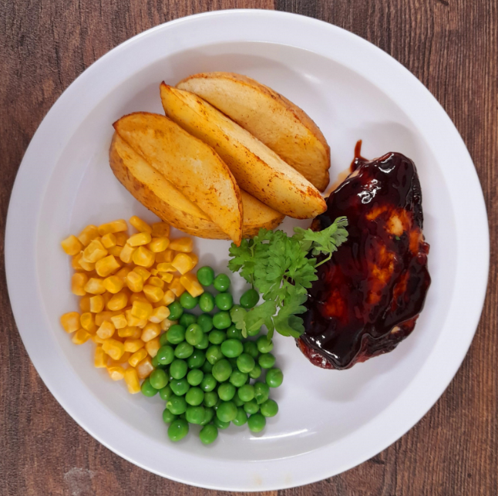
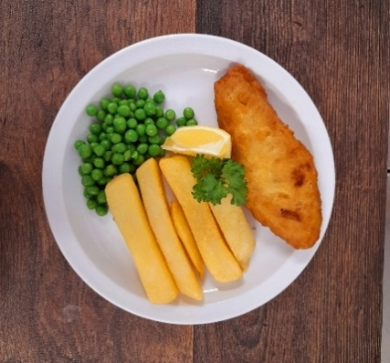
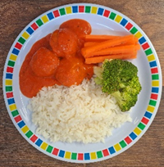
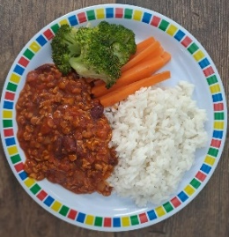
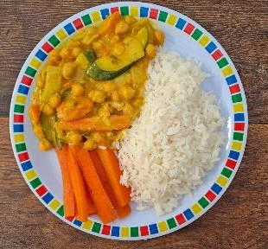
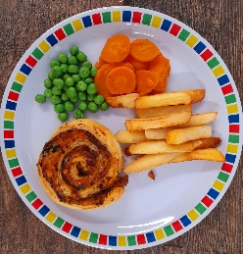
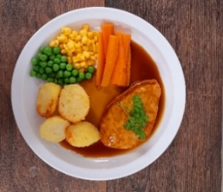
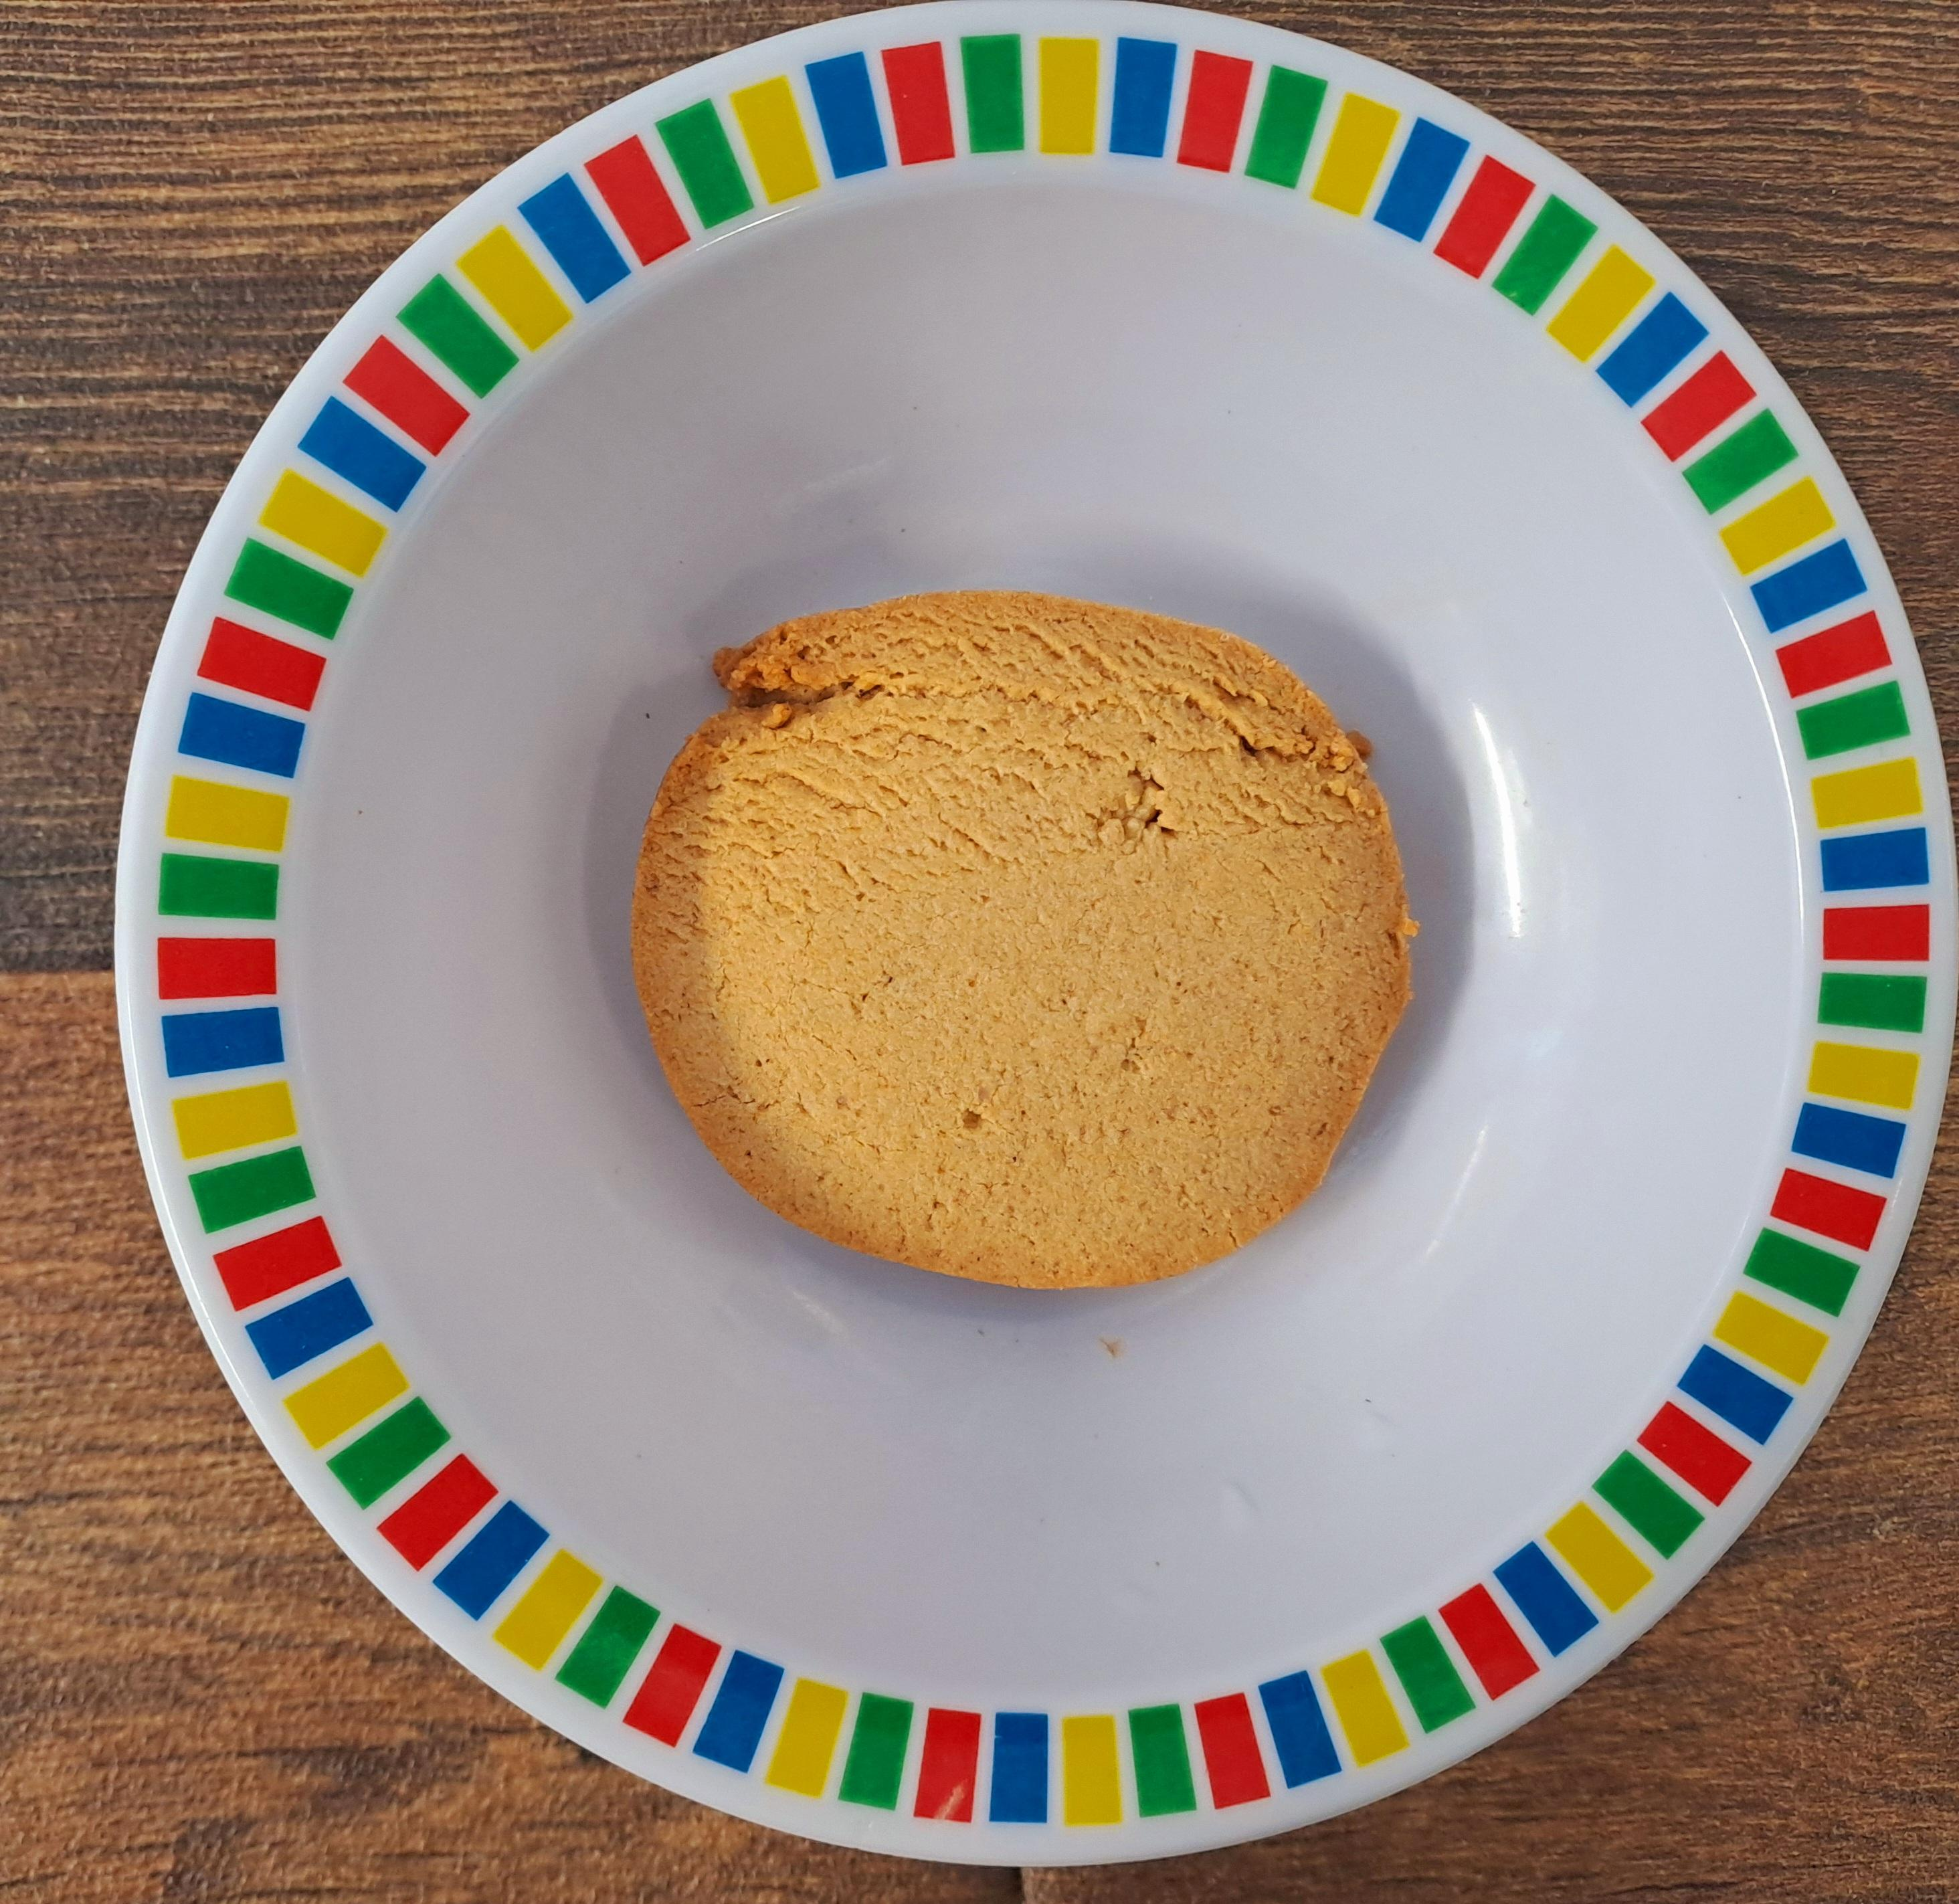
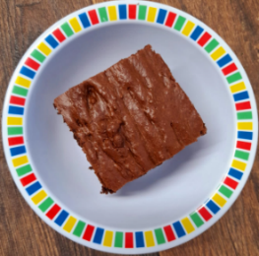
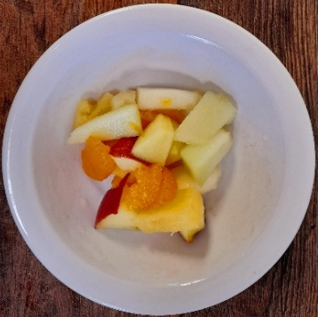
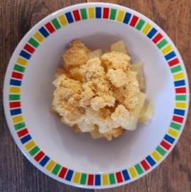
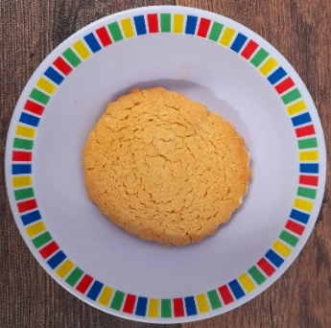
WEEK TWO
 | MONDAY | TUESDAY | WEDNESDAY | THURSDAY | FRIDAY
OPTION 1 | Cheese and Tomato Pizza with Wedges | Spaghetti Bolognaise | BBQ Chicken, Seasoned Potatoes and Sweetcorn Salsa | Chicken and Sweetcorn Meatballs in Tomato Sauce with Rice | Battered Fish with Chips & Tomato Ketchup
OPTION 2 | Five Bean Chilli and Rice | Vegan Spaghetti Bolognaise | Lemon and Herb Quorn, Seasoned Potatoes and Sweetcorn Salsa | Creamy Chickpea and Coconut Curry with Rice | Cheese Whirl with Chips & Tomato Ketchup
DESSERT | Gingerbread Cookie | Chocolate and Beetroot Brownie with Chocolate Sauce | Fruit Salad | Sticky Toffee Apple Crumble with Custard | Vanilla Shortbread
*VEGETABLES AND SIDES MAY DIFFER THAN THOSE SHOWN

Slide 3

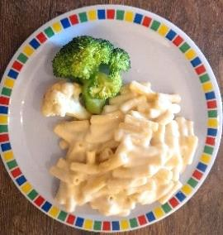
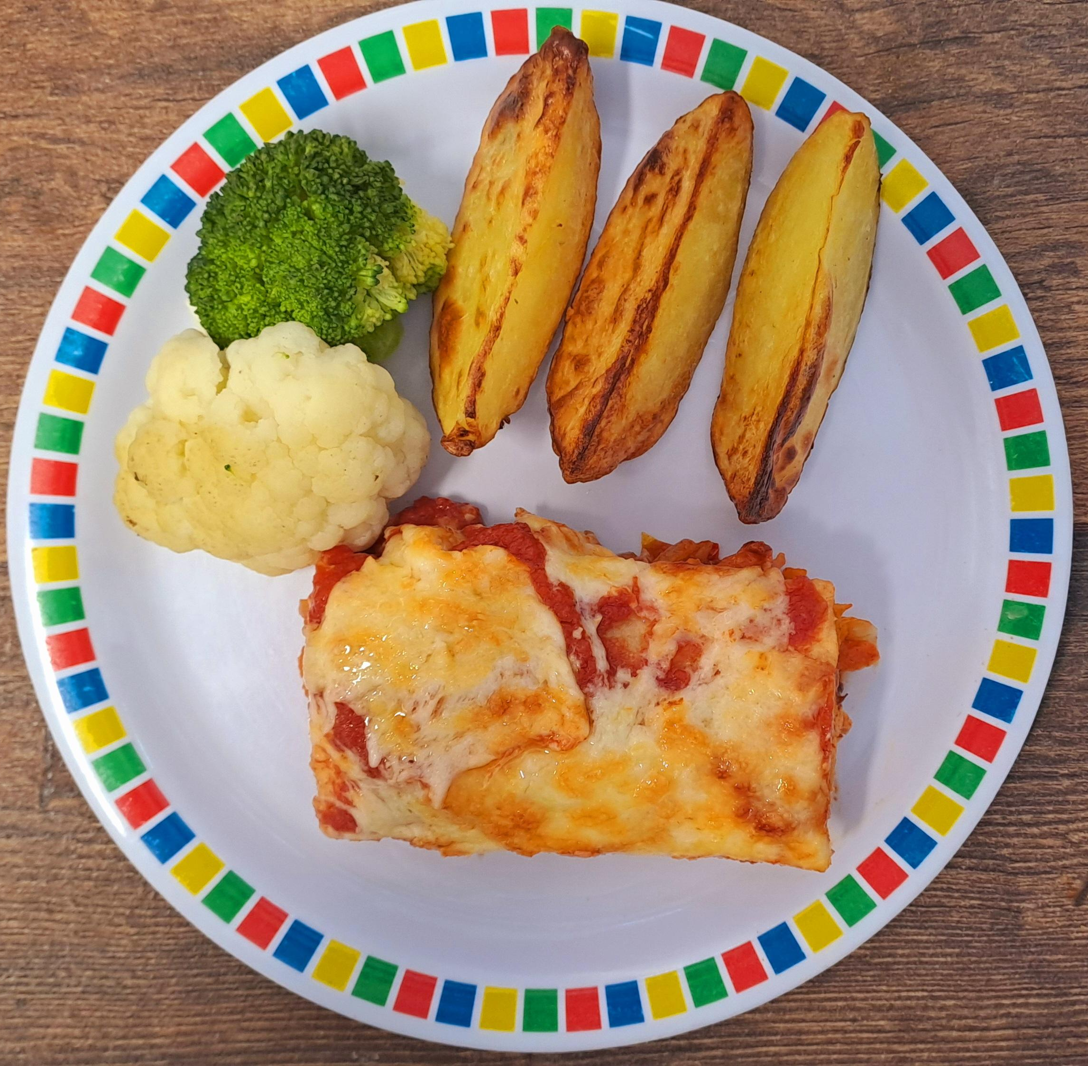
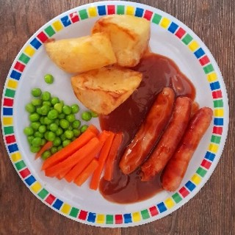
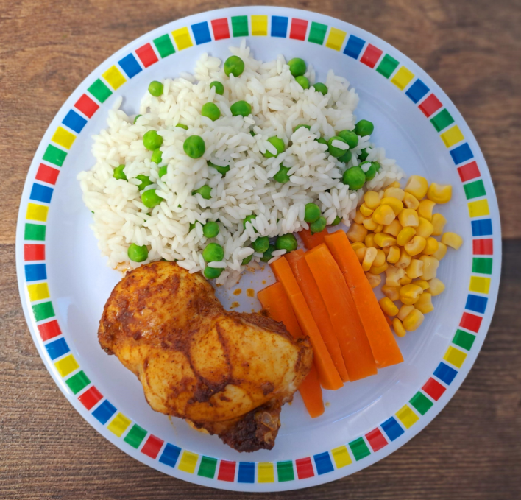

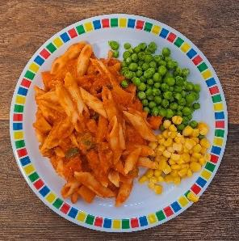
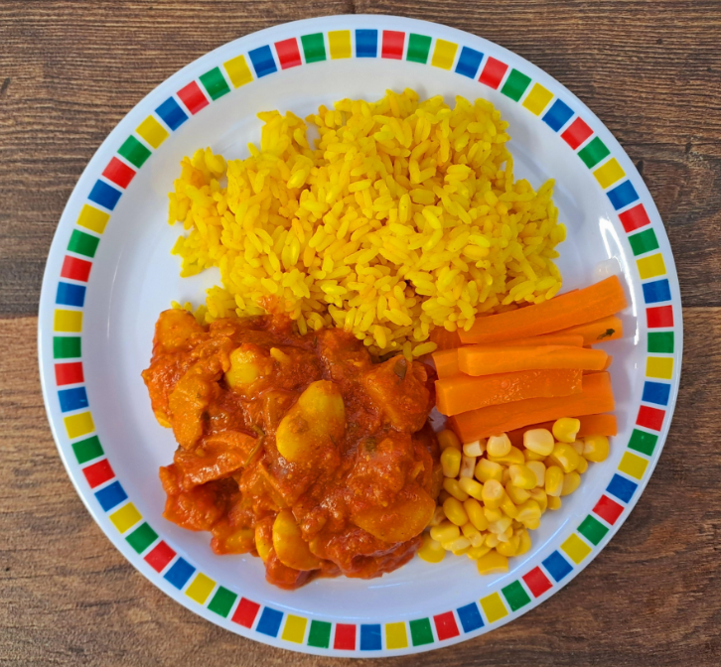
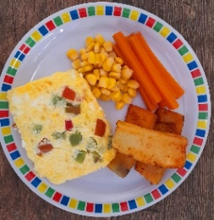
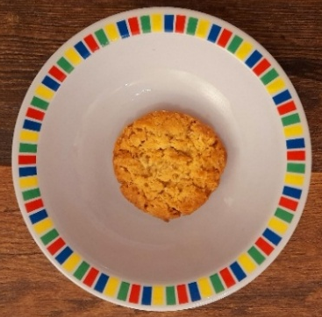
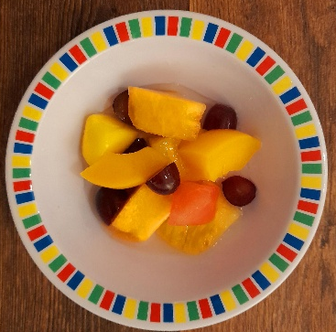
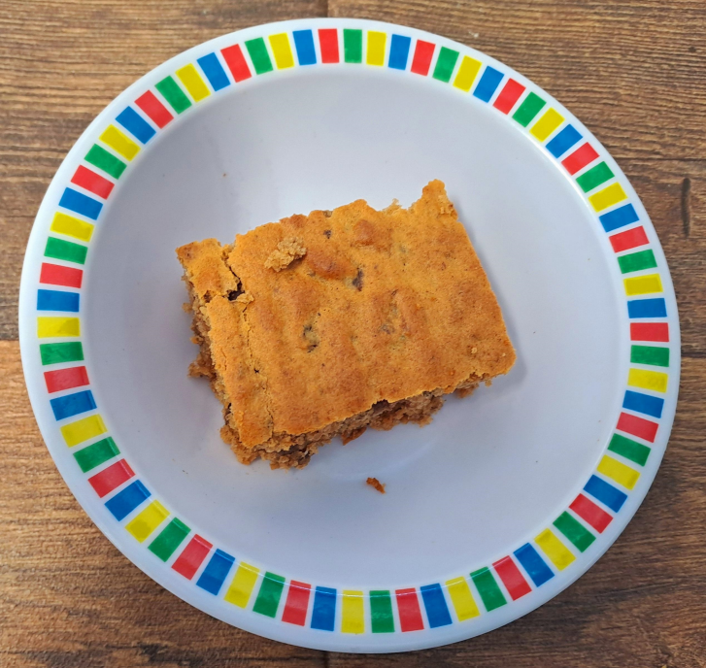
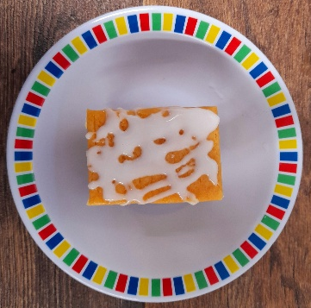
WEEK THREE
 | MONDAY | TUESDAY | WEDNESDAY | THURSDAY | FRIDAY
OPTION 1 | Macaroni Cheese | Chicken Enchilada Bake with Paprika Wedges | Pork or Chicken Sausage, Roast Potatoes & Gravy | Mild Caribbean Chicken with Golden Rice | Fish Fingers with Chips & Tomato Ketchup
OPTION 2 | Mexican Bean Roll with New Potatoes | Tomato Pasta | Vegan Sausages, Roasted Potatoes & Gravy | Caribbean Stew with Golden Rice | Red Pepper Frittata with Chips & Tomato Ketchup
DESSERT | Oaty Cookie | Pear Crumble with Custard | Fruit Salad | Jamaican Ginger Cake with Custard | Iced Sponge
*VEGETABLES AND SIDES MAY DIFFER THAN THOSE SHOWN

