Slide 1
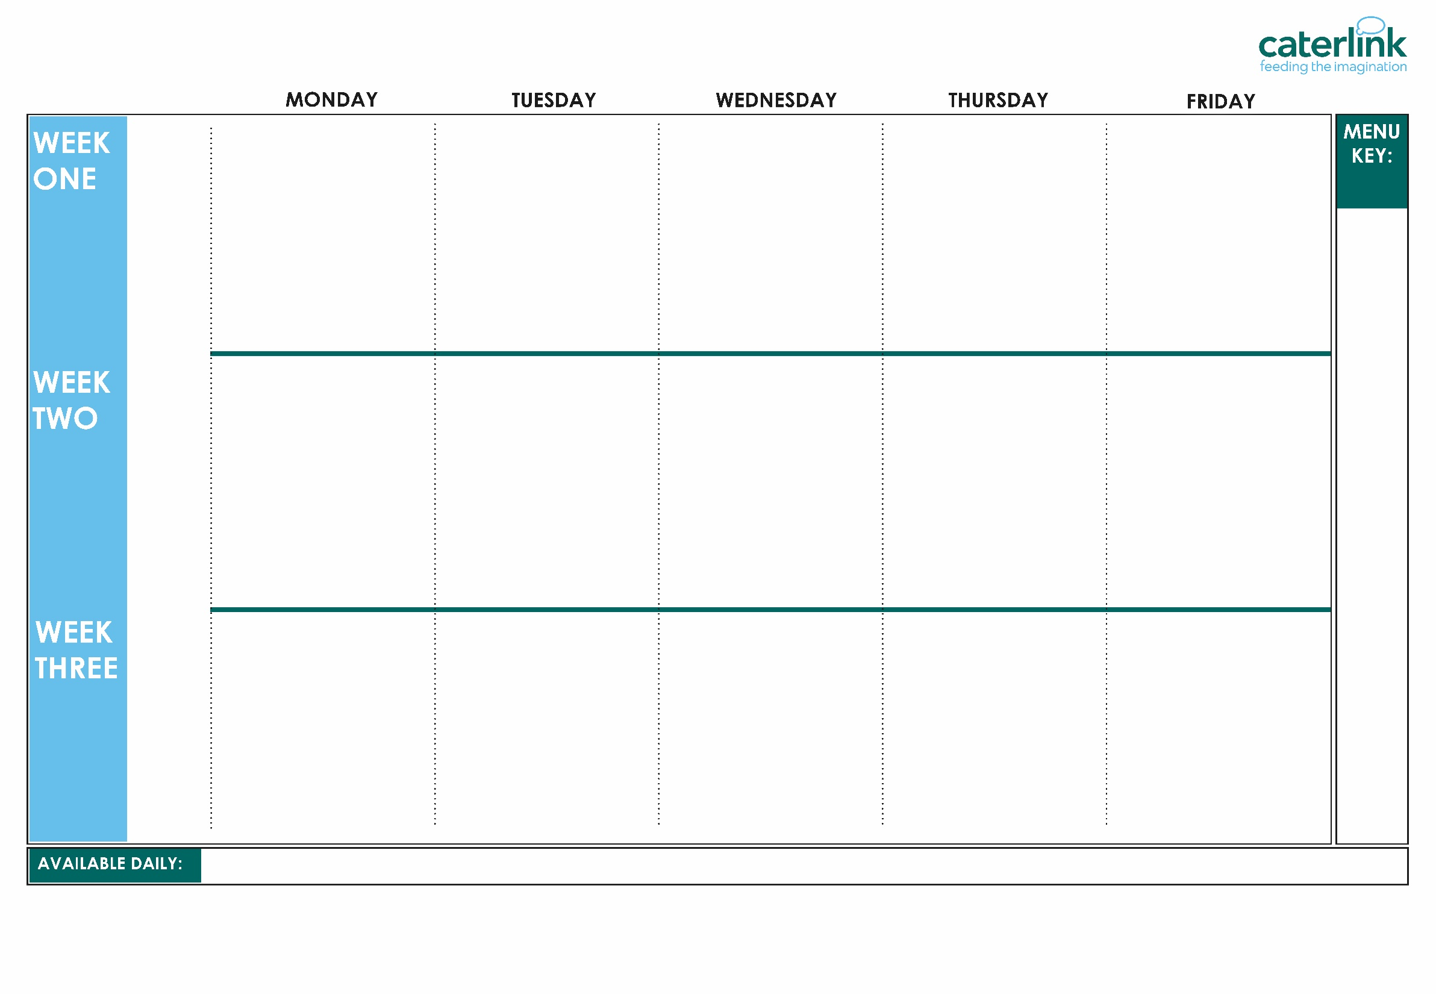


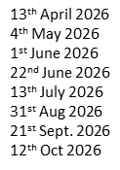



SUMMER/ AUTUMN MENU 2026
Macaroni Cheese | Phat Pasty Pork Sausage Roll with Potato Wedges | Roast Chicken, Stuffing, Roast Potatoes & Gravy | Spaghetti with Beef Bolognaise | Fishfingers with Chips & Tomato Sauce
Chickpea Curry with Rice | Mild Mexican Chilli with Rice | Roasted Quorn, Roast Potatoes, & Gravy | Smokey Bean Burger with Wedges & Tomato Sauce | Cheese & Bean Pasty with Chips & Tomato Sauce
Vegetables of the Day | Vegetables of the Day | Vegetables of the Day | Vegetables of the Day | Vegetables of the Day
NEW Banana Mousse | Orange Drizzle Cake | Fruit Platter | Apple Flapjack | Strawberry Jelly with Mandarins
Option
One
Option
Two
Sides
Dessert
Whole
grain
Cheese & Tomato Pizza with Summer Mixed Salad | Beef Chilli with Rice & Sweetcorn & Cucumber Salsa | Roasted Pork Sausage, Roast Potatoes & Gravy | Greek Chicken Pitta with Herby Rice, Tzatziki & Salad | Battered Fish with Chips & Tomato Sauce
Lentil & Sweet Potato Curry with Rice | Spaghetti & Meatballs in a Tomato Sauce | Veg Wellington, Roast Potatoes & Gravy | Greek Spinach & Cheese Whirl with Herby Rice, Tzatziki & Salad | NEW Cheesy Broccoli Frittata with Chips
Vegetables of the Day | Vegetables of the Day | Vegetables of the Day | Vegetables of the Day | Vegetables of the Day
Iced Vanilla Sponge | Peaches & Ice Cream | Freshly Chopped Fruit Salad | Jam & Coconut Sponge with Custard | Oaty Cookie
Option
One
Option
Two
Sides
Dessert
20th April 2026
11th May 2026
8th June 2026
29th June 2026
20th July 2026
7th Sept 2026
28th Sept 2026
19th Oct 2026
Plant
based
Added plant protein
Option
One
Option
Two
Sides
Dessert
Tomato Pasta | Beef Burger with Potato Wedges & Rainbow Slaw | Roast Turkey, Mashed Potatoes & Gravy | Chef Shilpa’s Chicken Korma with Rice | Fishfingers with Chips & Tomato Sauce
NEW Chinese Vegetable Noodles | Mexican Bean Roll with New Potatoes & Rainbow Slaw | Vegetable Loaf with Stuffing, Mashed Potatoes & Gravy | All Day Vegetarian Breakfast | Cowboy Sausage and Bean Hotpot
Vegetables of the Day | Vegetables of the Day | Vegetables of the Day | Vegetables of the Day | Vegetables of the Day
Pineapple Upside Down Cake | Cheese & Crackers | Fruit Medley | Strawberry and Apple Crumble with Custard | Vanilla Shortbread
27th April 2026
18th May 2026
15th June 2026
6th July 2026
14th Sept 2026
5th Oct 2026
Chef’s Special
Jacket Potatoes with a choice of fillings, baguettes with a choice of fillings, Salad Bar, Freshly Baked Bread, Fresh Fruit, Yoghurt,
If you would like to know about particular allergens in foods, please ask a member of the catering team for information. If your child has a school lunch and has a food allergy or intolerance you will be asked to complete a form to ensure we have the necessary information to cater for your child. We use a large variety of ingredients in the preparation of our meals and due to the nature of our kitchens it is not possible to completely remove the risk of allergen cross contact.

