Slide 1
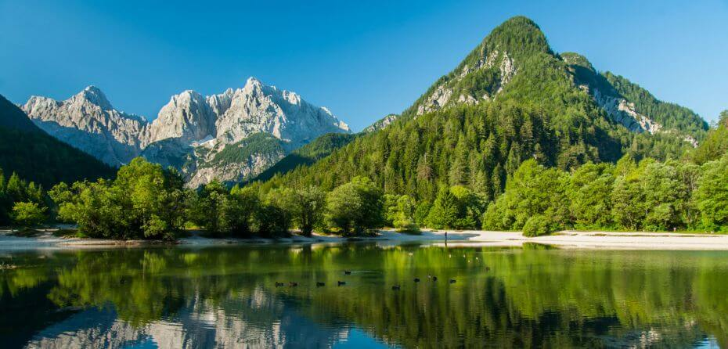
Maths
This term, with Miss Epton, we will be covering decimals, percentages and statistics. Miss Riley will be covering angles, 3D shapes, position and directions.
Please continue to support your child to practise all of their times tables as a secure knowledge underpins the majority of what we do in Year 6. The ability to recall these facts more confidently would be hugely beneficial for your child in their Maths lessons and eventually their SATs.
English
In English, we will be reading Spiderwick.
Our written work will focus on letter writing, character descriptions, newspaper reports linking these to our book Spiderwick and our Georgraphy topic.
We will continue to develop our knowledge of Year 5/6 grammar and punctuation.
During all lessons, we will continue to interrogate a variety of texts, attempt to broaden our range of vocabulary and further develop our writing styles.
Curriculum – Geography/ History
This half term our focus in history and geography are: Changes in our local environment and The Maya
In geography, the children will understand how the UK is changing and what positive and negative impacts this may have. The children will also be able to locate some key topographical features of the UK.
Key vocabulary- continent, country, physical/human features, sustainability, regeneration.
In history, the children will be learning about The Maya. We will be learning about how the Maya traded, the various periods and their inventions. Key vocabulary- Maya, batab, cacao, cenote
Year 5 Newsletter
Theseus Summer
Science
This half term Year 5 will be studying living things and their habitat as well as animals including humans. Within this topic, they will learn about living things and their habitat as well as the human body and how the circulatory system works. Key vocabulary- classification key, respire, reproduce, surroundings, heart, blood vasculature, arteries
DT
In DT, the children will be learning about programming a ‘Monitoring device’. The children will learn how to program to monitor the ambient temperature and how to code an alert should the desired temperature change. The children will understand and explain how this could be useful for an animal carer.
Reading
Please continue to share the love of books with your child. Encourage them to read/share books 3 times per week. This can be recorded on one page per week of the Reading Record. Reads will be counted every Friday. Reading should be a delightful experience and I truly believe there is a book out there for everyone. Please support us in encouraging your child to read as it opens up so many doors.
Creative Opportunities
Pupils will be given the opportunity to make a waistcoat out of fabric during our design and technology unit whilst in our art unit – sculpture – pupils will be studying the life and works of famous sculptors and will attempt to re-create one of their pieces using clay.
Our PE Days
Our PE days are still Thursday and Friday. This term will focus on athletics and tennis. Please ensure that children have a full outdoor and indoor PE kit in school all week. Long hair should be tied back and earrings removed as outlined in the school’s uniform policy.

