Slide 1
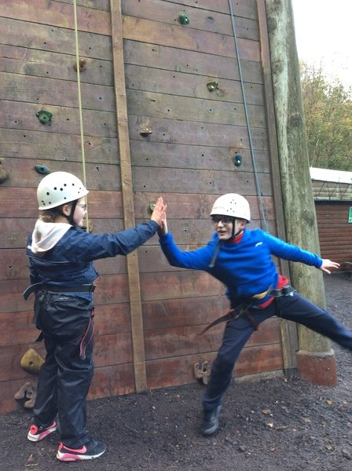
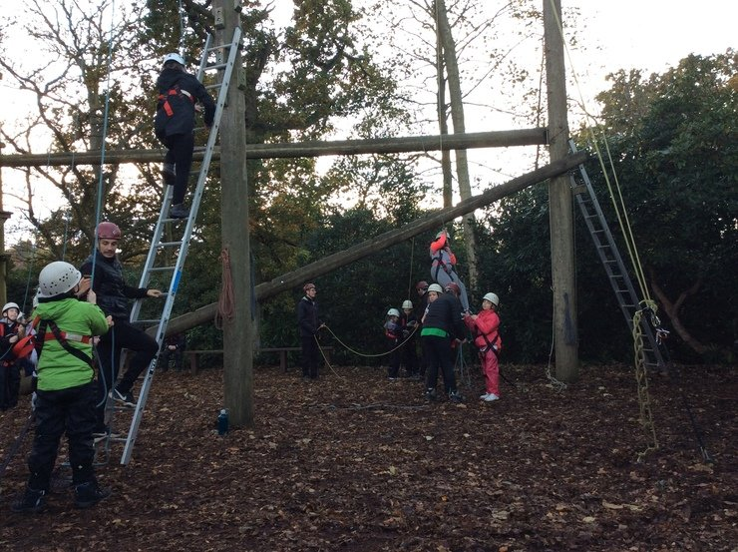
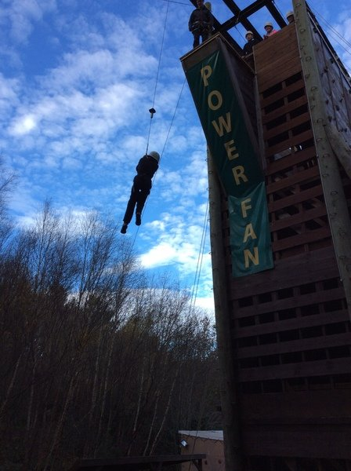
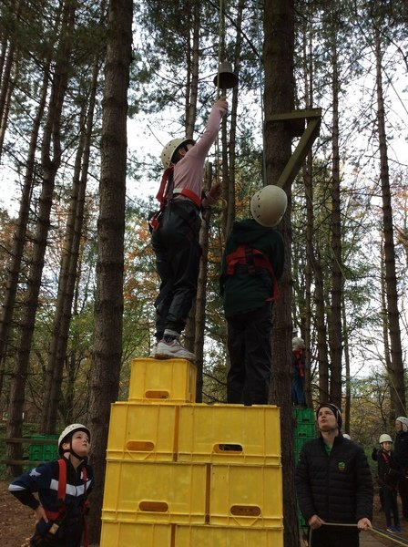

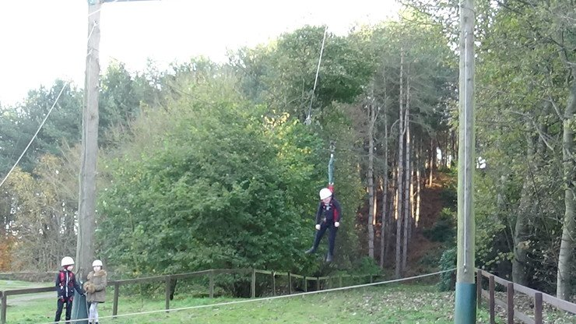
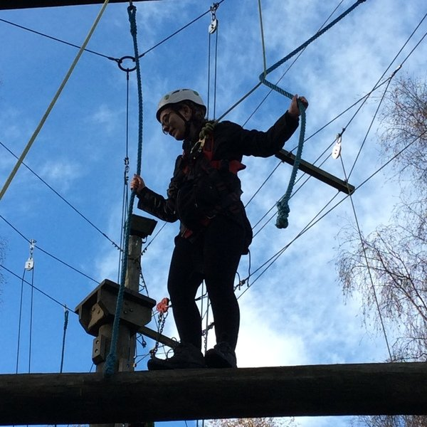
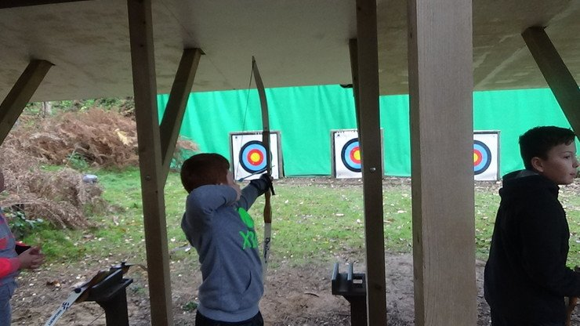
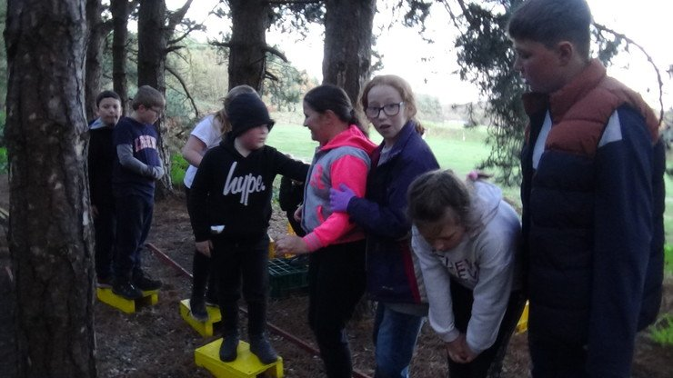

Slide 2

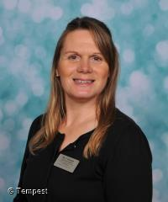
Hilltop 2023
Meet the Adults going with you!
Miss Jordan
Mrs Pharro
Mrs Dickson

Slide 3
The Day We Leave…….
AC children, take suitcases and belongings to the classroom at normal time.
TAS children, take suitcases and belongings to the hall at normal time.
Please come to school dressed in clothes for the afternoon’s activities (NOT school uniform)
You will need to bring a packed lunch
We leave AC at around 9.30am and therefore TAS later. Parents are welcome to stay and wave goodbye but it may be a bit of a wait!

Slide 4
When We Arrive…..
We aim to arrive at Hilltop for 11.30am
We will be met by our Group Leader who will show us to our rooms
The rooms will be chosen by Miss Jordan and Mrs Pharro who will ensure that, where possible, friendship groups are kept together
The children do not find out which room they are in until we arrive at Hilltop
This year we are staying at Seaview Lodge
Once we have had an introductory talk and lunch, activities will begin at 1pm!

Slide 5
Food
The food is chosen in advance. We have considered carefully the sort of foods the children are likely to eat. Unless a child has a dietary requirement, all children receive the same food.
You are welcome to pack a few extra snacks if think your child may need this after lots of physical activities.
We sit and have dinner altogether. We say grace before we eat.
The children have various responsibilities throughout the meal sitting such as clearing away the plates and cleaning the tables.

Slide 6
Rooms and Bedtimes
Miss Jordan and Mrs Pharro will set the bedtime. Hilltop rules are in bed by 10pm and children to stay in rooms until 7am to ensure all who are staying get a good night’s sleep. So no noise between 10pm and 7am!
Staff will be located in rooms nearby to the children and the children will be made aware where to find the staff if they are needed in the night. As you can imagine, we don’t sleep much just in case we get a knock at the door!
Usually bedtime is the time when children feel homesick, we are very aware of how difficult being away from home can be for some children so we will look after them.

Slide 7
Tuck Shop
There will be access to the tuck shop which the school staff will run, usually in the evenings after the evening activity.
Please do not send your child with any more than £10
In the tuck shop there are souvenirs, sweets, chocolate, fizzy drinks etc.

Slide 8
Responsibility
The children are responsible for getting themselves dressed, showered, teeth brushed etc, so please don’t be surprised if your child comes home having not had a shower for 3 days!
There are also many other responsibilities they will have throughout their stay such as cleaning up after meal times, belaying and keeping their rooms tidy.
Miss Jordan and Mrs Pharro will be carrying out room inspections and the room with the best score at the end of the week will win a prize!

Slide 9
Medication
If your child has any medication, Miss Jordan will be the designated adult to administer the medication.
Please ensure you have given any instructions clearly.
Please do not pack any medication in your child’s bag, not even paracetamol! Anything like this needs to be given to Miss Jordan to keep safe.

Slide 10
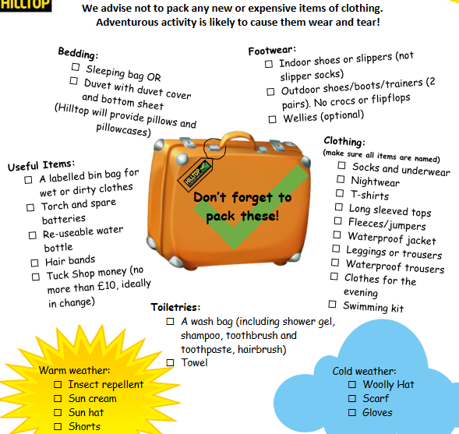
What will I need?
We will NOT be swimming, so no need to pack your swimsuits/trunks!

Slide 11
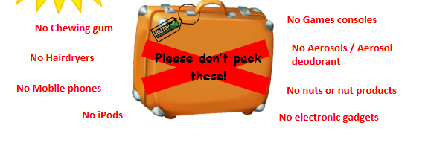

Slide 12
What happens if I am really scared and I really don’t want to do something?
Hilltop’s Motto is “Challenge by Choice”
No one is going to make you do something you really do not want to do

