Slide 1
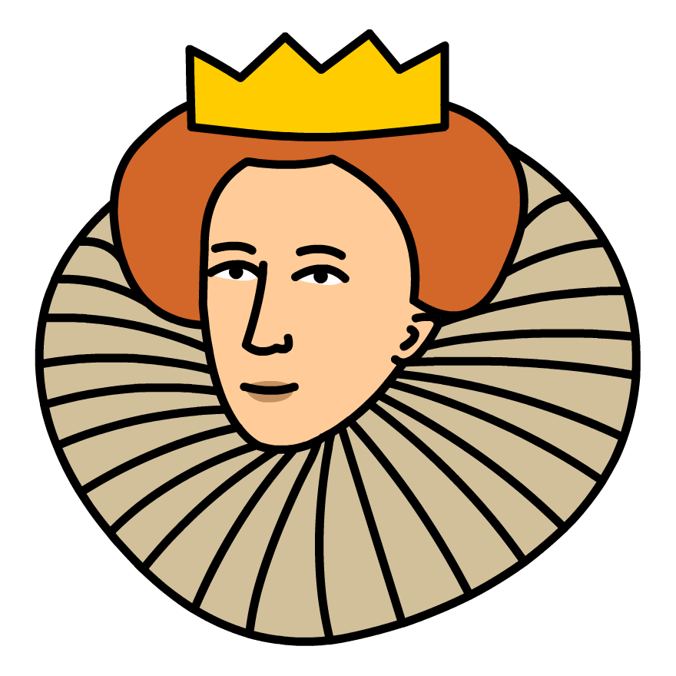
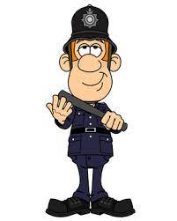
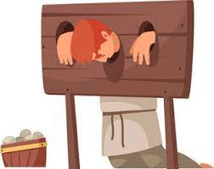
GCSE History (Edexcel)
Weimar and Nazi Germany, 1919-39 Term 3
Nazi control and dictatorship, 1933–39 inc the creation of a
Dictatorship 1933–34, the police state, controlling and influencing attitudes, opposition, resistance and conformity
Revision
Weimar and Nazi Germany, 1918-39 Term 2
The Weimar Republic 1918-29 inc the origins of the Republic 1918–19, the early challenges to the republic 1919-23, the recovery of the republic 24-29, changes in society 24-29
Hitler’s rise to power 1919-1933 inc early development of the Nazi Party 1920–22, The Munich Putsch and the lean years 1923–29, the growth in support for the Nazis 1929–32, how Hitler became Chancellor 1932–33
Superpower relations and the Cold War, 1941–91 Term 1
The origins of the Cold War, 1941–58 inc Early tension between East and West, the development of the Cold war and how the Cold War intensifies,
Cold War crises, 1958–70 inc increased tension between East and West, Cold War crises and reactions to Cold War crises
The end of the Cold War, 1970–91 inc attempts to reduce tension between East and West, Flashpoints, the collapse of Soviet control in Eastern Europe
Early Elizabethan England Term 3
Queen, government and religion 1558-69 inc
The situation on Elizabeth’s accession, the settlement of religion, challenges to the religious settlement, the problem of Mary Queen of Scots
Challenges to Elizabeth at home and abroad, 1569–88 inc
Plots and revolts at home, relations with Spain, outbreak of war with Spain and the Armada
Elizabethan society in the Age of Exploration, 1558–88 inc
Education, leisure, the problem of the poor, exploration, Raleigh and Virginia
Crime and Punishment Term 2
Crime and Punishment in 18th and 19th century Britain
Crime and Punishment in modern Britain
Inc nature and changing definitions of criminal activity, nature of law enforcement and punishment and case studies
Whitechapel c1870-1900 historic environment
Inc crime, policing and the inner city,
Knowledge, selection and use of sources for historical enquiries
Crime and Punishment Term 1
Crime and Punishment in Medieval England 1000-1500
Crime and Punishment in Early Modern England 1500-1700
Inc nature and changing definitions of criminal activity, nature of law enforcement and punishment and case studies
YEAR 10&11

