Slide 1
Ace Your Exams
Follow-up Tutor Pack
Elevate UK
Tottington High School

Slide 2
How to Use
Resource Outline
This follow up series is built around the Elevate Ace Your Exams workshop and is designed to reinforce the revision and exam room skills covered in the session.
How to Use
These resources are designed to fit around your form time schedule. As such, you have a 5-, 10- or 20-minute option with each skill:
5 minutes highlights the application of a skill through a follow-up video;
10 minutes allows for a class discussion around the contents of the video and the skill itself;
20 minutes gives students the opportunity to put into practice what they’ve watched and discussed through an activity.
These slides are editable, so please change activity and discussion content where applicable to your students needs!
Further resources
We want students to re-visit these resources as much as possible. As such, you can find a link to all the templates and videos on the next slide. Please share these with your students after they have first gone through the pack with you in class.
We can then track the engagement of your students with the resources for additional oversight. To access this data, please speak with whoever is in charge of organising the Elevate Programme at your school.

Slide 3
Contents
1. How to Create an Exam Planner
Video: How to create a planner
Discussion: What is your process for planning for exams?
Activity: ​What advice would you give to this student to improve their exam planner?
2. How to Create A Deluxe Planner
Video: How to create a deluxe planner
Discussion: How confident do you feel walking into an exam that you know everything that could come up?
Activity: Help this student set deadlines​
How to Identify Mistakes
Video: How to identify mistakes
Discussion: Do you currently analyse where you lost marks in exams?
Activity: Fill out the first 3 columns of the Bullet Proof Booklet
4. Analysing and Correcting Mistakes
Video: Analysing and Correcting Mistakes
Discussion: Do you currently analyse where you lost marks in exams?
Activity: Fill out the first 3 columns of the Bullet Proof Booklet
5. Creating an Exam Routine
Video: How to create an exam routine
Discussion: What is your exam routine?
Activity: Create an exam check list
6. Creating an Exam Routine
Video: Exam room techniques
Discussion: Do you struggle to manage your time in exams?
Activity: How long should this student spend on these questions?

Slide 4
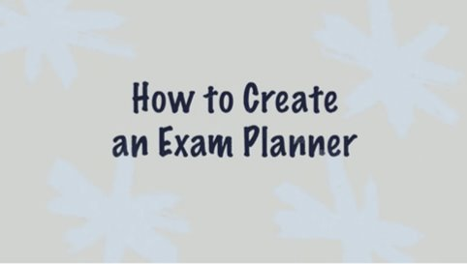
How to Create an Exam Planner
Video – 5 mins
Click the image below for your video:
Download your Exam Planner here!

Slide 5
How to Create an Exam Planner
Discussion – 5 mins
What is your process for planning for exams?
Are you an under-planner or an over-planner?

Slide 6
How to Create an Exam Planner
Activity – 5 mins
What advice would you give to this student to improve their exam planner?
Subject | Goal | Tasks | Deadline | Status
Biology (8461) | ? | Make notes | 08/04 | DONE
 |  | Do Exam | 17/05
Chemistry (8462) | 80/100 | Make notes on the model of the atom, symbols, relative atomic mass, electronic charge and isotopes | 20/05
 |  | Make notes on the periodic table | 20/05
 |  | Make notes on chemical bonds, ionic, covalent and metallic | 21/05
 |  | Memorise notes on the model of the atom, symbols, relative atomic mass, electronic charge and isotopes | 21/05
 |  | Memorise notes the periodic table | 21/05
 |  | Memorise notes on chemical bonds, ionic, covalent and metallic | 21/05
 |  | Do practice questions on notes on the model of the atom, symbols, relative atomic mass, electronic charge and isotopes | 22/05
 |  | Do practice questions on notes on the periodic table | 22/05
 |  | Do practice questions chemical bonds, ionic, covalent and metallic | 22/05
 |  | Do practice exam | 25/05
 |  | Final Exam | 27/05

Slide 7
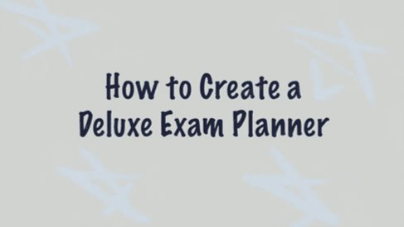
How to Create a Deluxe Exam Planner
Video – 5 mins
Click the image below for your video:
Download the Deluxe Exam Planner template here!
Download the practice exam template here!

Slide 8
How to Create a Deluxe Exam Planner
Discussion– 5 mins
Do you currently have a system for how to take notes?
How confident do you feel walking into an exam that you know everything that could come up?

Slide 9
How to Create a Deluxe Exam Planner
Activity– 5 mins
What advice would you give to this student when setting deadlines?
Exam date: 23rd May
Topic 4.1 Cell Biology | Do I have it in my notes | Note Making Deadline? | Memorising Deadline
4.1.1 Cell Structure |  | ? | ?
- 4.1.1.1 Eukaroytes and prokaryotes | yes | ? | ?
- 4.1.1.2 Animal and plan cells |  | ? | ?
- 4.1.1.3 Cell specialisation |  | ? | ?
- 4.1.1.4 Cell differentiation | Yes | ? | ?
- 4.1.1.5 Microscopy |  | ? | ?
- 4.1.1.6 Culturing microorganisms |  | ? | ?
4.1.2 Cell Division |  | ? | ?
- 4.1.2.1 Chromosomes | yes | ? | ?
- 4.1.2.2 Mitosis and the cell cycle |  | ? | ?
- 4.1.2.3 Stem Cells |  | ? | ?

Slide 10
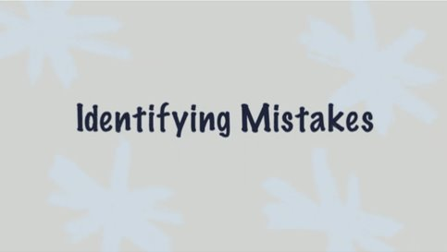
Bullet Proof Booklet (Identifying Mistakes) Video– 5 mins
Click the image below for your video:
Download the Bullet Proof Booklet template here!

Slide 11
Bullet Proof Booklet (Identifying Mistakes) Discussion– 5 mins
Do you currently analyse where you lost marks in exams? If not, why not? If you do, how do you structure this?

Slide 12
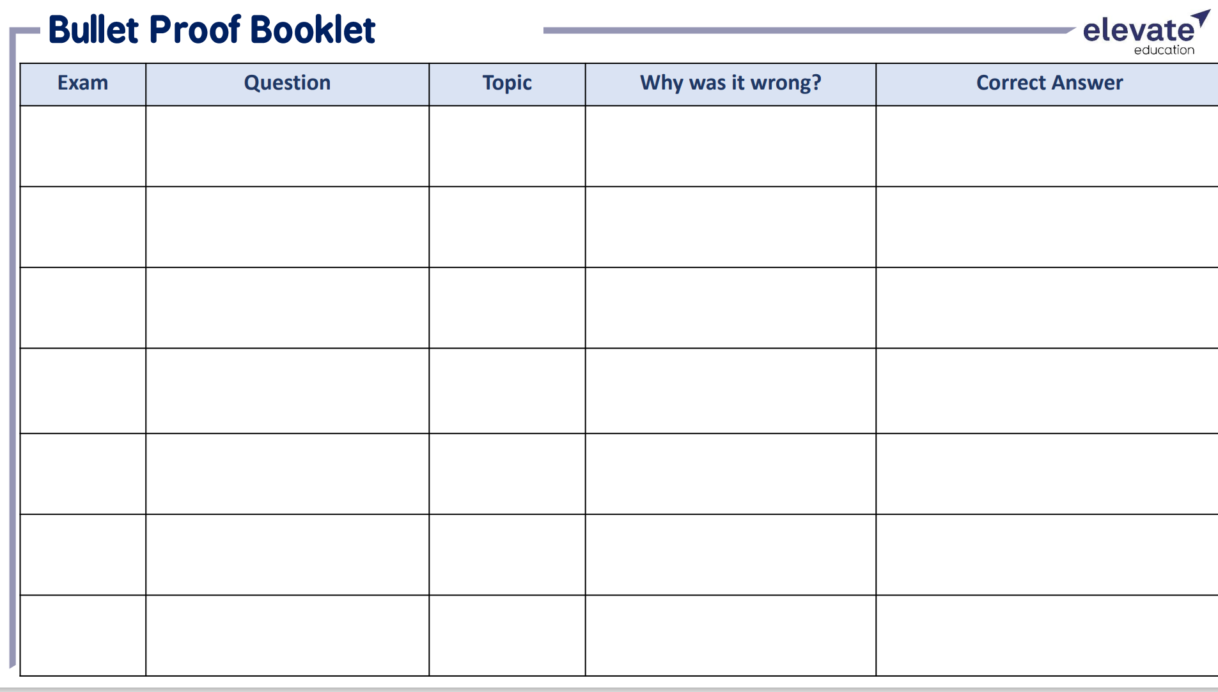
Using the Bullet Proof Booklet, identify where you lost marks in a practice/past paper and fill out the first 3 columns
Bullet Proof Booklet (Identifying Mistakes) Activity– 5 mins

Slide 13
Bullet Proof Booklet (Correcting Mistakes)
Video – 5 mins
Click the image below for your video:
Download the Bullet Proof Booklet template here!

Slide 14
Bullet Proof Booklet (Correcting Mistakes)
Discussion– 5 mins
When you have lost marks in an exam, do you re-do the question until you get it right? What is your current process for correcting past mistakes?

Slide 15
Using the Bullet Proof Booklet, identify why you lost marks and what the correct answer is using the last 2 columns
Bullet Proof Booklet (Correcting Mistakes)
Activity– 5 mins

Slide 16
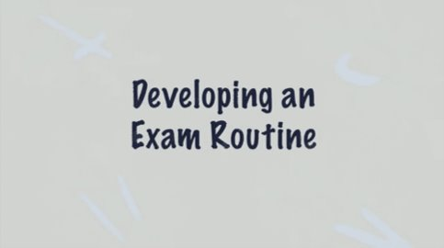
Developing an Exam Routine
Video – 5 mins
Click the image below for your video:
Download your exam check list here!

Slide 17
Developing an Exam Routine
Video – 5 mins
Do you have an exam routine? How do you manage your stress? What do you do normally do on the morning of an exam?

Slide 18
Developing an Exam Routine
Activity – 5 mins
Create a check list for the night before and the morning of your exam

Slide 19
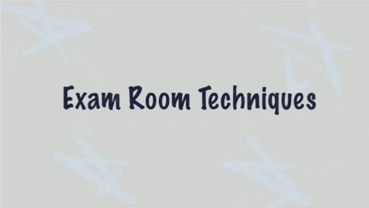
Exam Room Techniques
Video – 5 mins
Click the image below for your video:

Slide 20
Exam Room Techniques
Discussion – 5 mins
Do you struggle to manage your time in exams? Why?

Slide 21
Exam Room Techniques
Activity– 5 mins
How long should this student spend on these questions?

Slide 22
Feedback
For Teachers
We’d love your feedback on these follow-up resources.
We want to make them:
Easy to use for teachers;
Clear & helpful for students;
A part of your Elevate programme, so your school can embed the skills from our workshops.
And your feedback will help us get there. So click the link below and just take 30-60 seconds to fill out the questions so we can continue to improve. Thank you:
https://www.surveymonkey.co.uk/r/AceYourExams

