Slide 2
Aim
To understand the importance of exercise.
Success Criteria
I can talk about some of the benefits of exercise.
I know that exercise is part of staying healthy.
I know how much activity I should try to complete each day.
I can talk about some of the ways that I can be active.

Slide 3
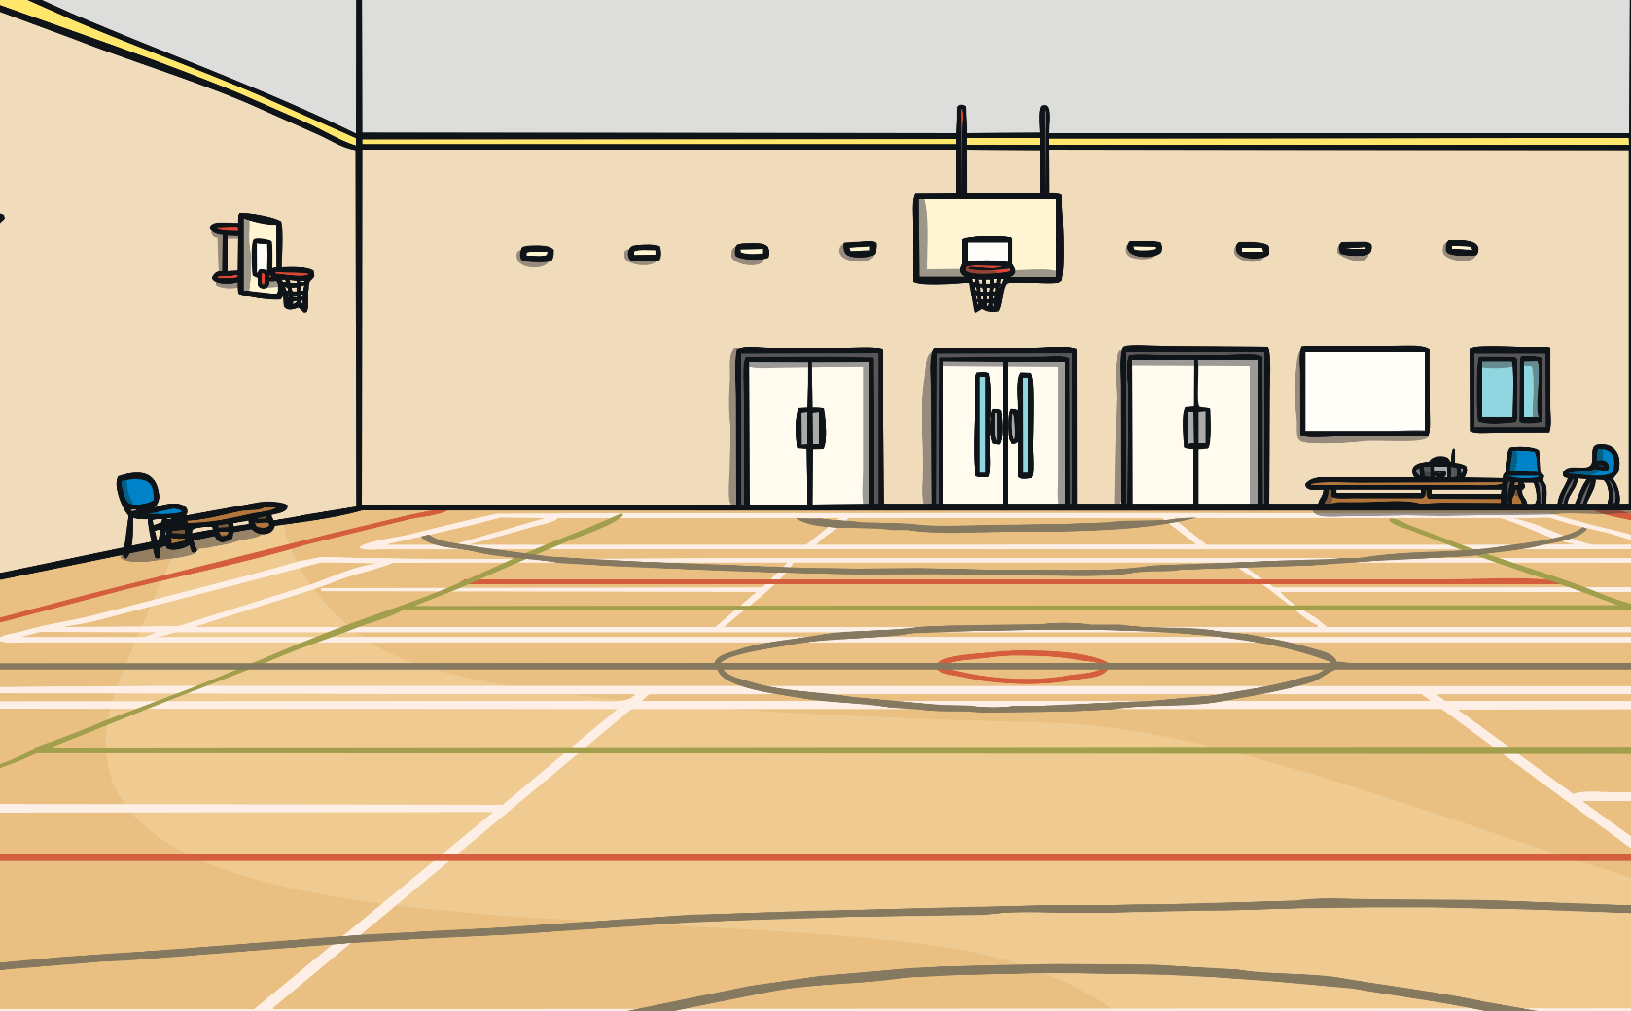



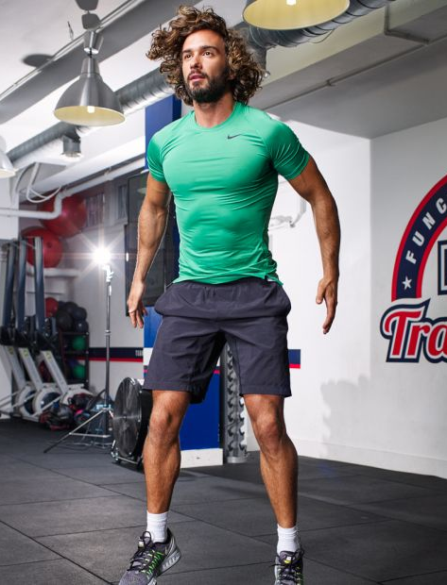
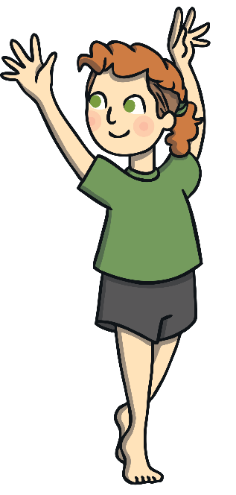
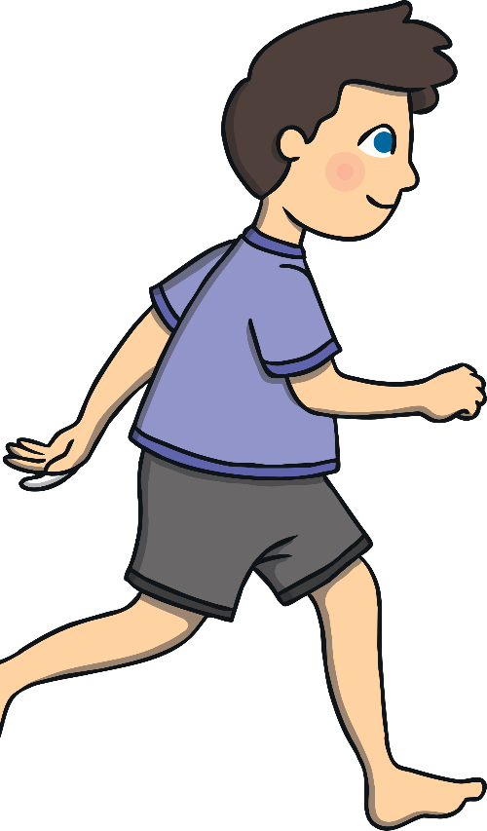
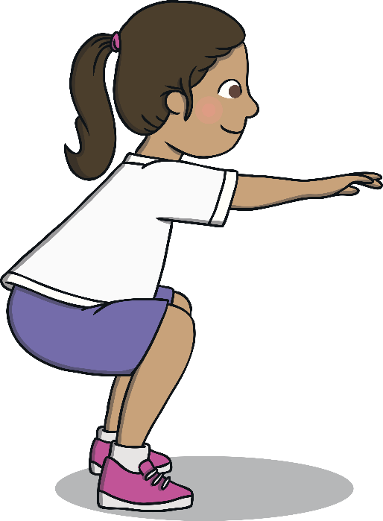
Why We Need to Exercise
Can you think of some different ways that you like to exercise and be active?
Exercising can
be great fun!

Slide 4
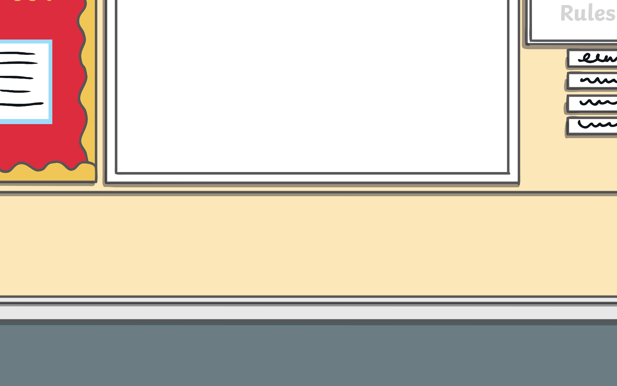
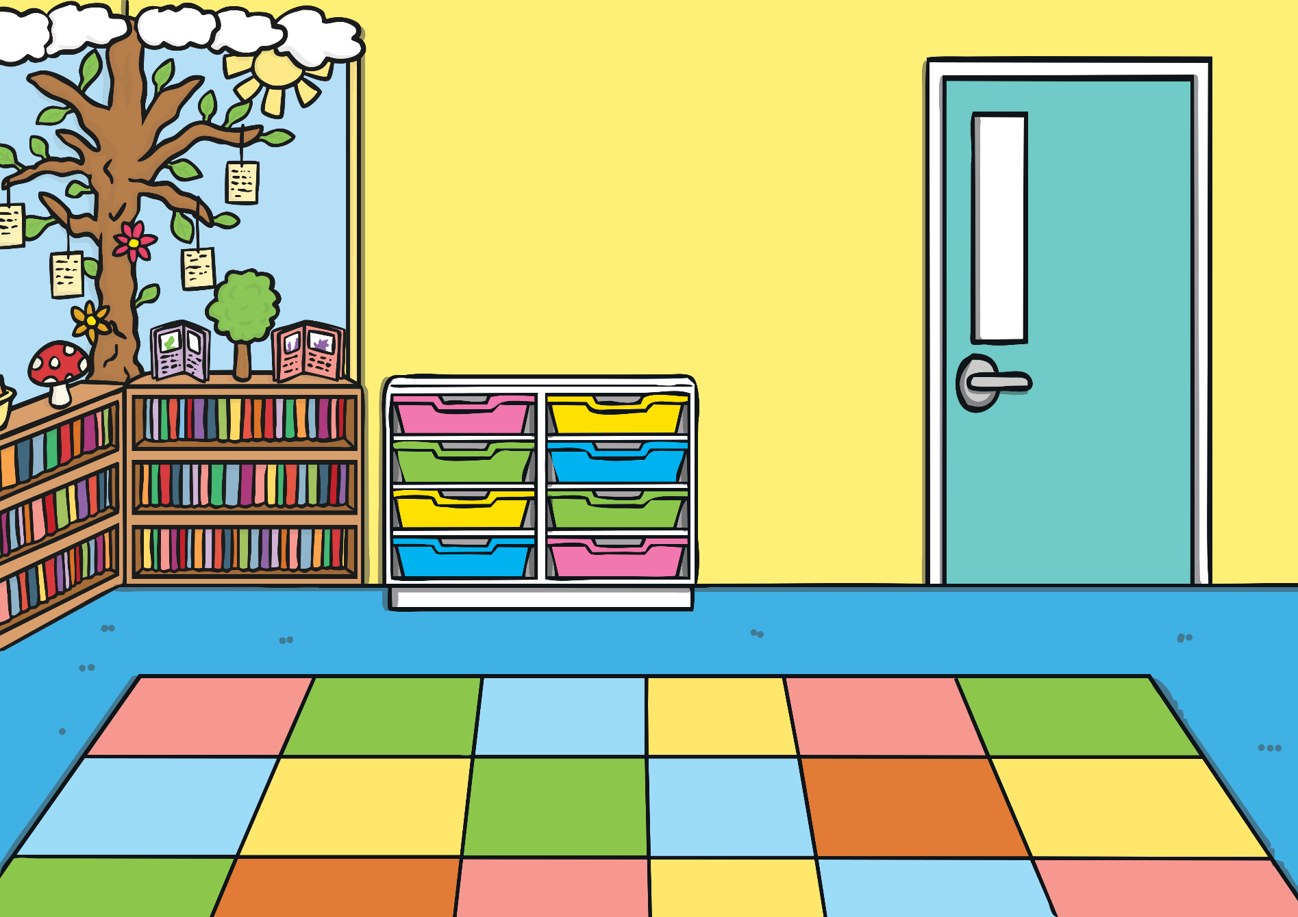
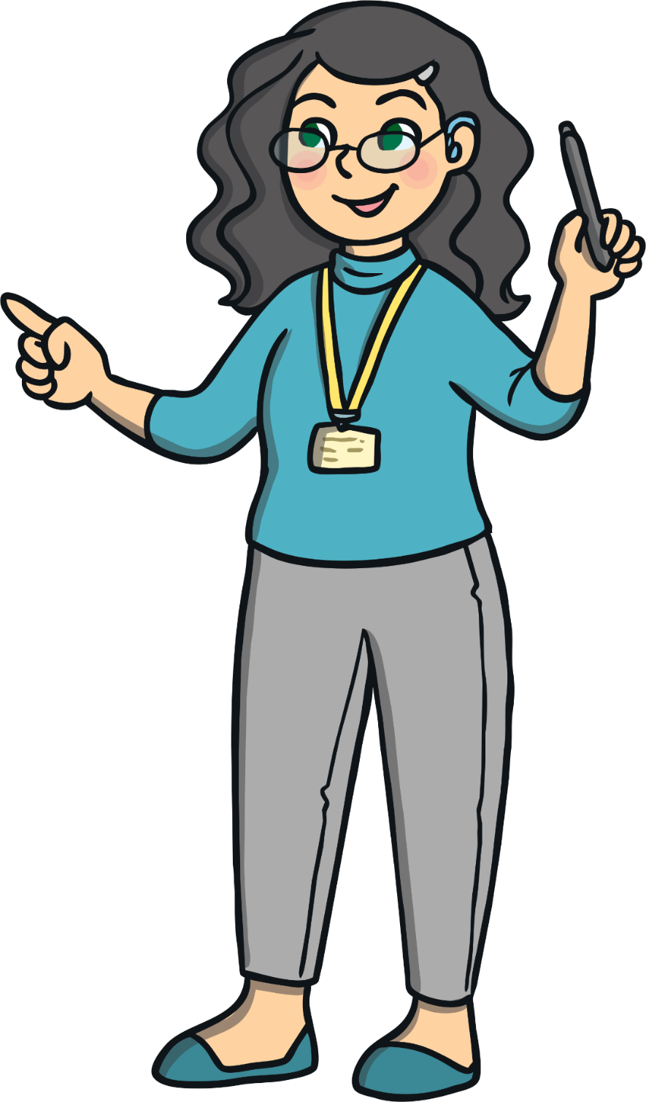
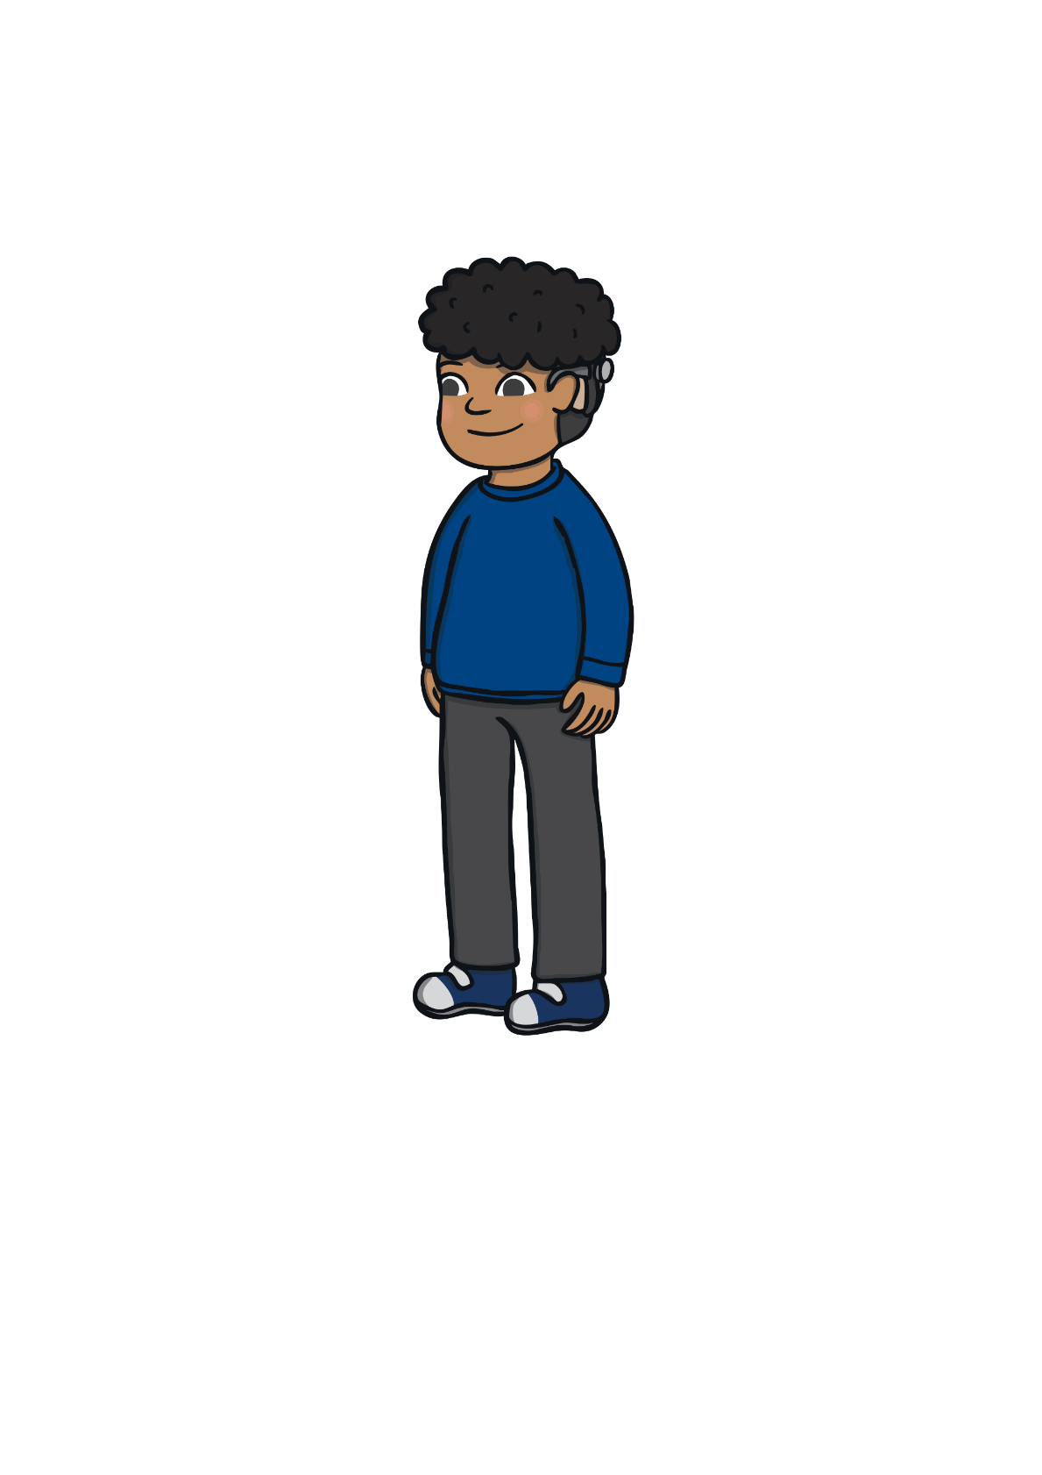

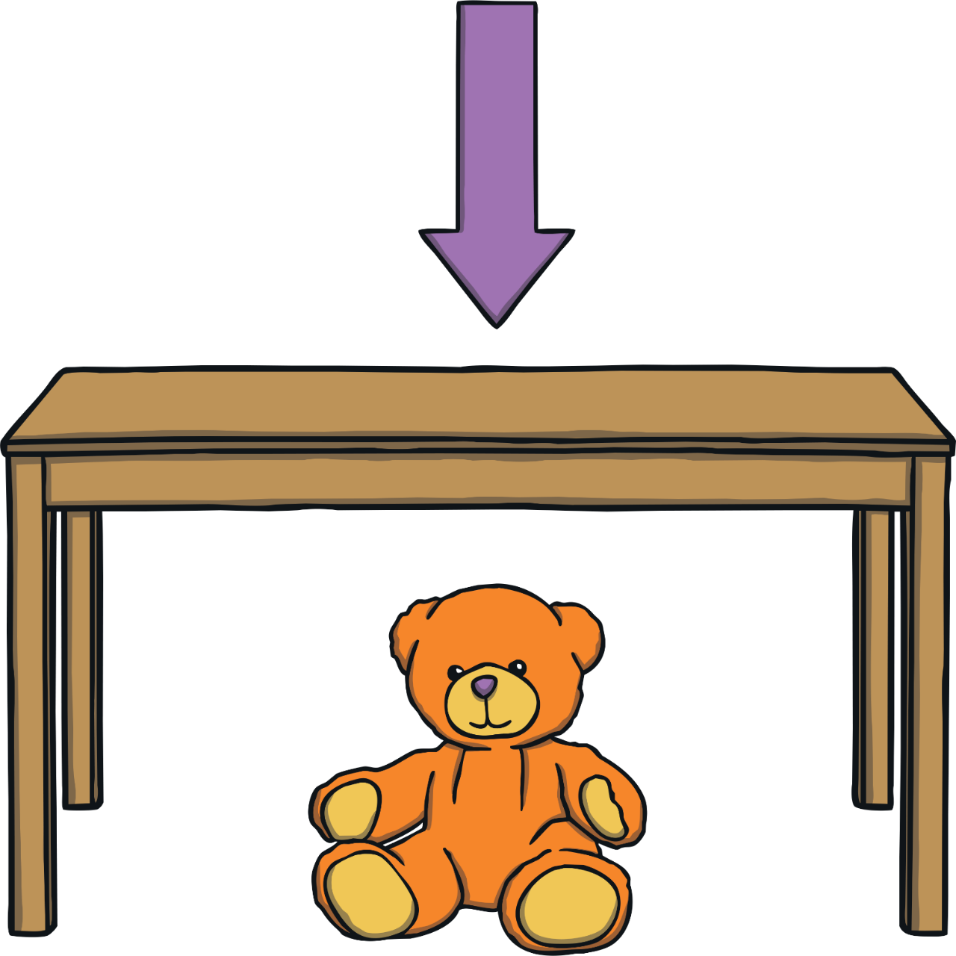
Why We Need to Exercise
As well as being lots of fun, exercise is really
important for your amazing body.
Discuss with a partner how your body feels now you have been sitting down for a while.

Slide 5

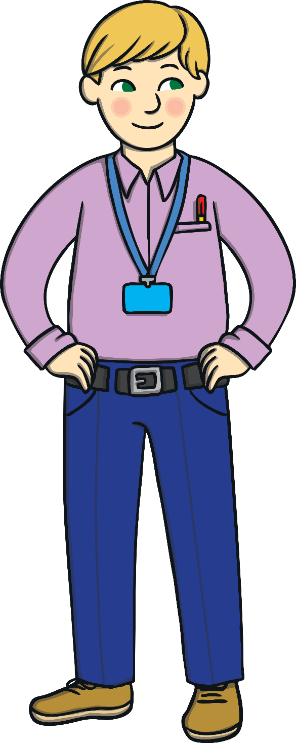
Why We Need to Exercise
We are now going to learn more about how exercise helps our bodies.
Can you think of some reasons why exercise is important?
Talk to a partner about how your body now feels.
End
1
2
3
4
5
6
7
8
9
10
11
12
13
14
15
16
17
18
19
20
21
22
23
24
25
26
27
28
29
30
31
32
33
34
35
36
37
38
39
Start
We are now going to stand up and
do quick marching on the spot for
40 seconds.
Well Done!
How high can you lift your knees up?
Keep your
back straight.
Push your knees as high as you can.
Make sure you have plenty of room.
March on the spot.
Pump your arms.
Lift your knees up.

Slide 6
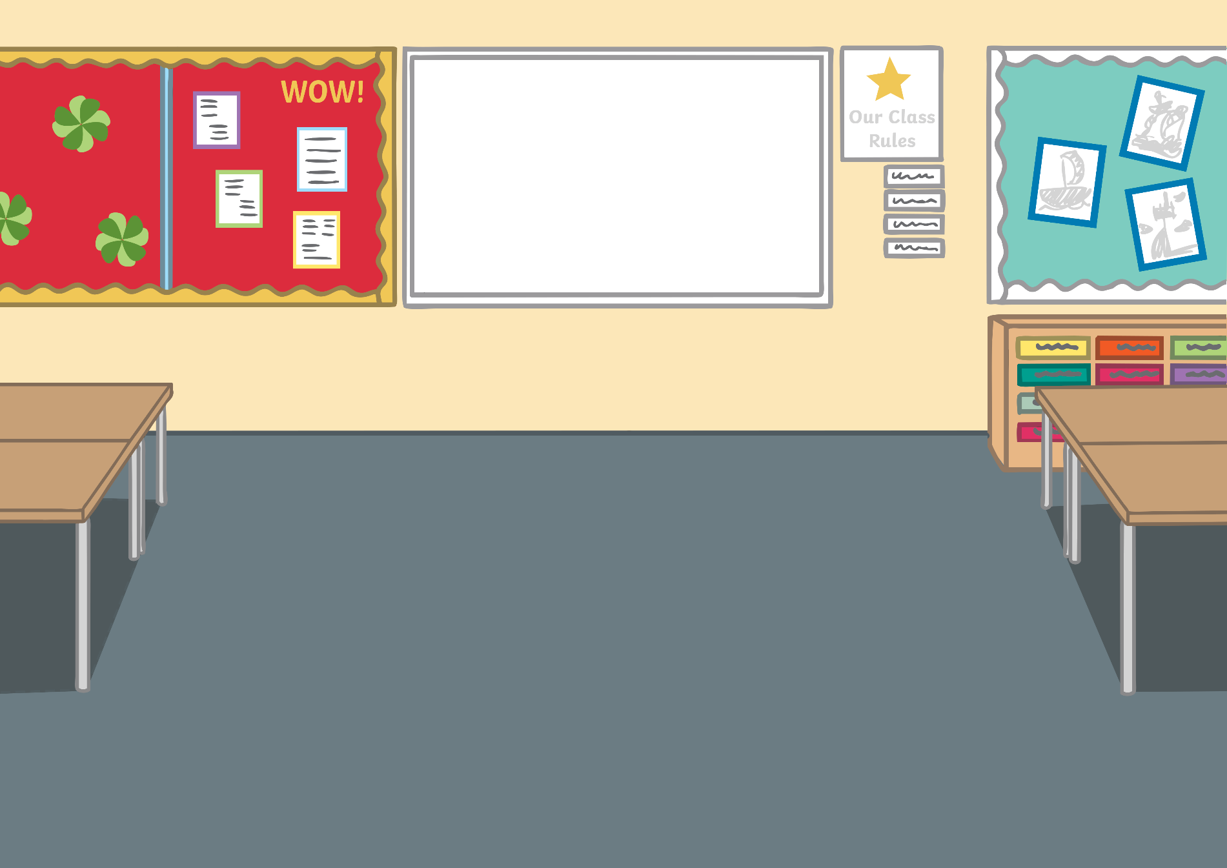
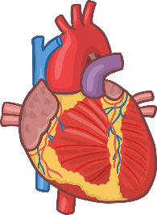
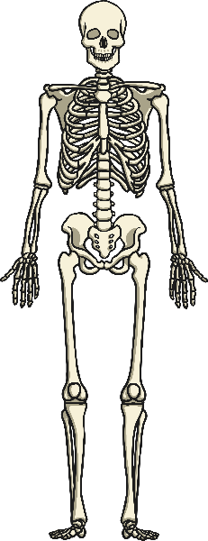
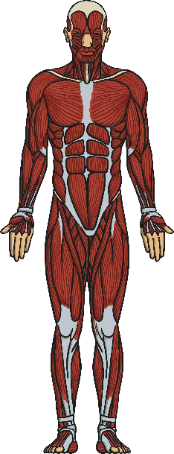
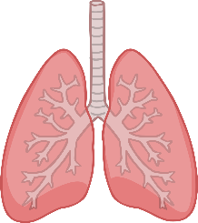
Your Body
Heart
Bones
Lungs
Muscles
Were you right?
Here are some of the important parts of your body.
Can you identify what each one is?

Slide 7
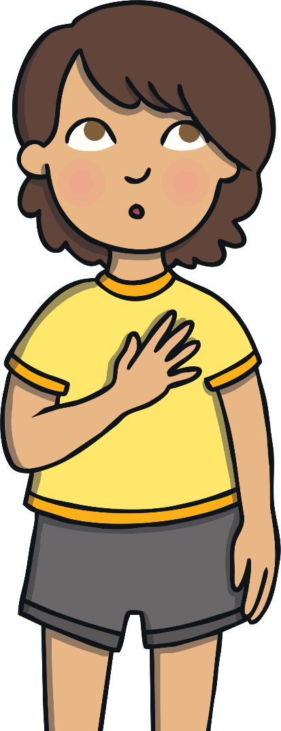
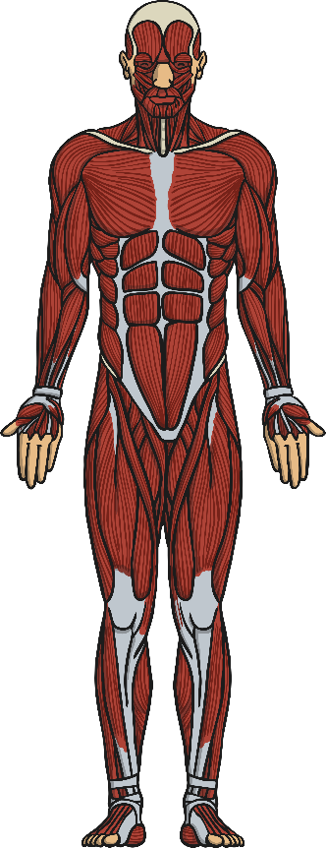

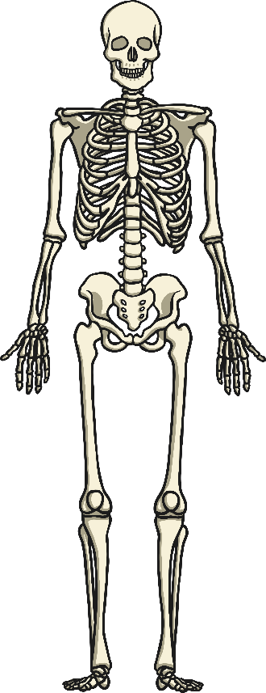

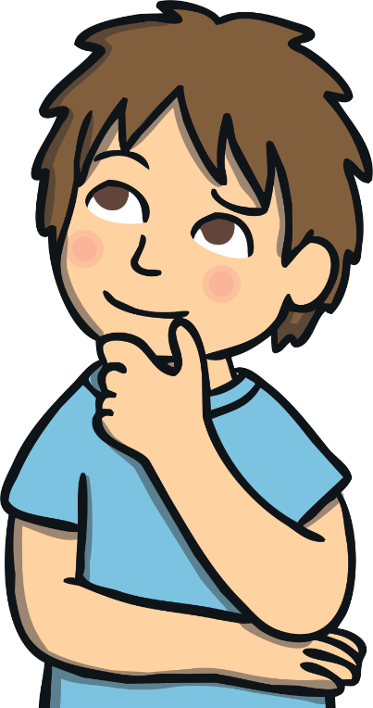
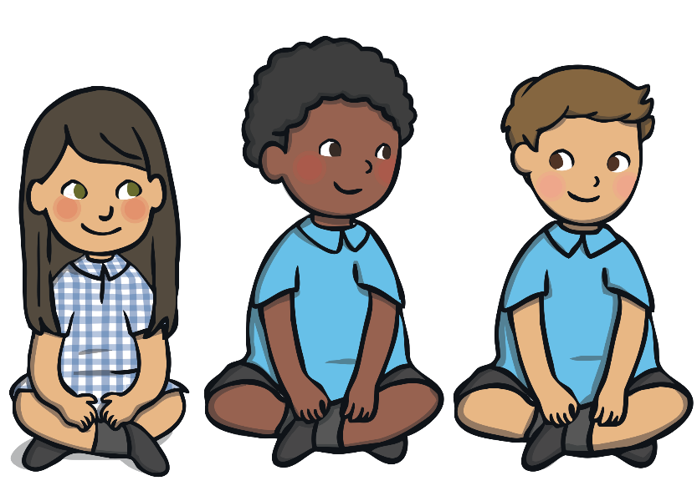
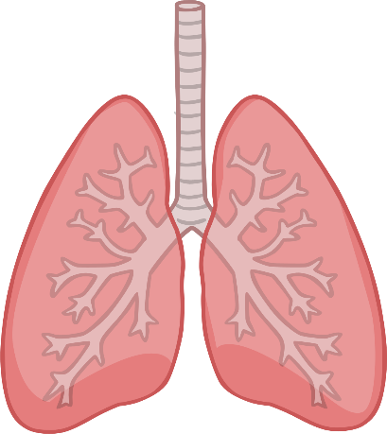
Your Body
Did you know that your heart is a muscle?
Each part of your body has a very important job.
Your bones support your body to give it structure.
Do you know what any of the jobs are?
Your heart pumps blood around your body to carry oxygen and other important things that you need.
Your muscles help you to move. They work with your bones to give your body power and strength.
Can you put your hand on your chest and feel your heart beating?
Do you know the names of any of the bones in your body?
Your lungs allow you to breathe. You breathe in oxygen and breathe out carbon dioxide.
Click here for a fascinating fact!

Slide 8
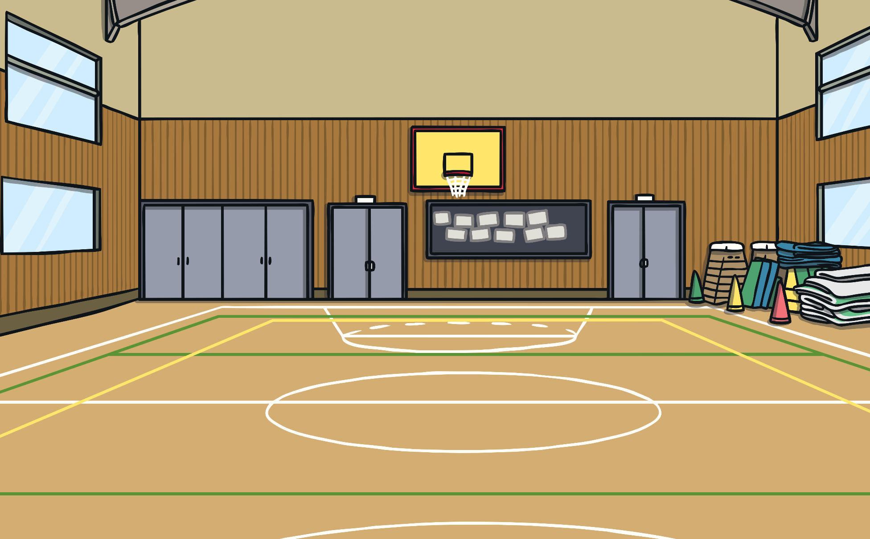

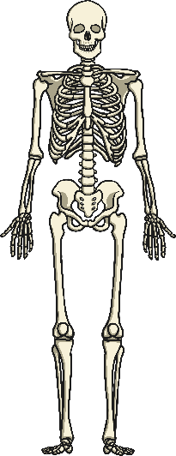
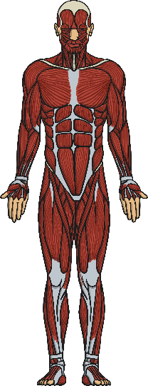
Help Your Body
How do you think exercise helps these parts of your body?
Exercise builds up your lungs so that they are using the oxygen well.
Exercise makes your bones and
muscles stronger.
Exercise is important for your amazing body!
Your heart pumps faster when you are being active.

Slide 9
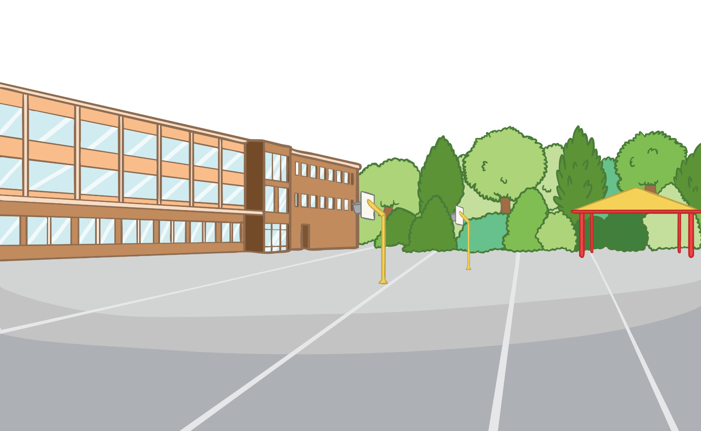
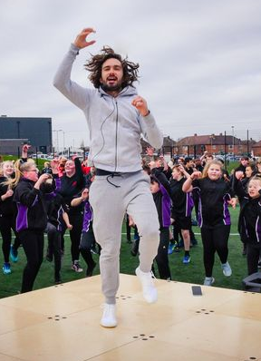
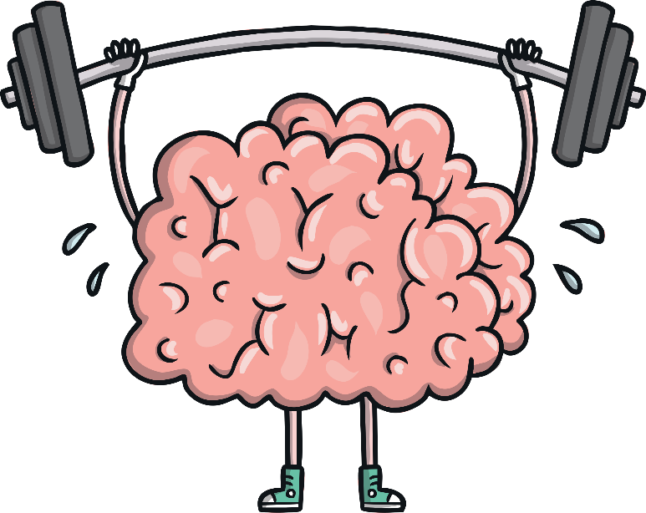
Another Important Part
Being active also helps another very important part of your body.
Can you think what it is?
Exercise helps your brain to concentrate so that you can
learn better.
Your brain!

Slide 10
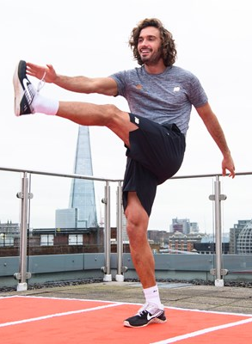
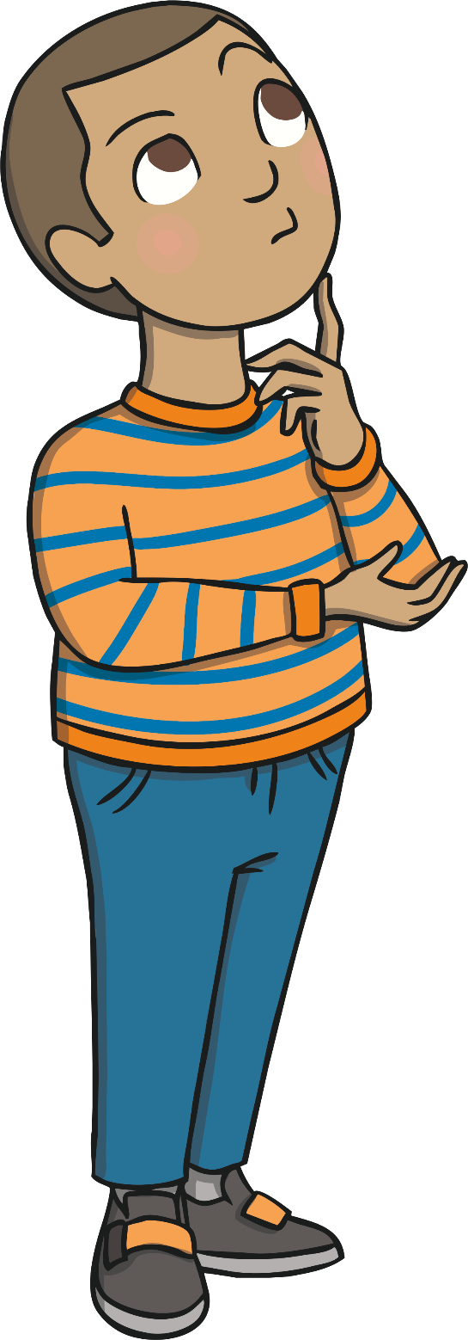
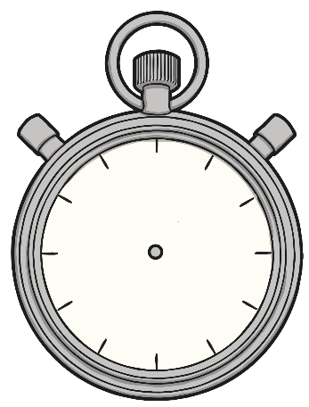
How Much Should You Exercise?
Being active every day is really important.
How long do you think you should spend exercising each day?
You should try to
be active for 60 minutes (or one hour) each day.
15 minutes
30 minutes
45 minutes
60 minutes
Remember: This doesn’t have to be all in one go.

Slide 11

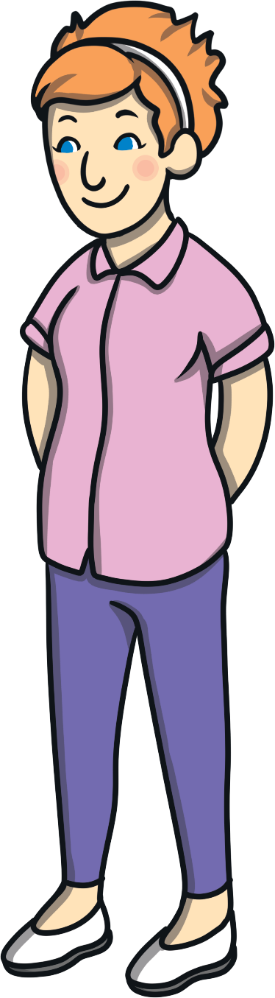
How Much Should You Exercise?
What ideas did you have?
End
1
2
3
4
5
6
7
8
9
10
11
12
13
14
15
16
17
18
19
20
21
22
23
24
25
26
27
28
29
30
31
32
33
34
35
36
37
38
39
Start
With a partner, think of different ways you can be active and exercise. How many can you think of
in 40 seconds?

Slide 12
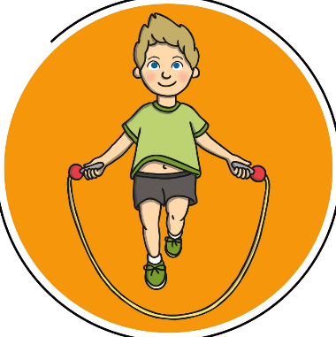

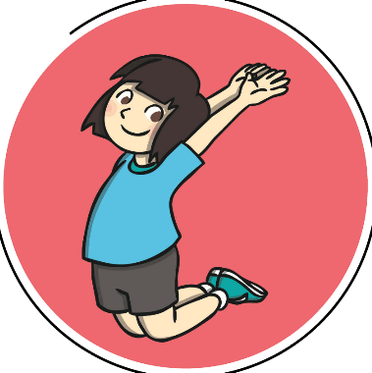
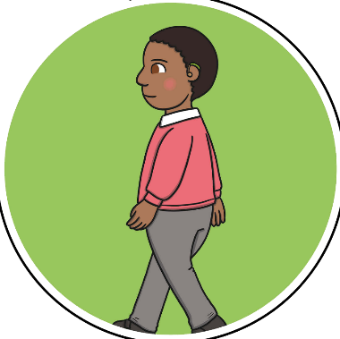
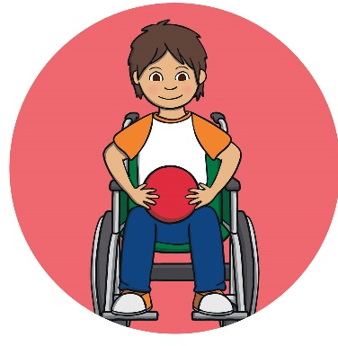

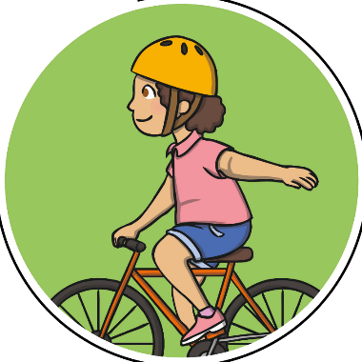
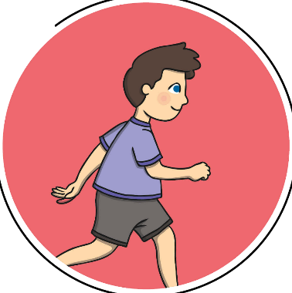
Ready, Set, Go!
How many of these ways did you think of?
What other ways did you think of?
Skipping
Dancing
Jumping
Walking
Playing with a ball
Riding a bike
Swimming
Running

Slide 13
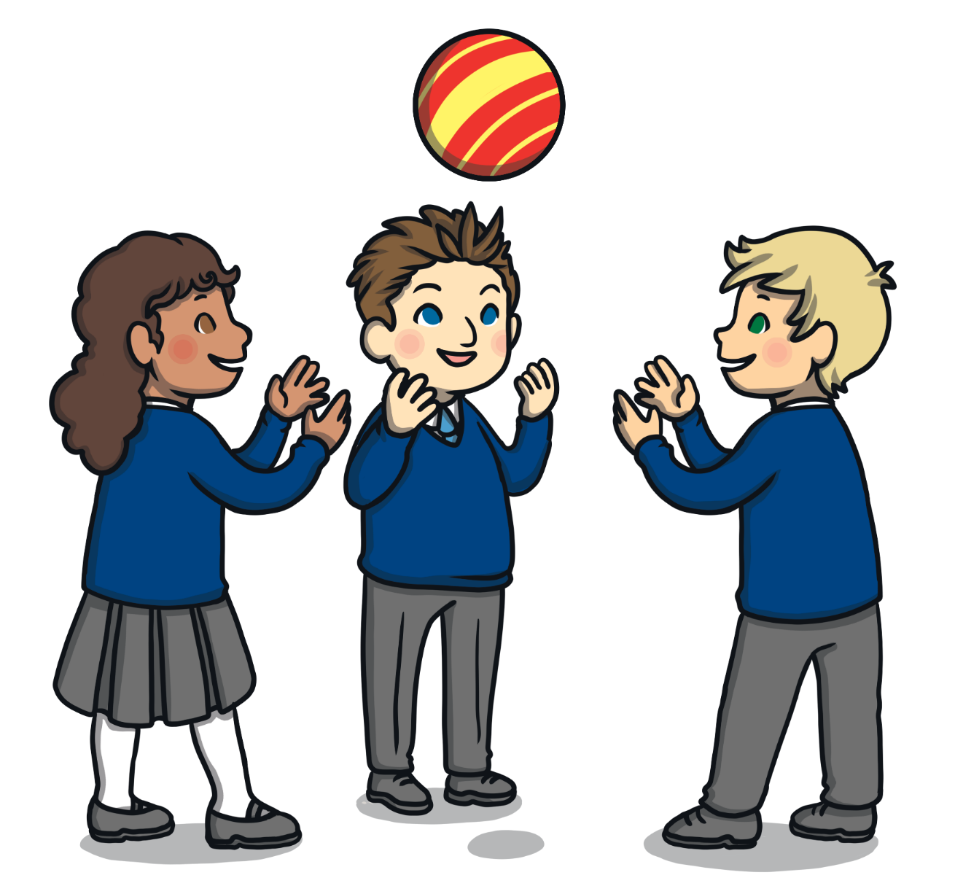
Have Fun!
It doesn’t matter how you choose to exercise, what is important is that you have fun while exercising!

Slide 14

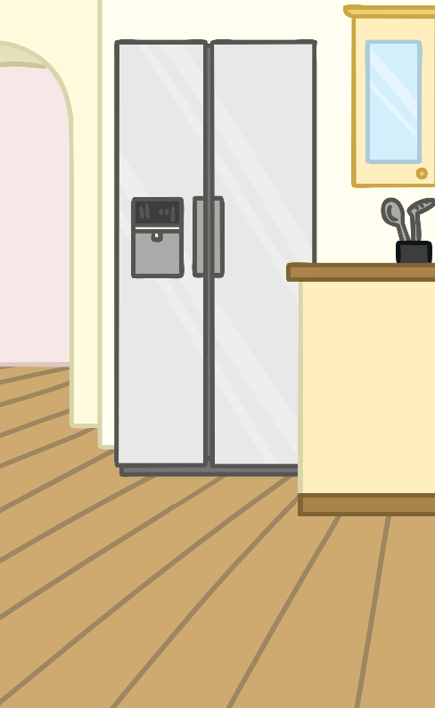
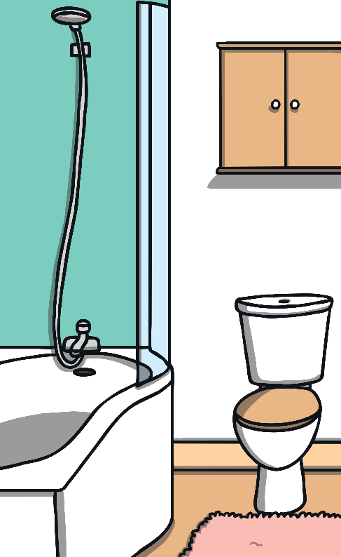
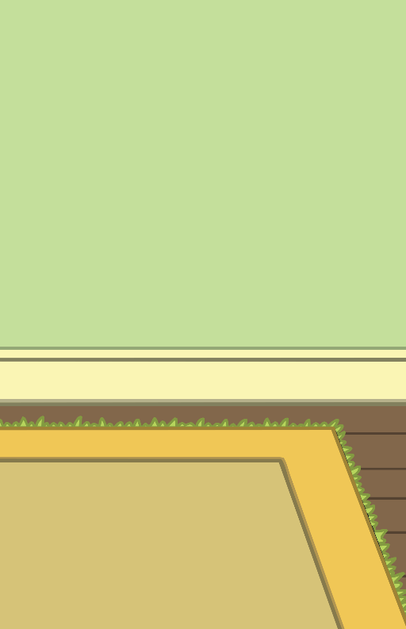

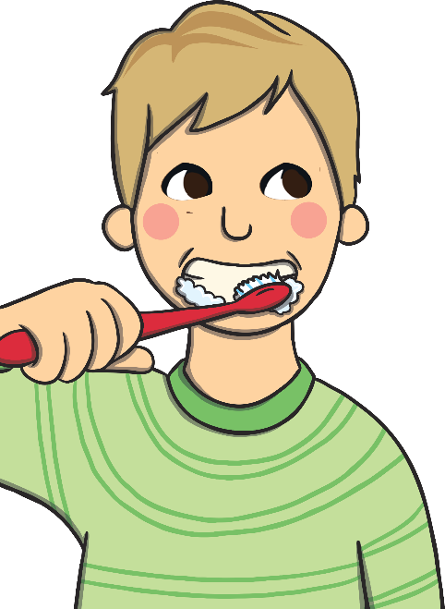
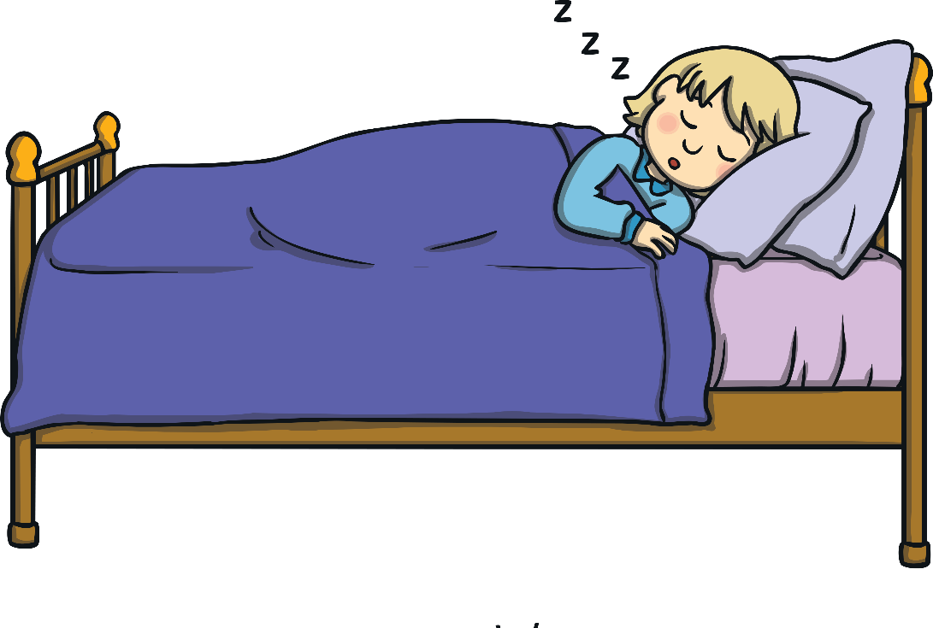
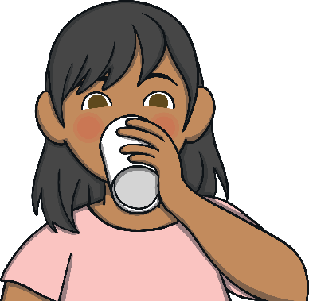

Staying Healthy
Moving and being active is an important part of staying healthy.
Staying healthy means looking after your body and mind so that they can do all of their important jobs.
What other things can you do to help your body and mind to stay healthy?
Drink plenty
of water.
Get plenty
of sleep.
Eat a
balanced diet.
Keep your body and teeth clean.

Slide 15
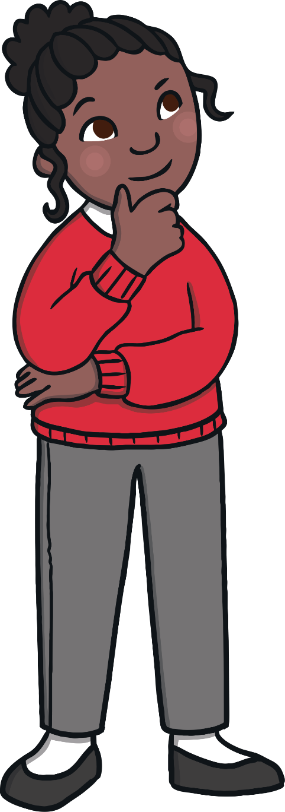
Reminder - Why Do We Exercise?
Why do we exercise?
Exercise helps to keep our body healthy.
It’s good for our heart, lungs, bones and muscles.
Activity is good for our brain and helps us to concentrate so that we can learn better.
Being active, moving, getting exercise, playing sports and games are fun and can help make us happy!

Slide 16
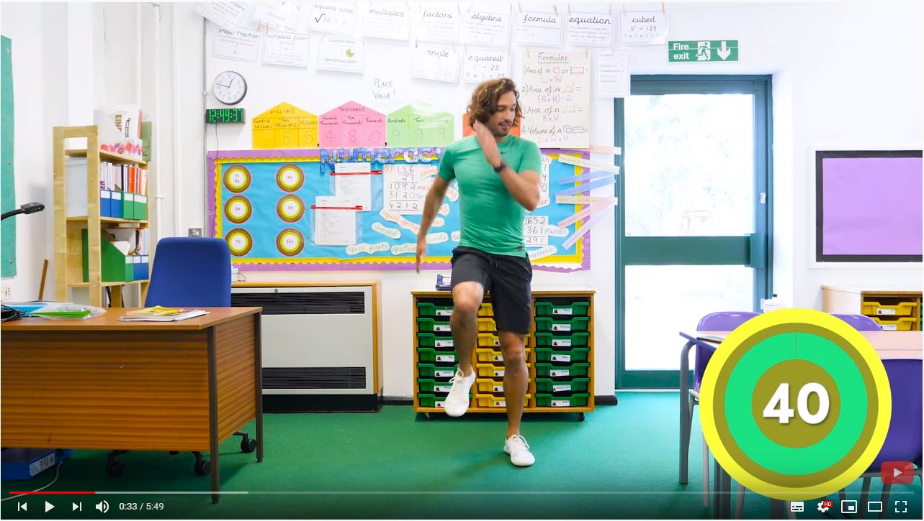
Joe Says….
Let’s now try one of my 5 minute workouts.
Can you do one each day to stay healthy and happy!

Slide 17
Aim
To understand the importance of exercise.
Success Criteria
I can talk about some of the benefits of exercise.
I know that exercise is part of staying healthy.
I know how much activity I should try to complete each day.
I can talk about some of the ways that I can be active.

