Slide 1
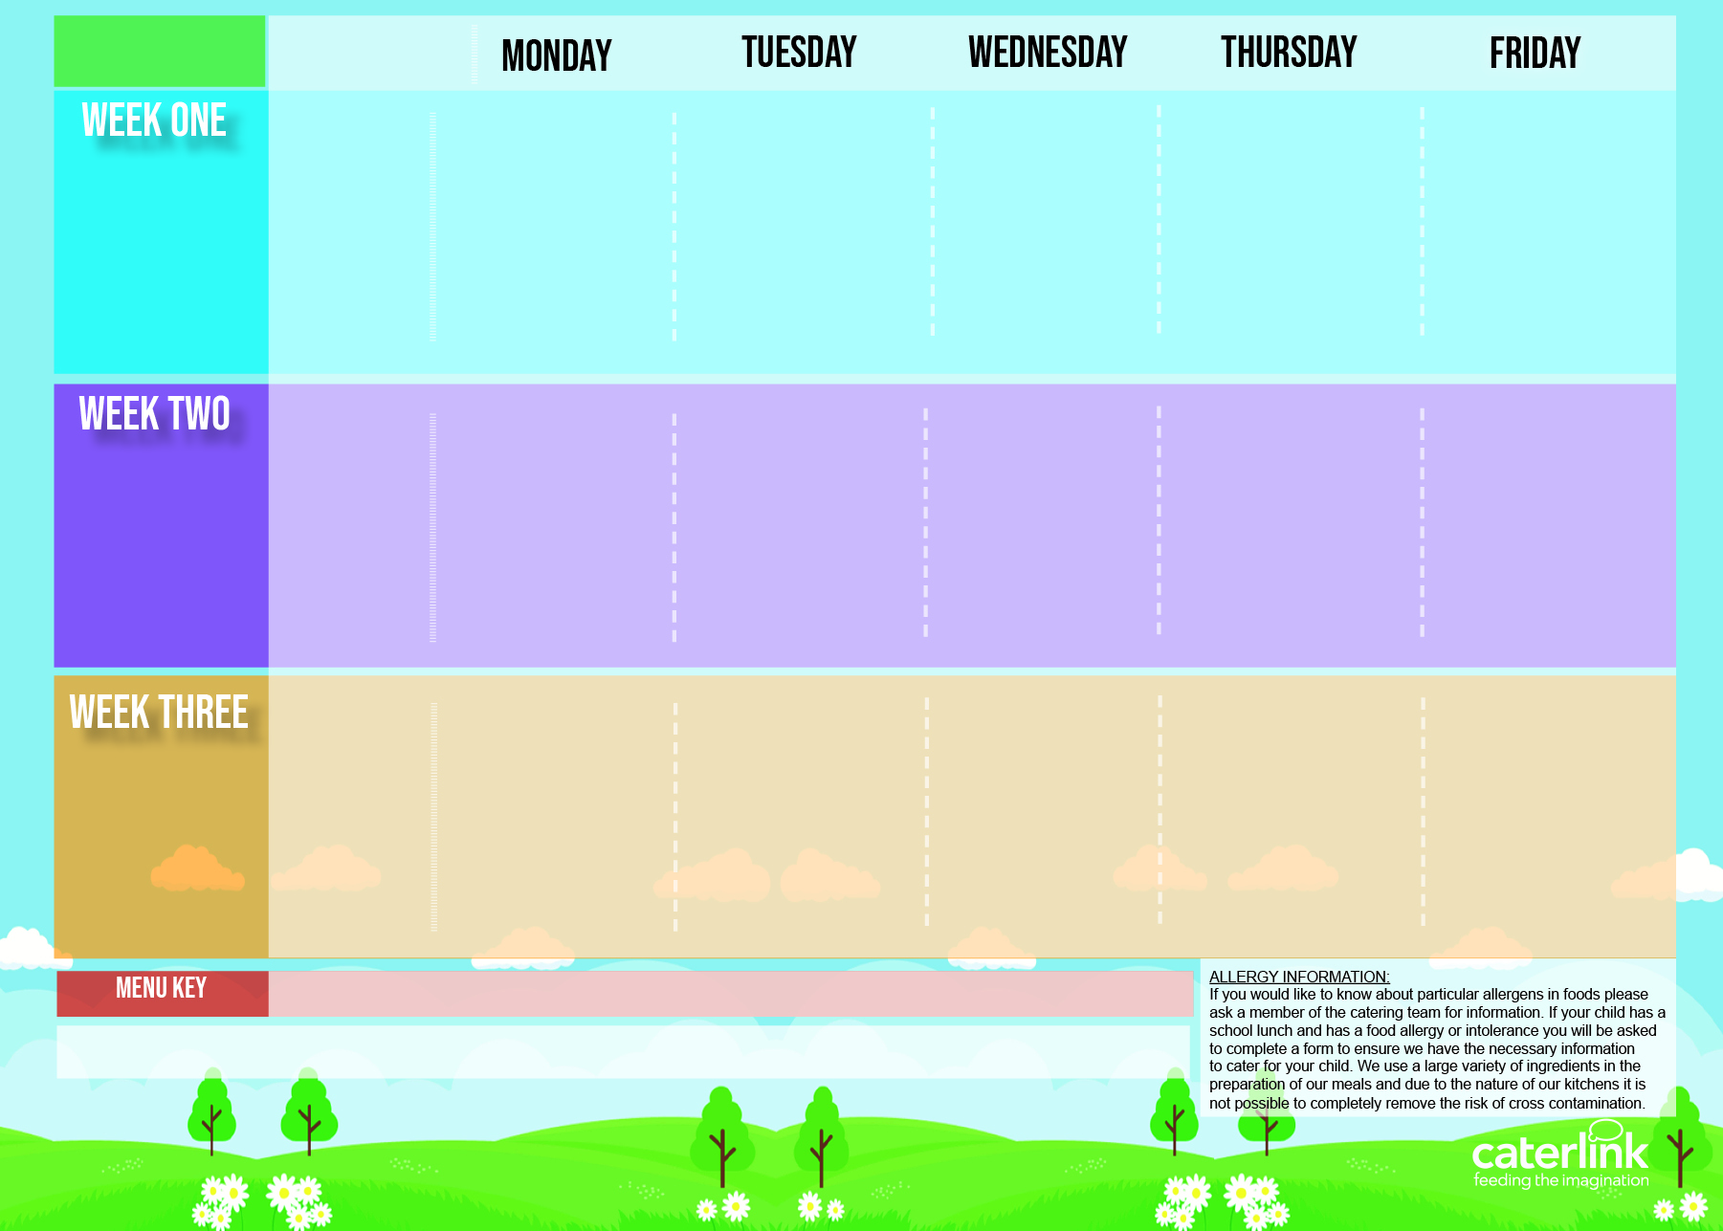
Central Autumn Winter Menu 2024 2025
Vegetable Pasta Bake | Cottage Pie with Gravy | Roast Chicken with Stuffing, Roast Potatoes and Gravy Roast Quorn with Stuffing, Roast Potatoes and Gravy | Meatballs in Tomato Sauce with Rice | Fishfingers with Chips & Tomato Sauce
NEW Cheese and Broccoli Pasta with Garlic Bread | Vegetable Korma with Rice |  | Vegan Burger with Wedges | Cheese and Bean Pasty with Chips & Tomato Sauce
Blackberry and Apple Crumble with Custard | Melting Moment Biscuit | Fruit Platter | Carrot and Courgette Cake | Chocolate Orange Cookie
4th Nov 24
25th Nov 24
16th dec 24
20th Jan 25
10th Feb 25
10th March 25
31st March25
Classic Cheese and Tomato Pizza Or Vegetable Rainbow Pizza With Potato Wedges | NEW Chicken Pasta Bake with Garlic Bread | Roast Chicken with Stuffing, Roast Potatoes and Gravy | Sausage and Mash with Gravy | Fishfingers with Chips & Tomato Sauce
 | Vegetable Korma with Rice | Roast Quorn with Stuffing, Roast Potatoes and Gravy | Vegan Sausage and Mash with Gravy | Vegan Sausage Rolls with Chips & Tomato Sauce
Marble Sponge Cake with Custard | Jelly with Mandarins | Fruit Medley | Peach Cake | Oaty Cookie
11th Nov 24
2nd Dec 24
6th Jan 25
27th Jan 25
24th Feb.25
17th March 25
Macaroni Cheese | Chicken & Vegetable Pie with Mash & Gravy Mild Mexican Chilli with rice | Roast Chicken with Stuffing, Roast Potatoes and Gravy | Spaghetti Bolognaise | Fish fingers with Chips & Tomato Sauce
Plant Balls in Tomato Sauce with Rice |  | Vegan Cottage Pie with Gravy | Cheese Whirl with wedges | BBQ Quorn with Chips & Tomato Sauce
Chocolate and Beetroot Brownie | Sticky Toffee Apple Crumble with Custard | Fruit Salad | Iced Sponge | Vanilla Shortbread
18th Nov 24
9th Dec 24
13th Jan 25
3rd Feb. 25
3rd March 25
24th March 25
Added Plant Power
Wholemeal
Vegan
Available Daily: Fresh Bread – Salad Selection, Jacket Potatoes, – Fresh Fruit and Yoghurt,

Slide 2
Central Autumn Winter Menu 2024 2025
V302 NEW Tomato & Vegetable Pasta | B33 SD118 Cottage Pie with Gravy | C1Roast chicken with SD40 Stuffing, SD82 Roast Potatoes and SD118 Gravy V204Roast Quorn with SD50 Stuffing, SD82 Roast Potatoes and SD118 Gravy | Meatballs in V225 Tomato Sauce with SD84 Rice | F6 Fishfingers with SD5 Chips & SD14 Tomato Sauce
V304 Cheese and Broccoli Pasta with SD50 Garlic Bread | V108Vegetable Korma with Rice SD84 |  | V236 SD6 SD17 Vegan Burger with Wedges | V191 Cheese & Bean Pasty with SD5 Chips & SD14 Tomato Sauce
D74 Apple and Blackberry Crumble with D2 Custard | D231 Melting Moment Biscuit | D225 Fruit Platter | D174 Carrot and Courgette Cake | D230 Chocolate Orange Cookie
4th Nov 24
25th Nov 24
16th dec 24
20th Jan 25
10th Feb 25
10th March 25
31st March25
V231 Classic Cheese and Tomato Pizza Or V305 Vegetable Rainbow Pizza With SD6 Potato Wedges | C101 NEW Chicken Pasta Bake with SD40 Garlic Bread | C1Roast chicken with SD40 Stuffing, SD82 Roast Potatoes and SD118 Gravy | C6/P3 Sausage and SD1 Mash with SD118 Gravy | F6 Fishfingers with SD5 Chips & SD14 Tomato Sauce
 | V108 Vegetable Korma with Rice SD84 | Roast Quorn V204 with SD50 Stuffing, SD82 Roast Potatoes and SD118 Gravy | V238 Vegan Sausage and SD1 Mash with SD118 Gravy | V251Vegan Sausage Rolls with SD5 Chips & SD14 Tomato Sauce
D199 Marble Sponge Cake with D2 Custard | D235 Jelly with Mandarins | D224 Fruit Medley | D176 Peach Cake | D85 Oaty Cookie
11th Nov 24
2nd Dec 24
6th Jan 25
27th Jan 25
24th Feb.25
17th March 25
V11 Macaroni Cheese | C21Chicken & sweetcorn Pie with Mash SD1 & Gravy SD118 V309 Mild Mexican Chilli with SD84 Rice | C1Roast chicken with SD40 Stuffing, SD82 Roast Potatoes and SD118 Gravy | B48 SD8 Spaghetti Bolognaise | F6 Fishfingers with SD5 Chips & SD14 Tomato Sauce
V237 Classic Plant Balls in V225 Tomato Sauce with SD84 Rice
V237 Classic Plant Balls in V225 Tomato Sauce with SD84 Rice |  | V241 Vegetarian Cottage Pie with SD118 Gravy | GR2 Cheese Whirl with wedges SD6 | V205 BBQ Quorn with SD5 Chips & SD14 Tomato Sauce
D169 Chocolate and Beetroot Brownie | D243 Sticky Toffee Apple Crumble with D2 Custard | D223 Fruit Salad | D177 Iced Sponge | D57 Vanilla Shortbread
18th Nov 24
9th Dec 24
13th Jan 25
3rd Feb. 25
3rd March 25
24th March 25
Added Plant Power
Wholemeal
Vegan
Available Daily: Fresh Bread – Salad Selection – Jacket Potatoes - Fresh Fruit and Yoghurt

