Slide 1
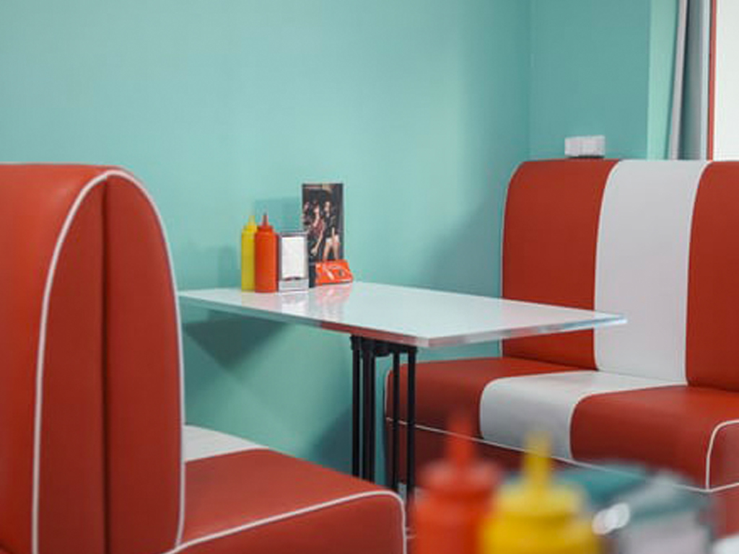
American Diners Day
5th October 2023
Beef Burger served in a Seeded Bun
***
Quorn Burger served in a Seeded Bun
***
Potato Wedges,
Baked Beans
Coleslaw
***
American Soft Bake Chocolate Cookie
Served with Ice Cream

