Slide 1
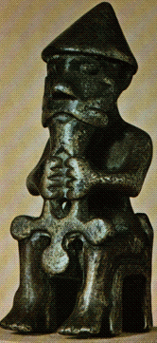
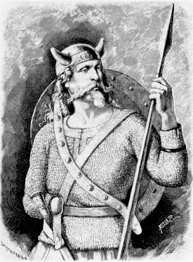
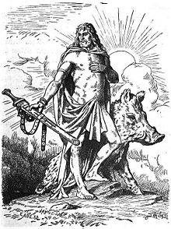
Anglo-Saxon Beliefs
God of battle
- Tiw
God of rain and crops
- Frey
God of Thunder
- Thor
WALT: understand the Saxon religion.

Slide 2
Pagan Religion
The Anglo-Saxons were pagans, who did not believe in the Christian God. Gradually the Christians outside Britain returned to England and Scotland and began to covert the Picts, Scots and the Anglo-Saxons and after a while most of England became Christians.
Each pagan god controlled a particular part of everyday life: the home, growing crops, healing, wisdom, metalworking, love, the weather, the family, war and day and night.

Slide 3
Pagan Beliefs..did you know…
Our word Easter comes from the name of the Anglo-Saxon goddess of the dawn, Eostre.
When the Saxons first settled in Britain, they were pagans. This means that they worshiped lots of different gods. Their religion was called 'paganism'.
The Saxons were very superstitious and believed in elves, goblins and dragons.

Slide 4
The Anglo-Saxons worshipped the gods Tiw, Woden, Thor and Frig. From these words come the names of our days of the week: Tuesday, Wednesday, Thursday, Friday. Most of the days of the week are named after Saxon gods. Can you work out which ones?
Tiw’ day
Woden’s day
Thunor’s day
Frig’s day

