Slide 1
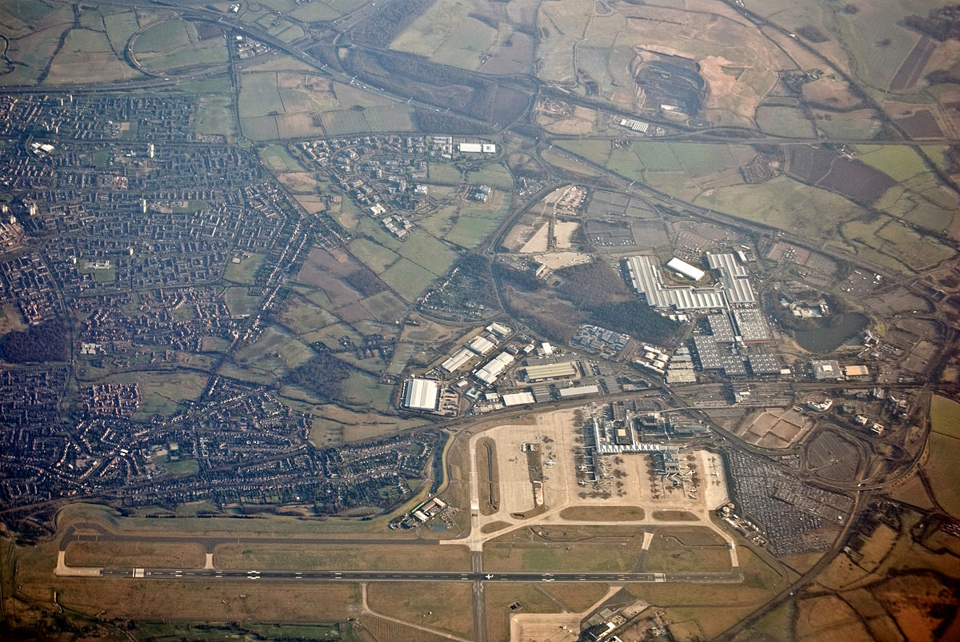
Mrs Dewar’s Isolation Lesson
Anglo Saxon Place Names
Friday 18th December 2020

Slide 2
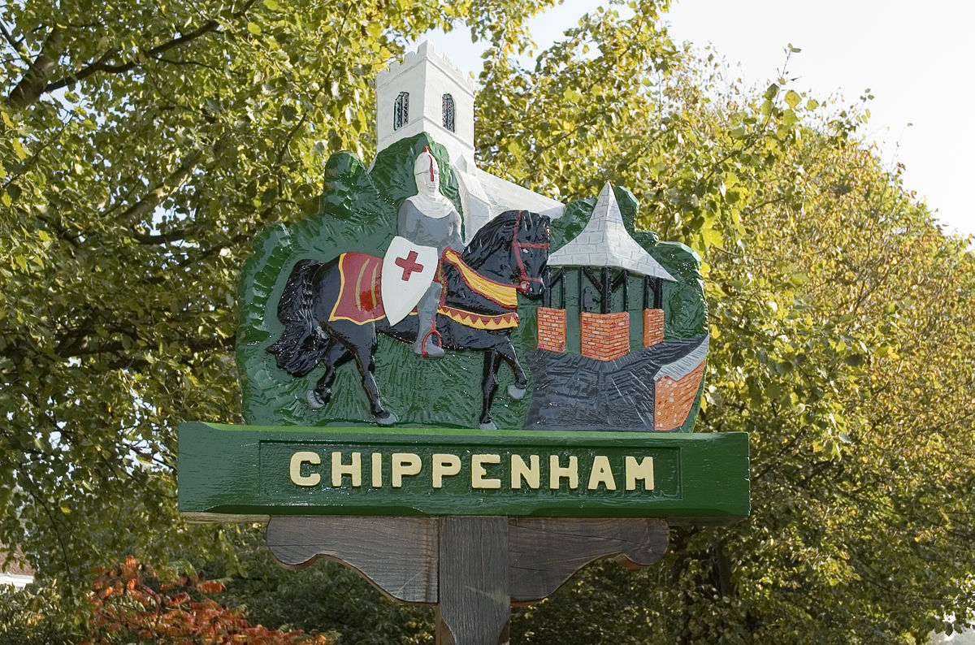
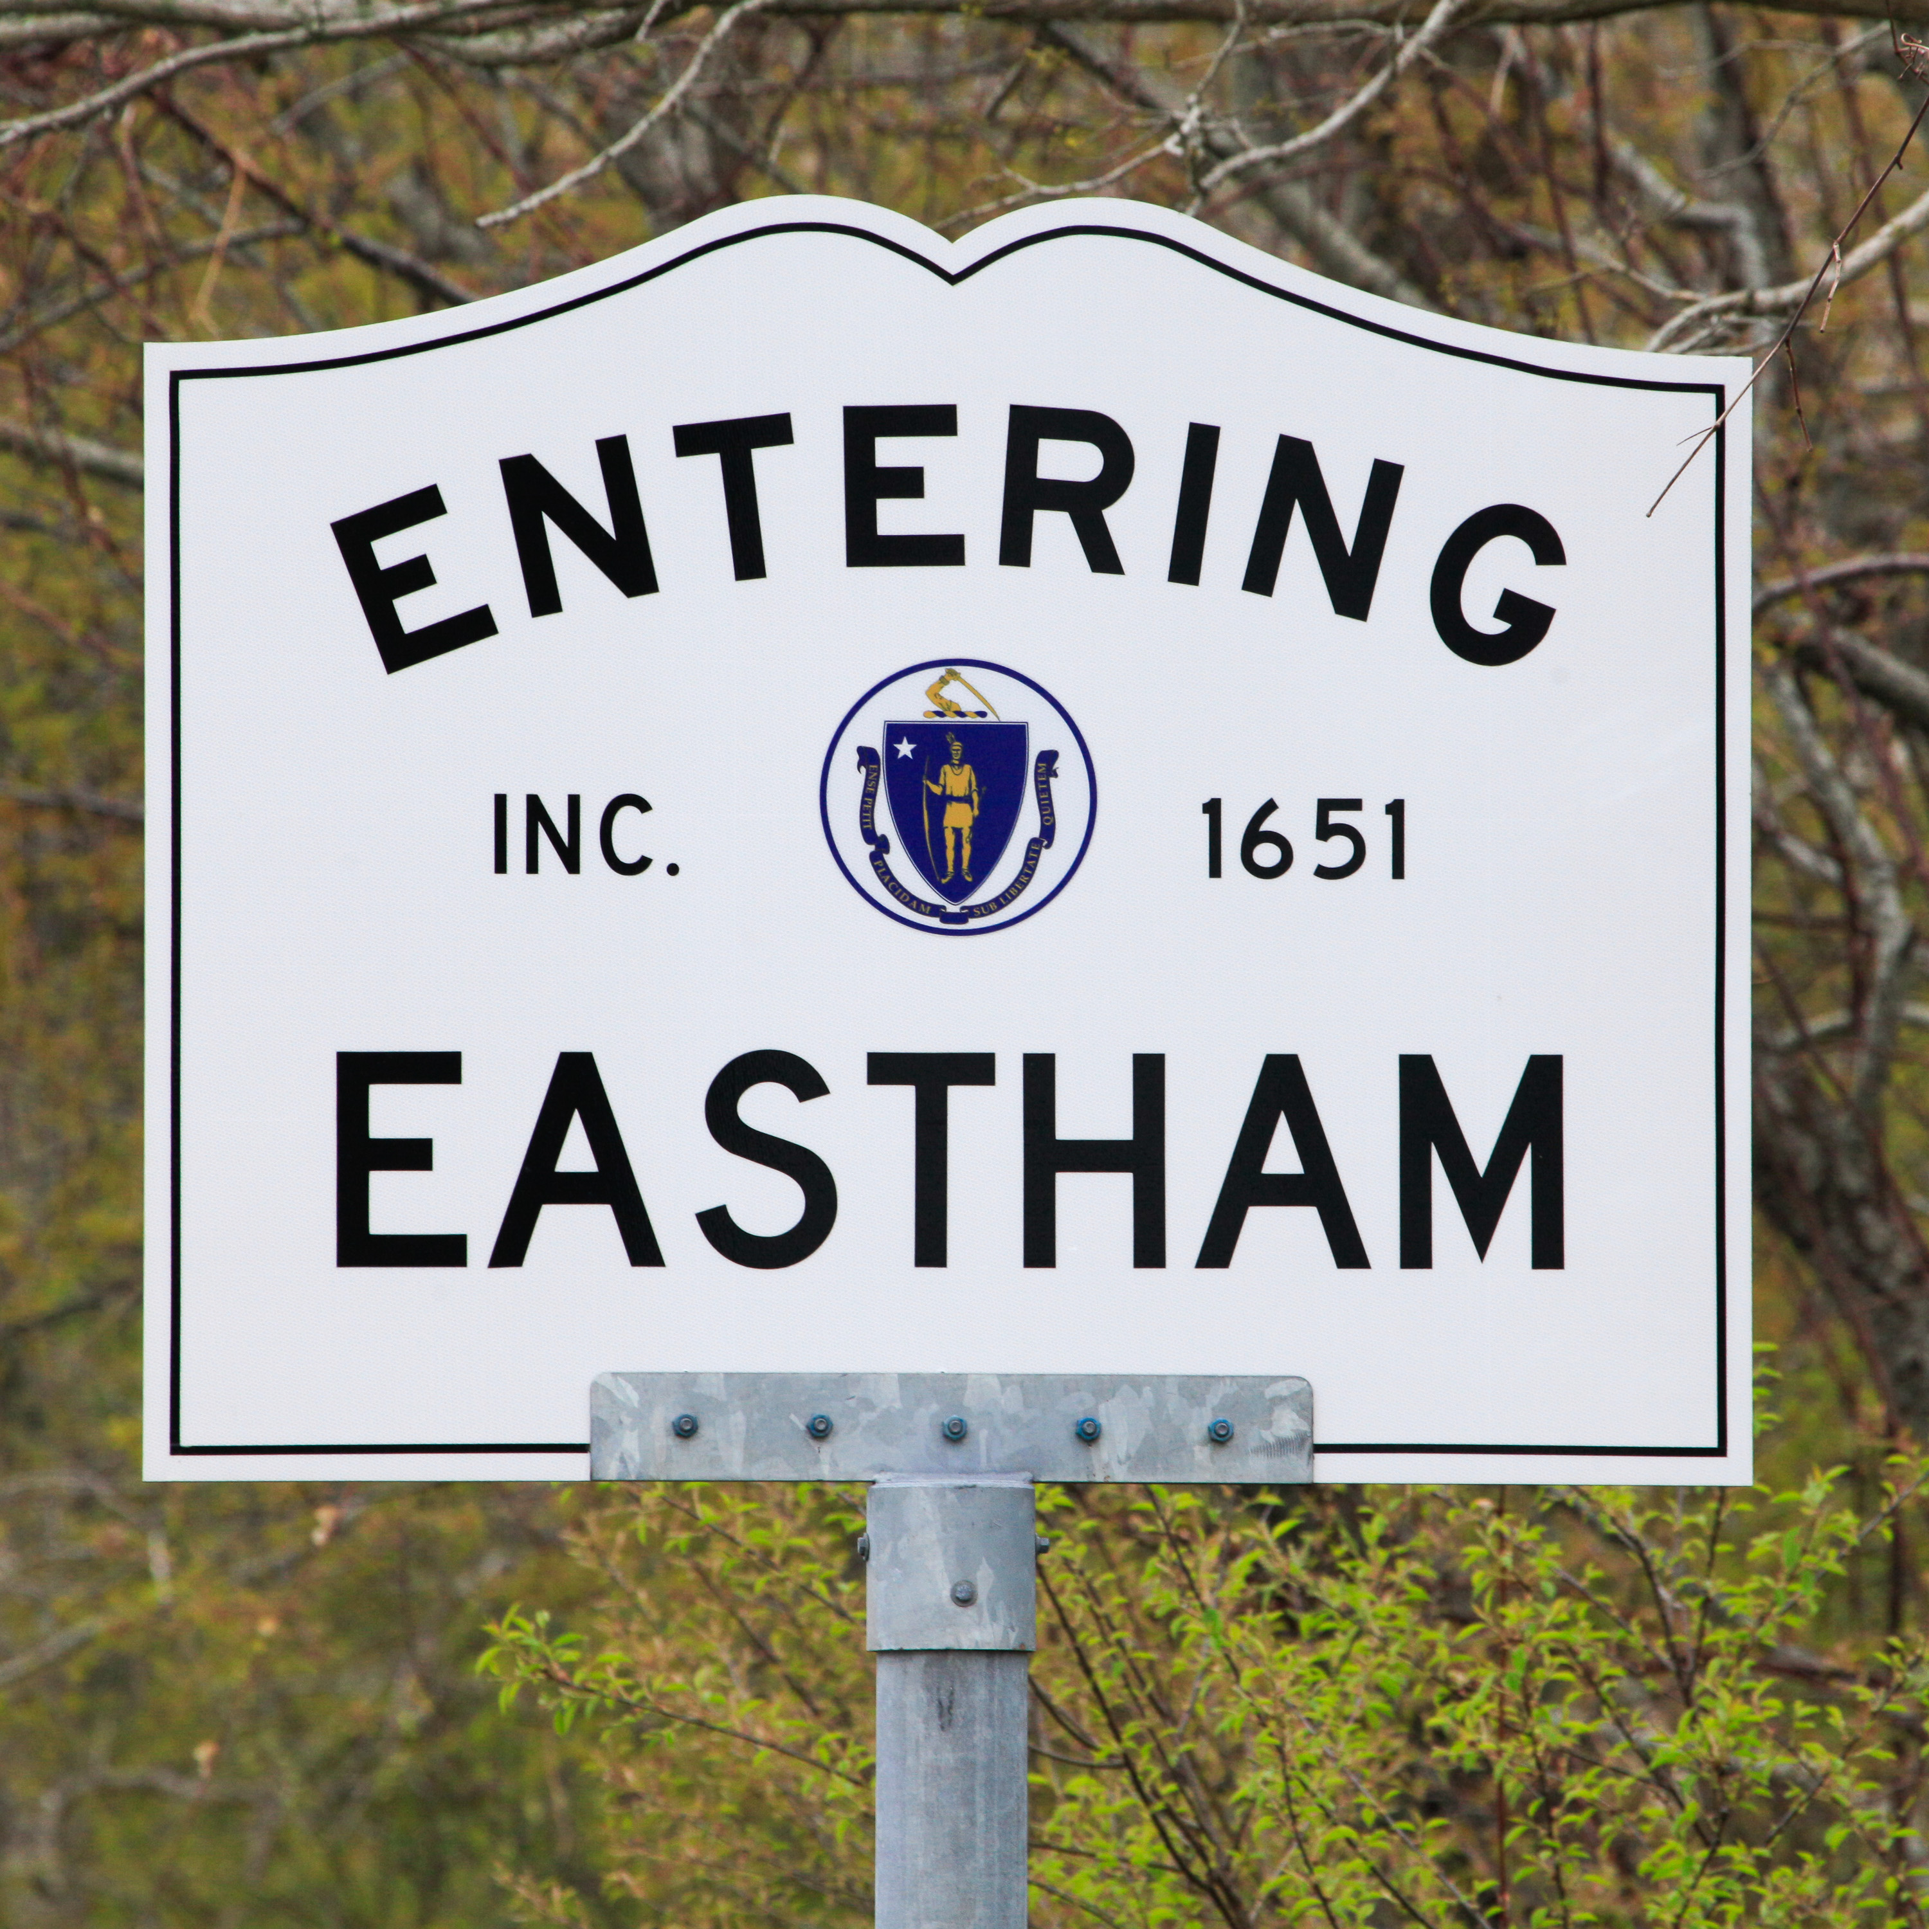
Some Anglo Saxon place names exist today.
Here are some place-name endings and their meaning.
burg, borough = fortified place
den = valley
ea, ey = river
ham = home
holt = thick wood
mere = lake
stow = meeting place
tun = farm
wald = wood
ham = home
worth = fenced land
Investigation
Can you find, towns, cities and villages in the UK, with these words in their name?

Slide 3
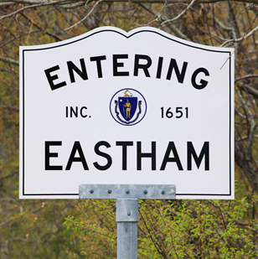
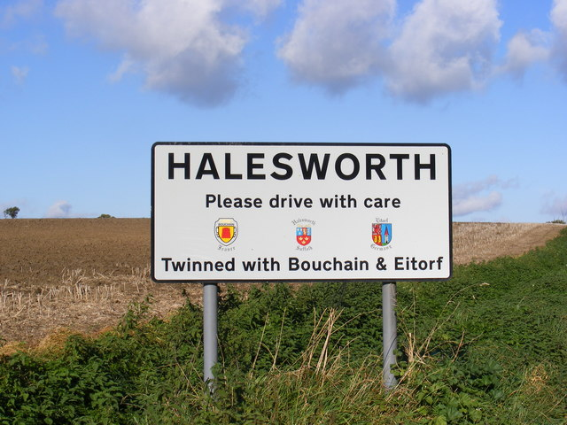
How many can you note down.? Keep a list and bring it to school in January.

