Slide 1
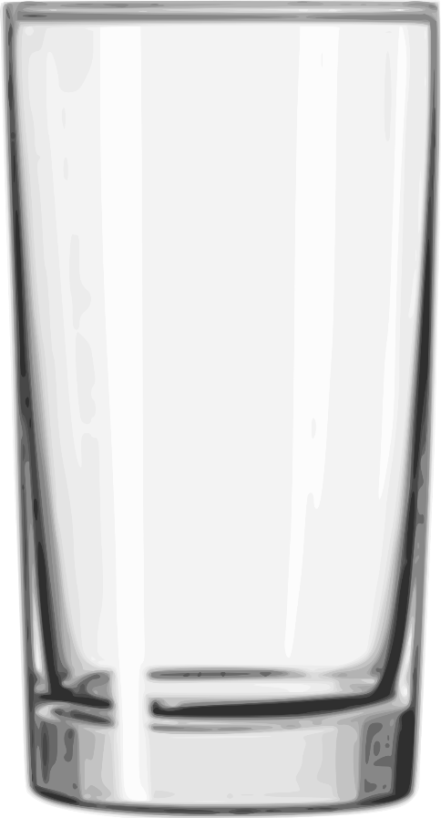
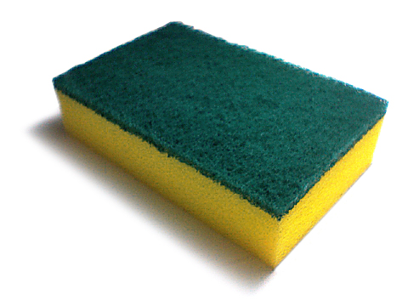
SCIENCE
Are spaces really empty?
Mrs Dewar
Notes:
1

Slide 2
FOCUS
Results
Conclusion

Slide 3
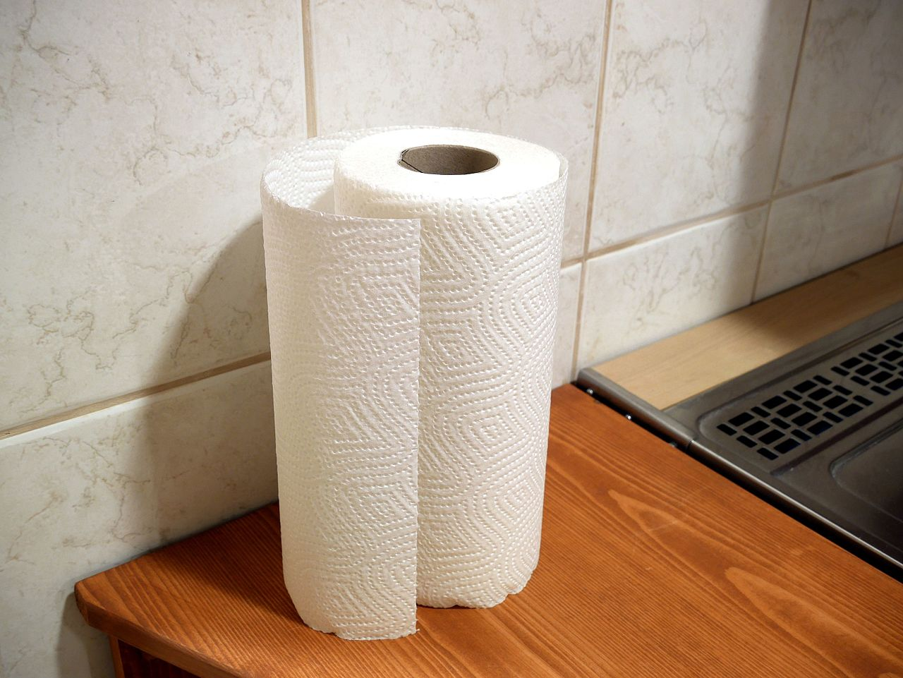
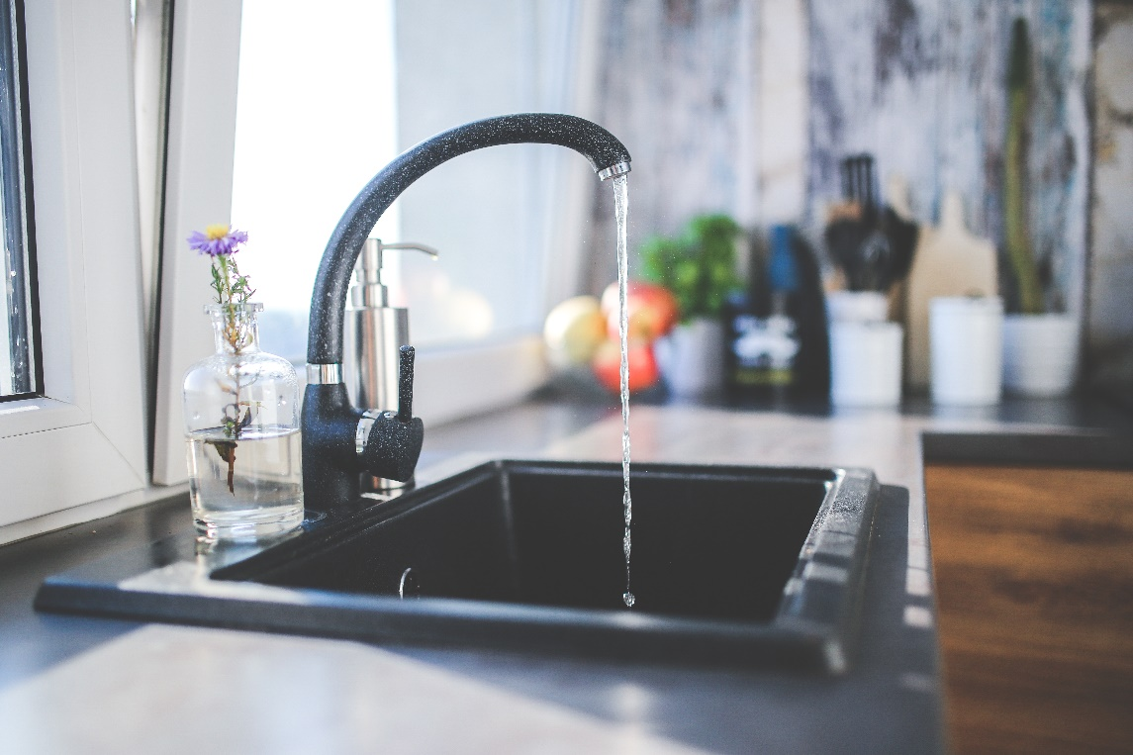
Investigation
If you put the paper towel at the bottom of a cup, turn it upside down and place it in a bowl of water.
What do you think will happen when you lift the cup out? Will the paper towel be wet or dry?

Slide 4
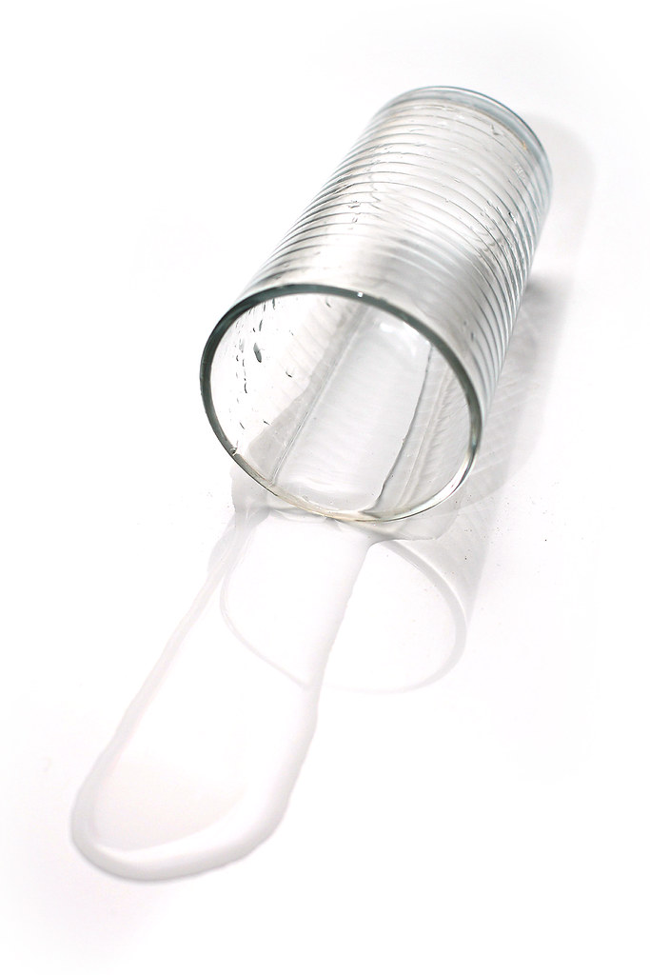
Hypothesis
A sensible GUESS
What will happen? Hypothesis: When the glass is placed under the water the paper towel will…………

Slide 5
Method
You can complete this at home or click below.
THE EXPERIMENT CLICK HERE
Or Both

Slide 6
Results
Write up the result of this investigation
You must include a pencil drawn diagram with labels drawn with a ruler. The glass must be drawn with a ruler and the line of water
You should include two to three sentences to explain what happened, your observations.
Your writing should also be in pencil.

Slide 7
Conclusion
Look back at your hypothesis and restate what you thought would happen and say whether it did or didn’t happen as you suggested. Give your reasons why you think you got the result you did even if it wasn’t the result you expected. You can suggest any changes you would like to make to the experiment or something you would like to go on to investigate next time.
The conclusion must say WHY?
It can be as short as three sentences.

