Slide 1
Aristotle
The arrival of Aristotle the Axolotl

Slide 2
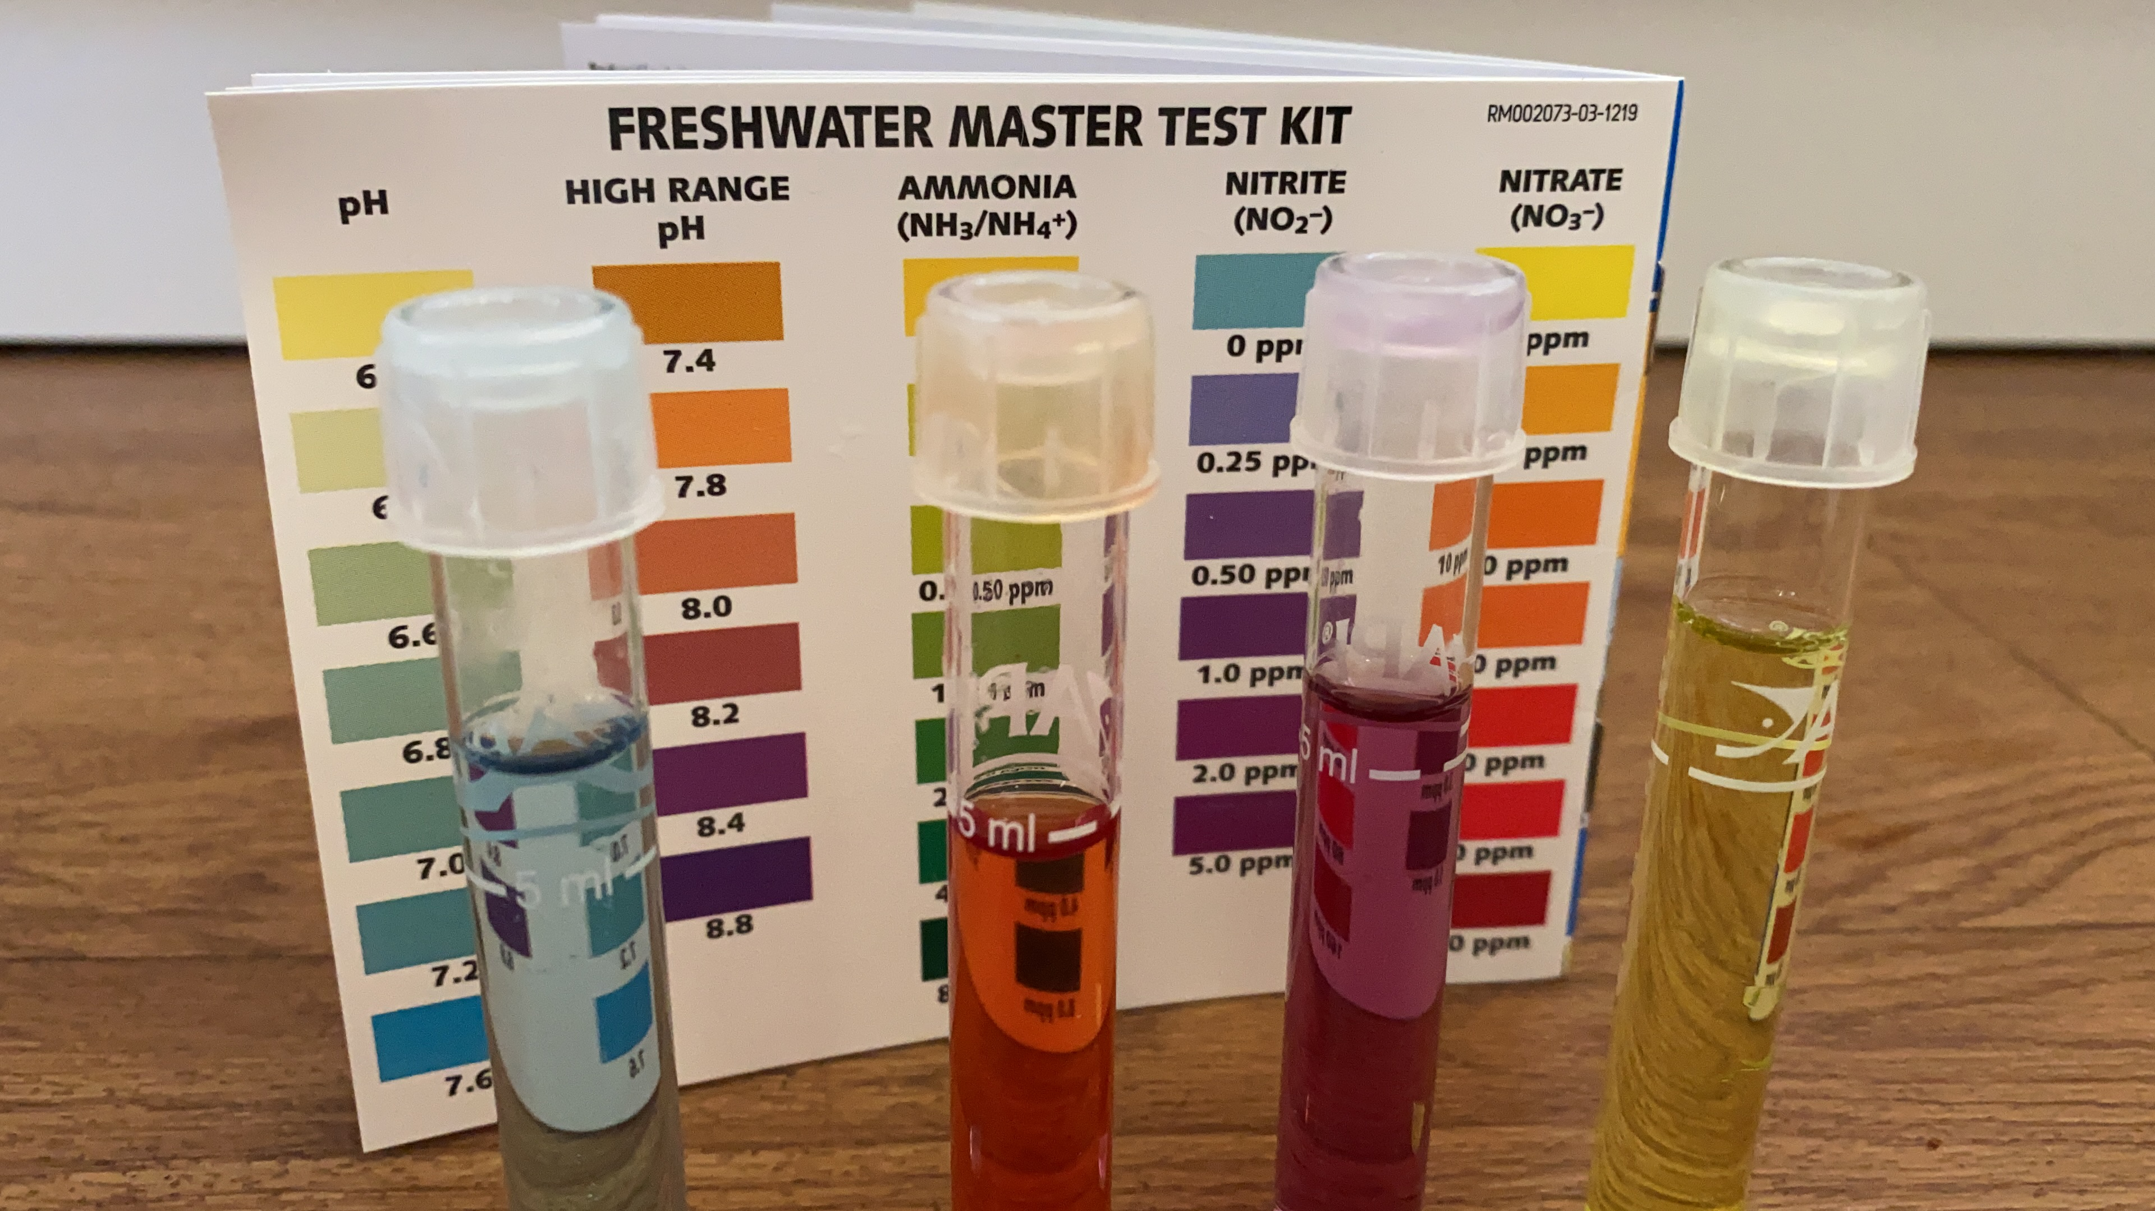

Slide 3
Hello Year 4
At the moment he is very tiny, about 2 to 3cm long. His little ‘Hello Year 4’ message got cut off.
When he arrived the first thing he did was eat.
He can’t go into the tank yet because he is too little, so he is in a plastic tub.
I need to part change the water daily.

Slide 4
Aristotle Settling into his new temporary home.
He will live in this tub until he grows bigger, then he will move to his new tank. He cannot have any gravel on the bottom, or he will eat it. He also can’t have any friends in with him or he will eat them as well.
The red things in the water are blood worm.

Slide 5
This is what Aristotle will look like.
If we take good care of him, this is what he will look like when he grows.
I need volunteers to help me look after him. I will be training up some children to check the water each week. To check the Ph, ammonia and nitrate and nitrite levels. I will need some of you to help clean him out and some to help feed him.
He is our pet, a new member of Year 4.
This Photo by Unknown Author is licensed under CC BY

