Slide 1
RE lesson
Week beginning 18th January 2021

Slide 2
WALT: to know the story of Jesus healing the blind man
Last week I asked you to find out what the definition of a miracle is.
You may have found something like this:
an extraordinary event that is hard to explain how it could have happened, often taken as a sign of the power of God.

Slide 3
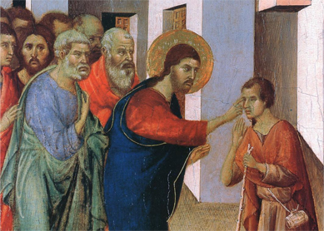
Today we are going to look at one of the miracles that is written about in the Bible. It is a story about a blind man.
This is a very old picture that an artist called Duccio painted of what he thought it might have looked like in about 1311.

Slide 4
The story is told in the New Testament book written by John. It is in the 9th chapter. Here is a version of the story:
9 As he went along, he saw a man blind from birth. ² His disciples asked him, “Rabbi, who sinned, this man or his parents, that he was born blind?”
³ “Neither this man nor his parents sinned,” said Jesus, “but this happened so that the works of God might be displayed in him. ⁴ As long as it is day, we must do the works of him who sent me. Night is coming, when no one can work. ⁵ While I am in the world, I am the light of the world.”
⁶ After saying this, he spat on the ground, made some mud with the saliva, and put it on the man’s eyes. ⁷ “Go,” he told him, “wash in the Pool of Siloam” (this word means “Sent”). So the man went and washed, and came home seeing.
⁸ His neighbours and those who had seen him begging asked, “Isn’t this the same man who used to sit and beg?” ⁹ Some claimed that he was. Others said, “No, he only looks like him.” But he himself insisted, “I am the man.”
¹⁰ “How then were your eyes opened?” they asked. ¹¹ He replied, “The man they call Jesus made some mud and put it on my eyes. He told me to go to Siloam and wash. So I went and washed, and then I could see.”

Slide 5
I have uploaded another version of the story to the Class News page with pictures for you to look at.
The man was blind from birth. He had never seen flowers, trees, the sky or his friends. He wouldn’t have been able to work and would have had to beg for food or money.
When he was healed, the people who knew him were amazed. They didn’t understand how it could have happened. Some people may even have thought that it was a trick and that it didn’t really happen because Jesus wasn’t a doctor and didn’t have any medicine, just some mud and a pool to wash in.

Slide 6
Draw a picture of the man before the miracle and another picture to show him afterwards.
Add speech bubbles to show how he was feeling before and after he was healed.

