Slide 1
Daily Writing Challenge Friday
Mrs Dewar

Slide 2
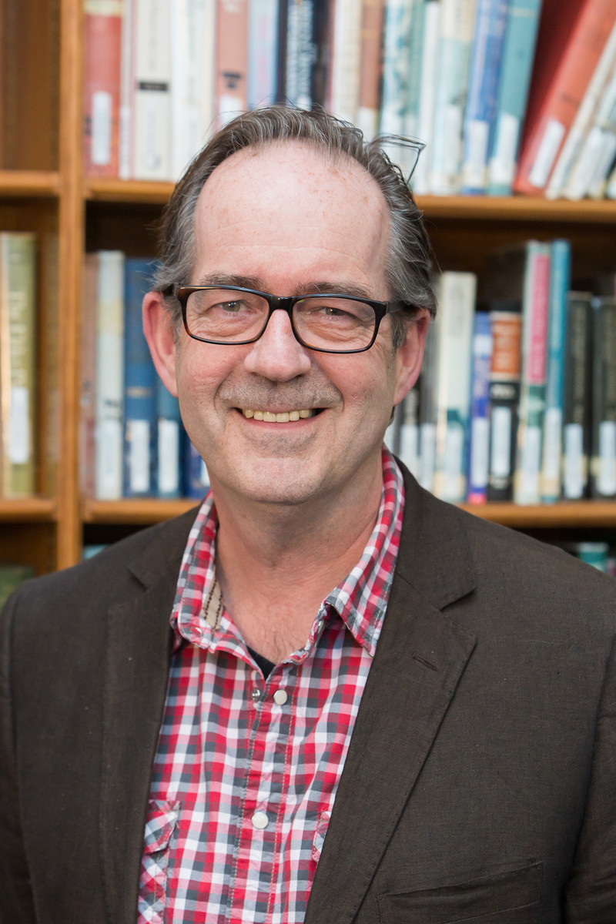
Ross Welford
10 Minute Challenges - authorfy

Slide 3
Ben (my son) had a go at this challenge. I recorded him. I started to write a story about freezing time.

