Slide 1
Week beginning18th January
Adventure story writing 6

Slide 2
WALT: to write an adventure story
Today we are going to use all the work you have already done to piece together a final version of this story.
You can use the writing you did about the setting as well as your paragraphs describing the action sequences.
You may need to add some linking sentences and you will need to organise it into paragraphs.

Slide 3
I have written a version of the beginning, you can continue it…

Slide 4
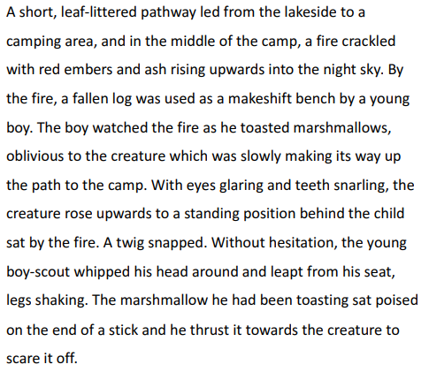

Slide 5
You don’t need to write the opening as today I am more interested in the action sequences.
I am hoping for detailed and descriptive work using a variety of sentence structures and the features we worked on over the last couple of days such as the noun-verb pairs.
Check your work carefully.

