Slide 1
Maths
Friday

Slide 2
Subtracting 2 digit numbers by counting back

Slide 3
Subtracting 2 digit numbers by counting back

Slide 4
Today, you are going to solve some subtraction word problems
Top Tips for solving word problems:
Read the problem carefully
Decide what type of problem it is e.g. is it an addition or subtraction problem?
Write the matching number sentence to go with the problem
Work out the answer
Check your answer carefully

Slide 5
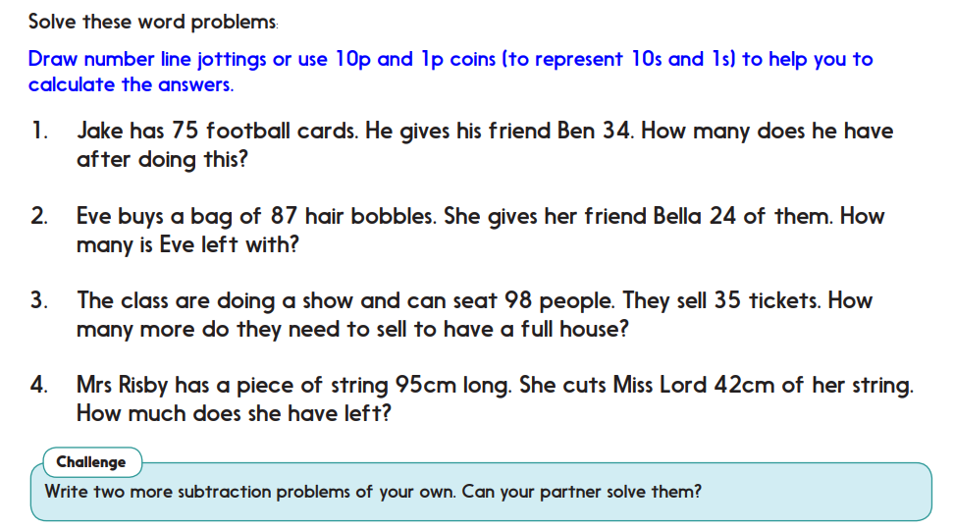
Activity- Can you solve these subtraction word problems?

Slide 6
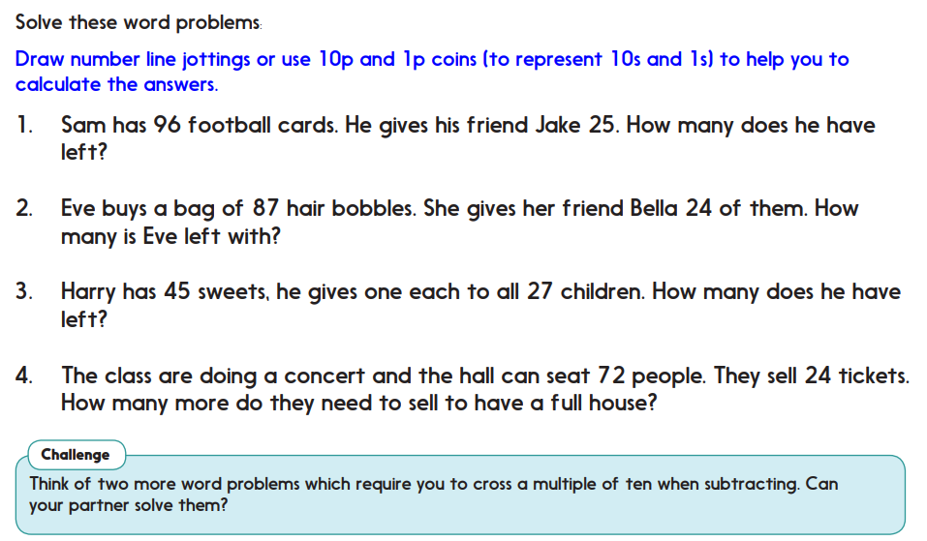
Challenge version if you are feeling confident!

