Slide 1
Friday Maths lesson

Slide 2
WALT: use addition and subtraction to solve problems
You are hopefully feeling confident with expanded column addition and using maths frog to subtract.
So today I am giving you some word problems to solve. You will need to decide whether you need to add or subtract and carry out the appropriate calculation.

Slide 3
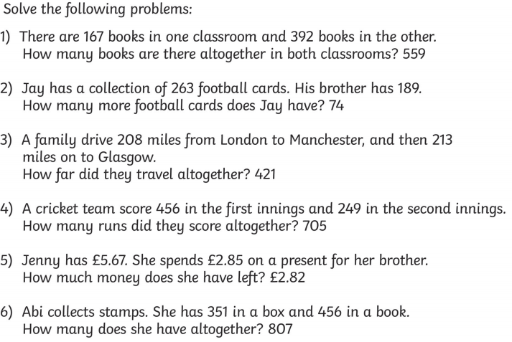

Slide 4
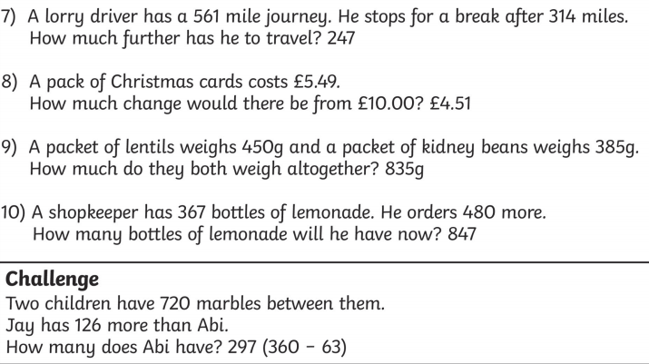

Slide 5
Answers:
559
74
421
705
£2.82
807
247
£4.51
835
847
Challenge: Abi has 297 (360 – 63)

