Slide 1
English Lesson
The Snail and the Whale
Places for the snail to visit

Slide 2
The trip around the world
Yesterday we thought about all the amazing things snail got to see on her trip around the world

Slide 3
Task
Today I would like you to think of 3 places you think snail should visit on her next trip around the world.
It could be places in England or places from a different country.
You are going to be drawing a picture and writing a sentence to describe what you have drawn. It would be great if you could use adjectives.

Slide 4
Examples
Here are some of Miss Horth’s ideas……

Slide 5
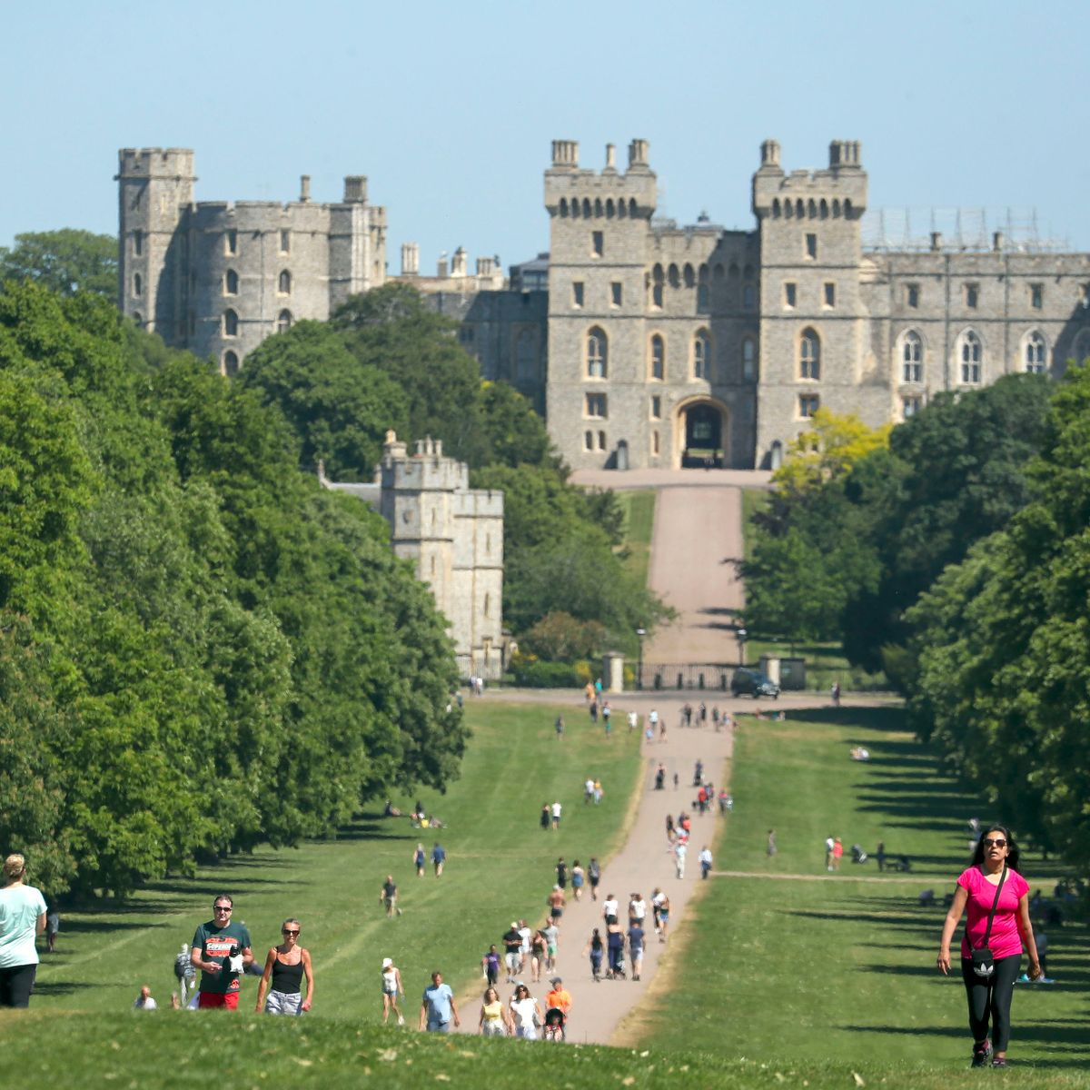
Windsor Castle
Windsor because there
you will get to see an
amazing castle where
the Queen lives.

Slide 6
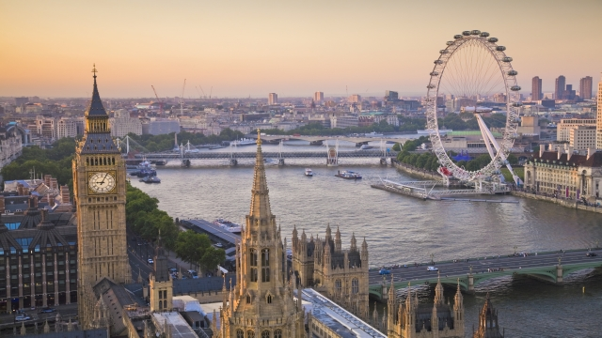
London
London because you can see places like Big Ben and the London Eye.

Slide 7
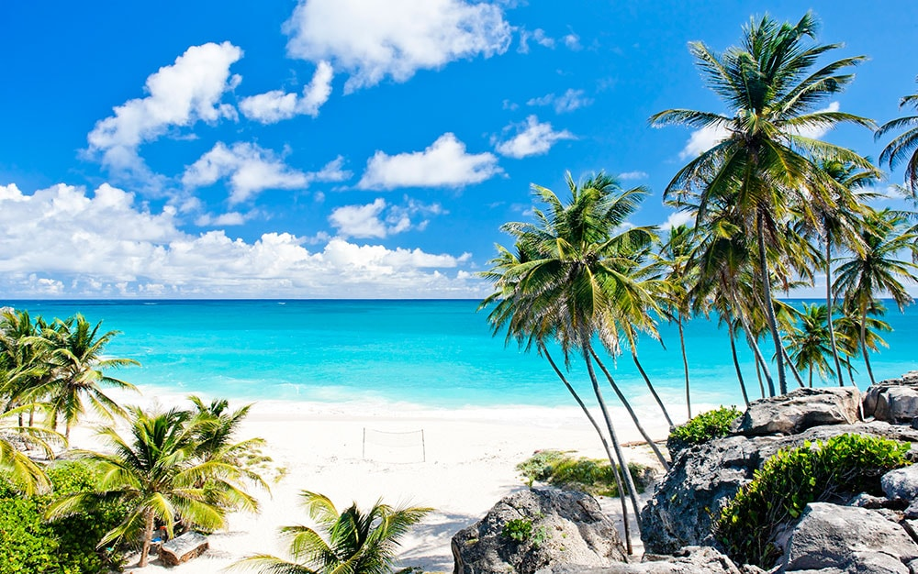
Barbados
Barbados because you will see clear blue sea and golden soft sand.

Slide 8
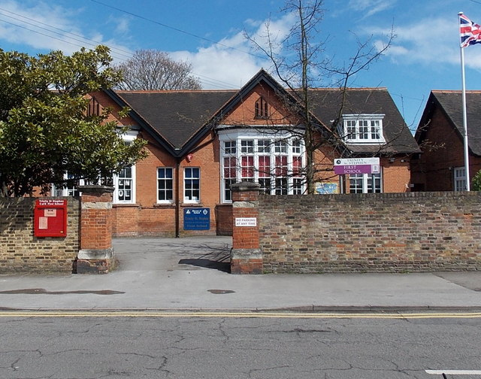
Trinity St Stephens
Trinity St Stephens because it is the best school with lots of lovely children.

