Slide 1
Marcus Rashford
Footballer

Slide 2
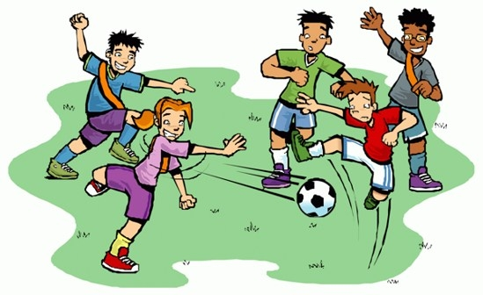
What do you know about football?
Do you like playing or watching football?
Do you have a favourite team that you support?
What can you tell us about football?

Slide 3
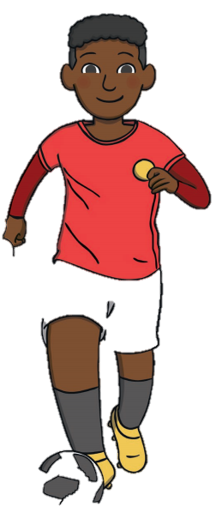
Marcus Rashford
Marcus Rashford is a famous football player
He was born on 31st October 1997. that is the same day as Halloween!
He was born in Manchester

Slide 4

Manchester united
Marcus played football from a young age and played for his first team when he was only 5 years old!
He joined the Manchester united academy and trained with them for many years in order to become a skilful football player

Slide 5
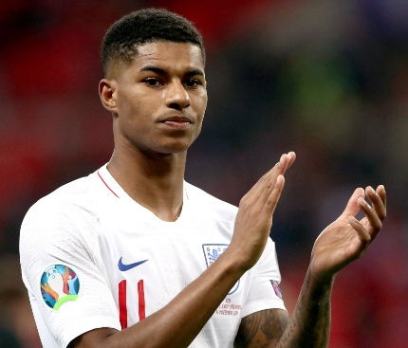
Manchester united
In 2016 Marcus played his first game for Manchester united and he even managed to score 2 goals!
Take a look at Marcus scoring a goal: https://www.youtube.com/watch?v=6IDgx0FDUxg
Marcus now plays matches for both Manchester united and england

Slide 6
Charity work
When Marcus was younger his family did not have much money or food and he often remembers feeling hungry
Since becoming an international footballer Marcus has decided to try and help other people who might be in a similar situation to the one that he was in when he was younger
Marcus has helped to raise money and awareness for a charity that helps to feed people who are hungry https://fareshare.org.uk/

Slide 7
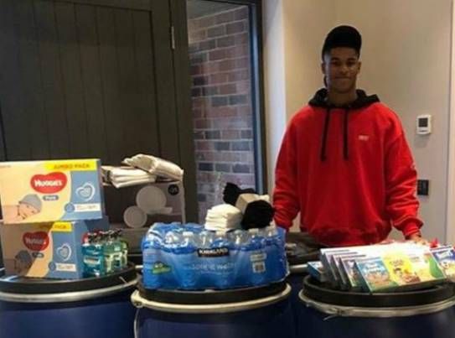
Charity work
On the 15th June 2020 Marcus wrote a letter to the prime minister to encourage him to ensure that over the summer holidays all children were fed and none went hungry
This letter led to the government saying that it would give special vouchers to children so they can still get the food they need

Slide 8
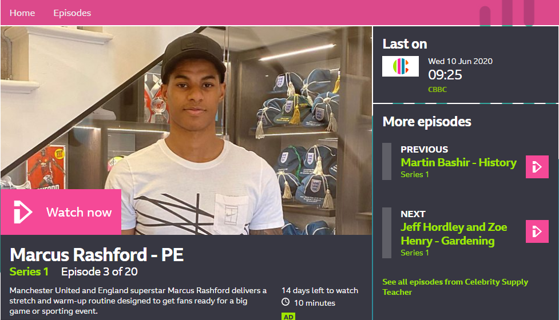
Pe with Marcus!
https://www.bbc.co.uk/programmes/m000jycy

