Slide 1
Megan Rapinoe
Soccer Player

Slide 2
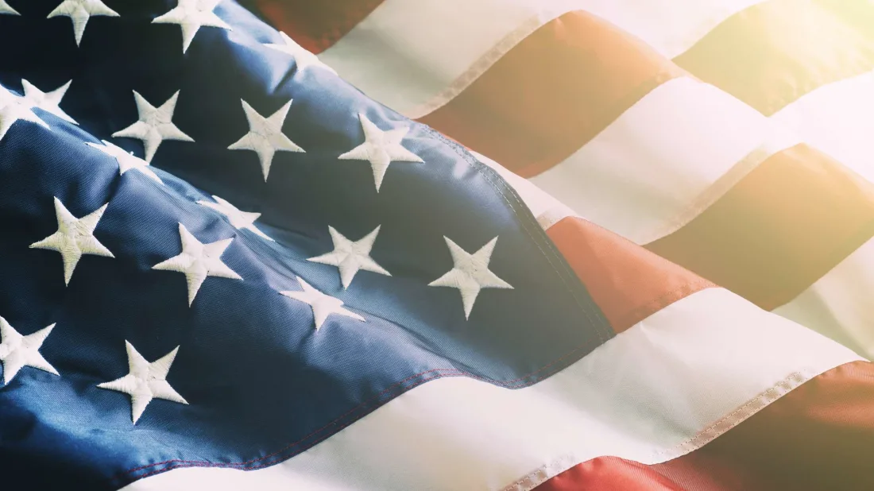
Megan Rapinoe
Megan was born in California in America
Have you ever visited America?
What do you know about America?

Slide 3
Soccer
Megan was inspired to play soccer when she watched her older brother playing
She started to play soccer herself when she was only 3 years old!
Soccer is the name for football in America!

Slide 4
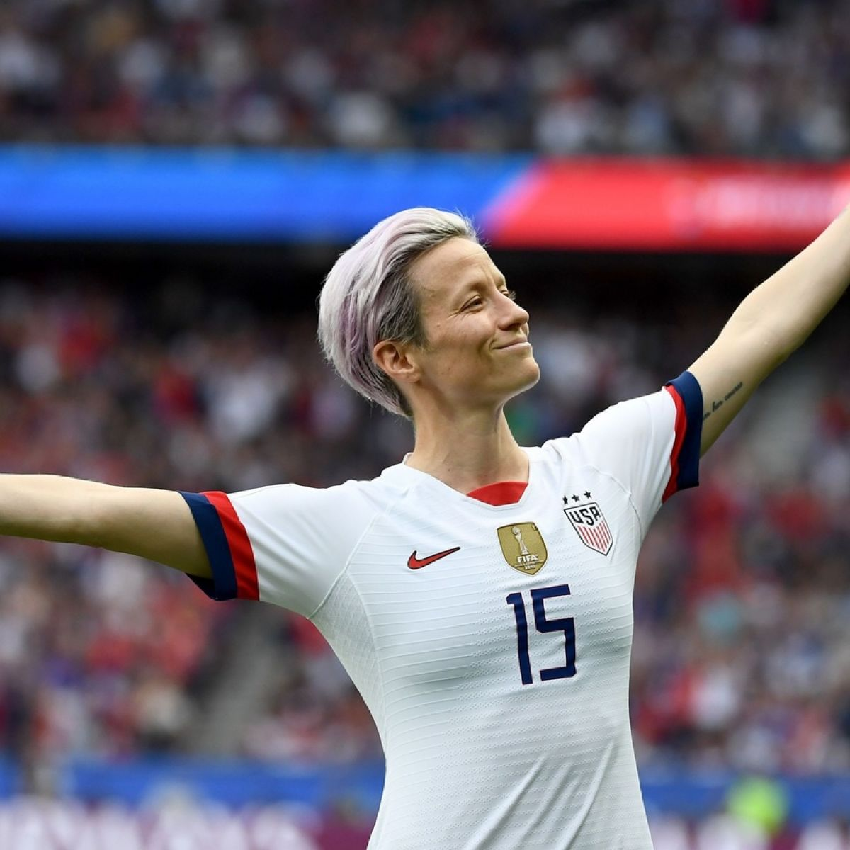
Playing for the USA
Megan first played for the USA Women’s Soccer Team in 2006
Since then she has helped the USA team to win Gold in the 2012 Summer Olympics, 2015 Women’s World cup and the 2019 Women’s World Cup!
Take a look at Megan in action: https://www.youtube.com/watch?v=U94N3ZG2Duw

Slide 5
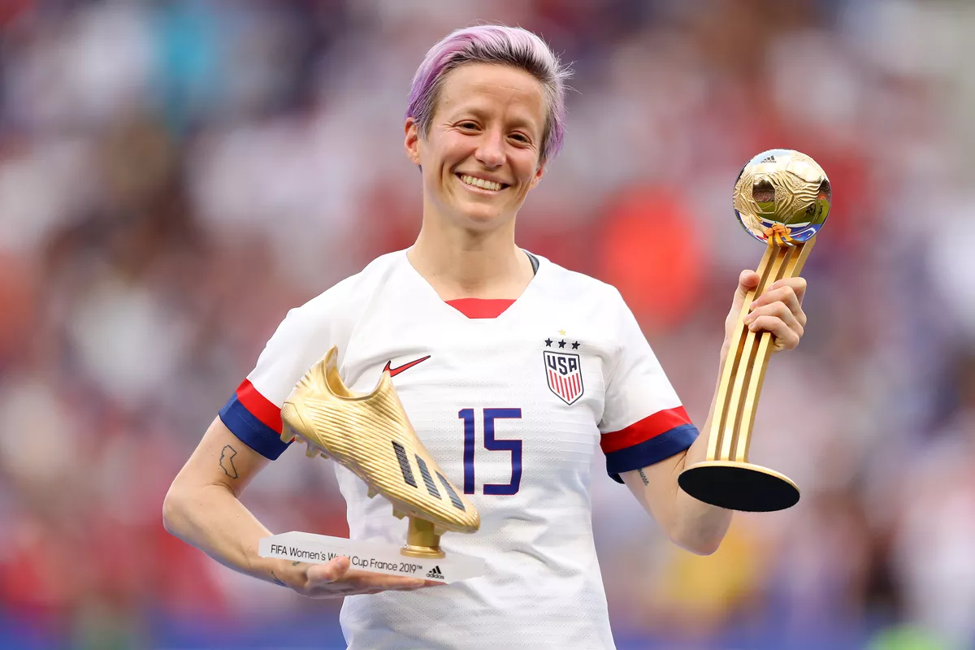
Awards!
Megan is such a talented Soccer player that she has made 158 appearances for the Women’s USA Soccer team and she has score 50 goals!
In 2019 Megan was given the honour of winning ‘The Golden Boot’ which is a special award given to the highest goal scorer in each World Cup

Slide 6
Off the pitch
Megan has a twin sister and together they have set up Rapinoe FC which helps to run soccer clinics for young players

Slide 7
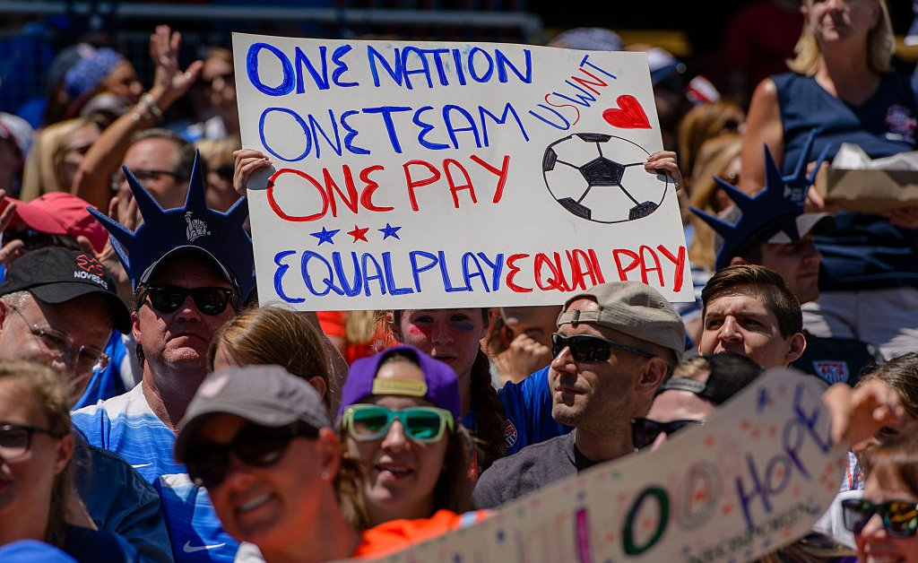
Campaigning
Currently, Megan is spending a lot of her time campaigning for equal pay for the Women’s Soccer team. At the minute the Women’s team are paid a lot less then the Men’s team and Megan thinks that this is unfair.
She has said ‘ We will never stop fighting for EQUALITY!’

Slide 8
Fun Fact!

