Slide 1
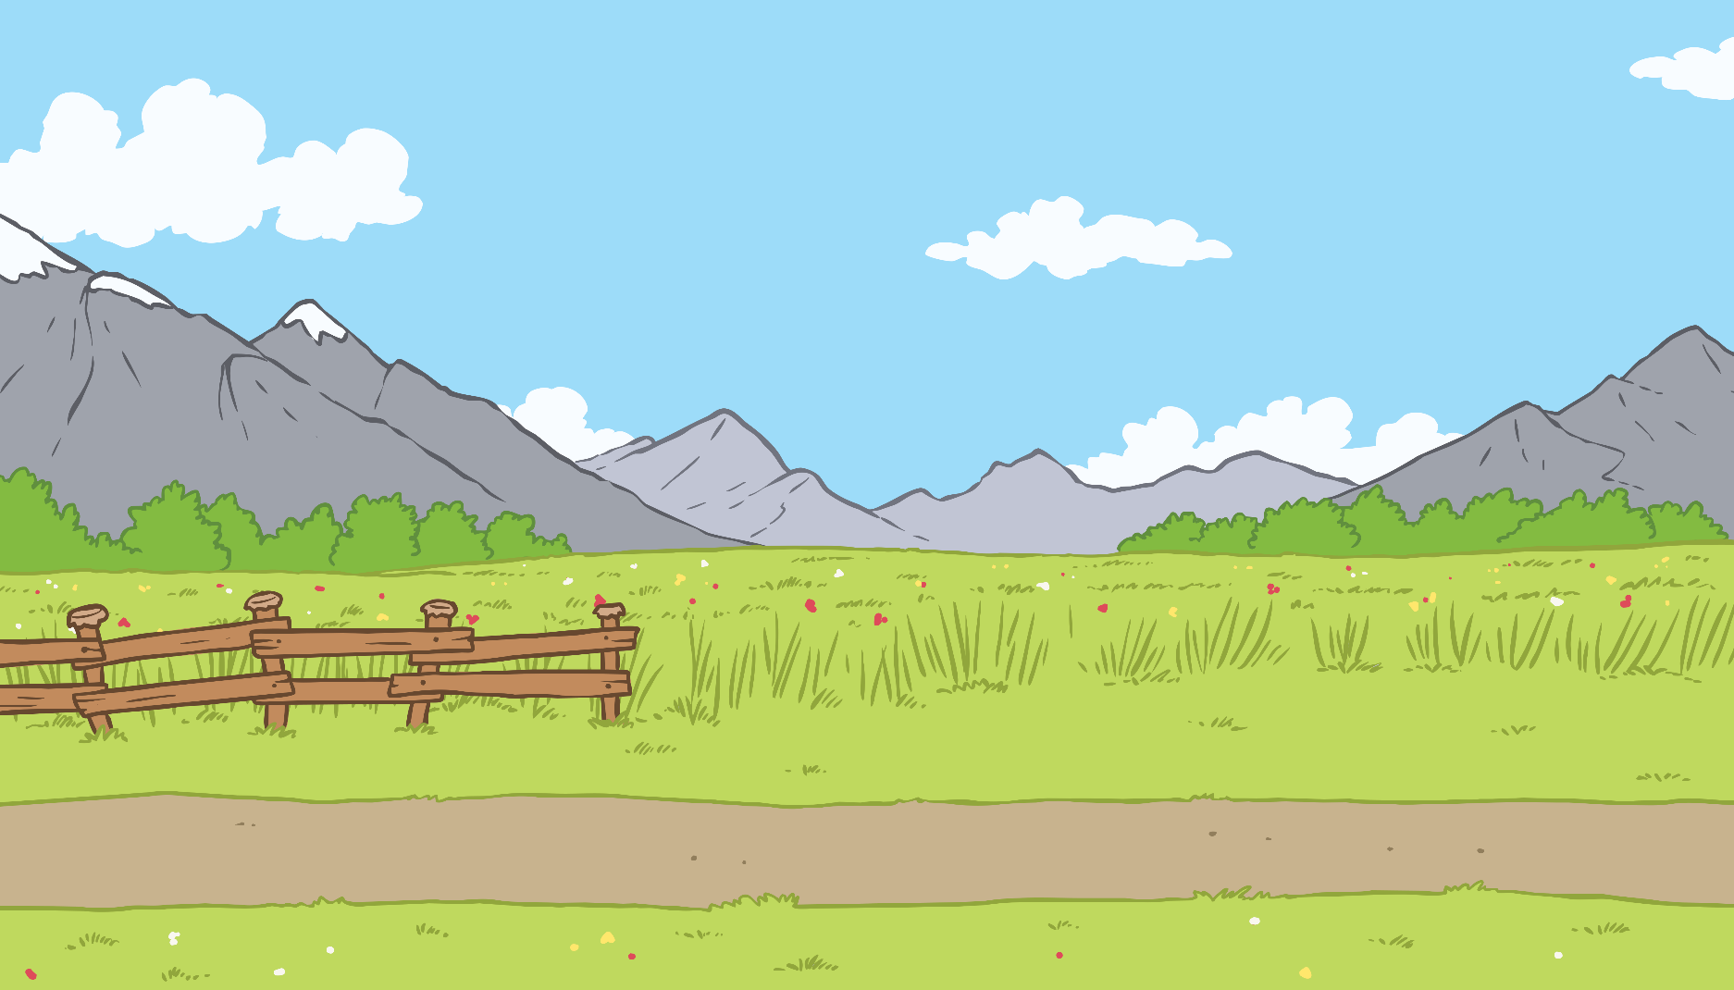
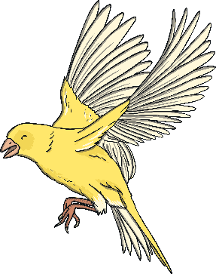
Contents
Day 1
Day 2
Day 3
Day 4
Day 5

Slide 2
Menu
Week 1 Day 1
Number
Put these numbers in order, from smallest to biggest:
12, 7, 5, 10, 18
5, 7, 10, 12, 18
Reveal Answer
Number
Double each of the numbers below. 2 5 4 3
4 10 8 6
Reveal Answer
Number
Write the numbers below in digits.
2 tens and 5 ones 6 tens and 3 ones 1 ten and 9 ones 5 tens and 5 ones
25
63
19
55
Reveal Answer

Slide 3
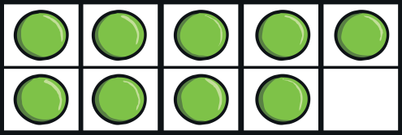
Menu
Week 1 Day 2
Number Draw a ten-frame for the number 9.
Addition
12 + 4 =
16
Reveal Answer
Reveal Answer
Number
Write how many tens and ones each of the numbers have.
12, 46, 52, 99
1 ten and 2 ones, 4 tens and 6 ones, 5 tens and 2 ones, 9 tens and 9 ones
Reveal Answer

Slide 4
Menu
Week 1 Day 3
Addition 5 + 4 =
9
Reveal Answer
Multiplication Draw 5 groups of 4 dots.
How many dots are there altogether?
20
Reveal Answer
Division Draw 5 circles. Share 30 dots between the 5 circles. How many dots are in each circle?
6
Reveal Answer

Slide 5
Menu
Week 1 Day 4
Subtraction 10 – 4 =
6
Reveal Answer
Division Share 14 apples between the two children.
How many does each person get?
7
Reveal Answer
Multiplication 2 × 9 =
18
Reveal Answer

Slide 6
Menu
Week 1 Day 5
Number What bonds with 8 to make 10?
What bonds with 6 to make 10?
What bonds with 1 to make 10?
Number Put these numbers in order, from biggest to smallest:
15, 4, 11, 19, 6, 9
2, 4, 9
19, 15, 11, 9, 6, 4
Reveal Answer
Reveal Answer
Addition Use your knowledge of doubles to answer these questions. 7 + 8 = 6 + 5 = 8 + 9 =
15, 11, 17
Reveal Answer

