Slide 1
Maths
Monday

Slide 2
Adding numbers using number facts to help us

Slide 3
Adding numbers using place value

Slide 4
Selecting the best method in order to solve each addition quickly

Slide 5
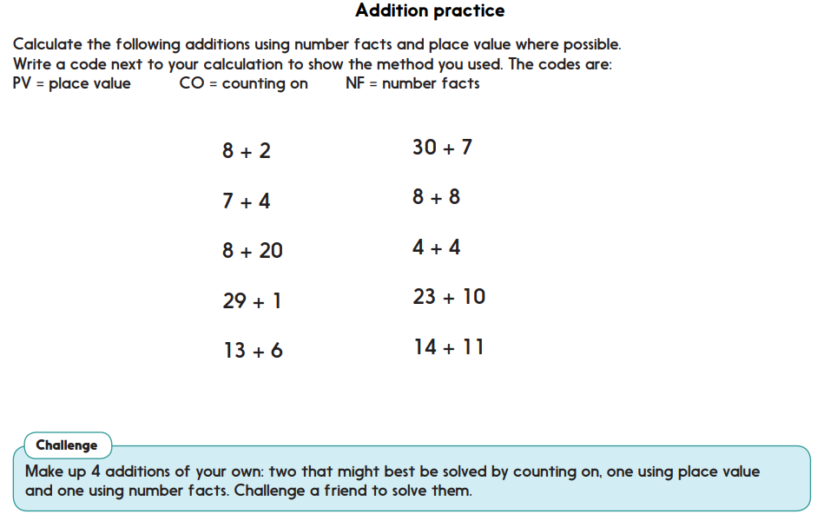
Activity- Can you solve these?

Slide 6
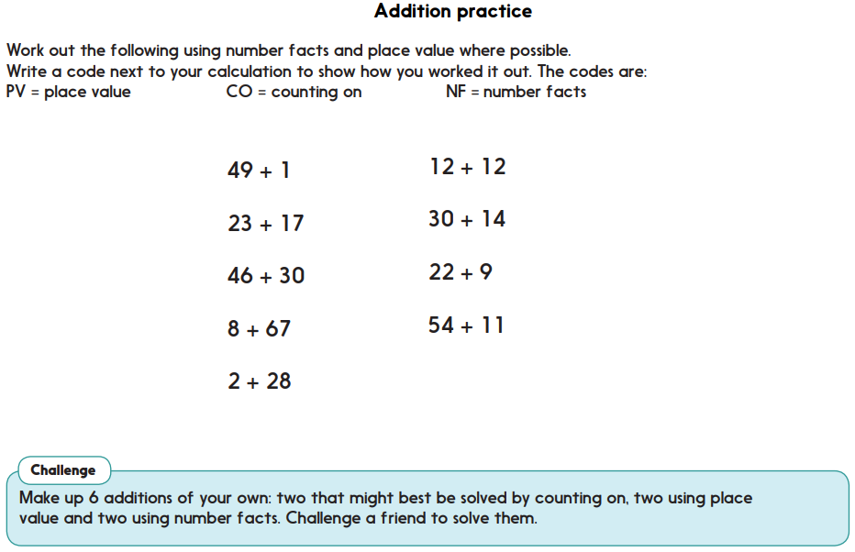
Challenge- if you are looking for more of a challenge you could try and solve these ones instead

