Slide 1
Year 4 – Spring Block 2 – Speech
WALT: Punctuate Direct Speech
© Classroom Secrets Limited 2019

Slide 2
What do I want to see?
Open speech marks.
Capital letter.
Punctuation.
Speech marks.
New speaker new line.

Slide 3
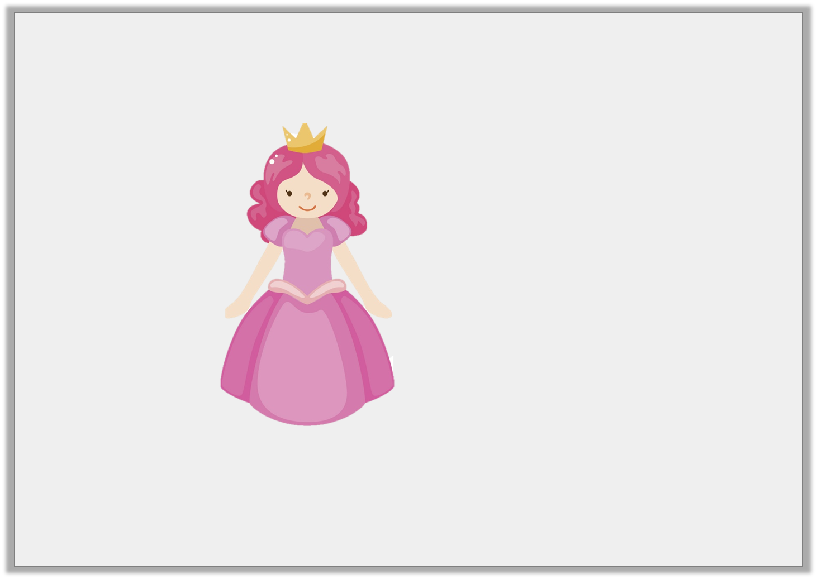
Introduction
Which words should be in the speech bubble?
Cinderella exclaimed, “Now I can go to the ball!”
© Classroom Secrets Limited 2019

Slide 4
Introduction
Which words should be in the speech bubble?
Now I can go to the ball!
Cinderella exclaimed, “Now I can go to the ball!”
© Classroom Secrets Limited 2019

Slide 5
Varied Fluency 1
Circle the missing or incorrect punctuation in this sentence:
“ Mother said, Don’t talk to any strangers!”
© Classroom Secrets Limited 2019

Slide 6
Varied Fluency 1
Circle the missing or incorrect punctuation in this sentence:
“ Mother said, Don’t talk to any strangers!”
Mother said, “Don’t talk to any strangers!”
© Classroom Secrets Limited 2019

Slide 7
Varied Fluency 2
Tick the sentence that has been punctuated correctly.
The wolf asked, “where are you going little girl?”
Little Red Riding Hood replied, “I am going to visit my grandmother.”
© Classroom Secrets Limited 2019

Slide 8
Varied Fluency 2
Tick the sentence that has been punctuated correctly.
The wolf asked, “where are you going little girl?”
Little Red Riding Hood replied, “I am going to visit my grandmother.” |  | ✓
© Classroom Secrets Limited 2019

Slide 9
Varied Fluency 3
Tick where the inverted commas should go.
Dear Grandmother, what big ears you have!
exclaimed Little Red Riding Hood.
© Classroom Secrets Limited 2019

Slide 10
Varied Fluency 3
Tick where the inverted commas should go.
✓
✓
Dear Grandmother, what big ears you have!
exclaimed Little Red Riding Hood.
© Classroom Secrets Limited 2019

Slide 11
Varied Fluency 4
Punctuate these sentences:
little red riding hood cried what big eyes you have
the wolf replied all the better to see to you with my dear
© Classroom Secrets Limited 2019

Slide 12
Varied Fluency 4
Punctuate these sentences:
little red riding hood cried what big eyes you have
Little Red Riding Hood cried, “What big eyes you have!”
the wolf replied all the better to see to you with my dear
The wolf replied, “All the better to see you with my dear.”
© Classroom Secrets Limited 2019

Slide 13
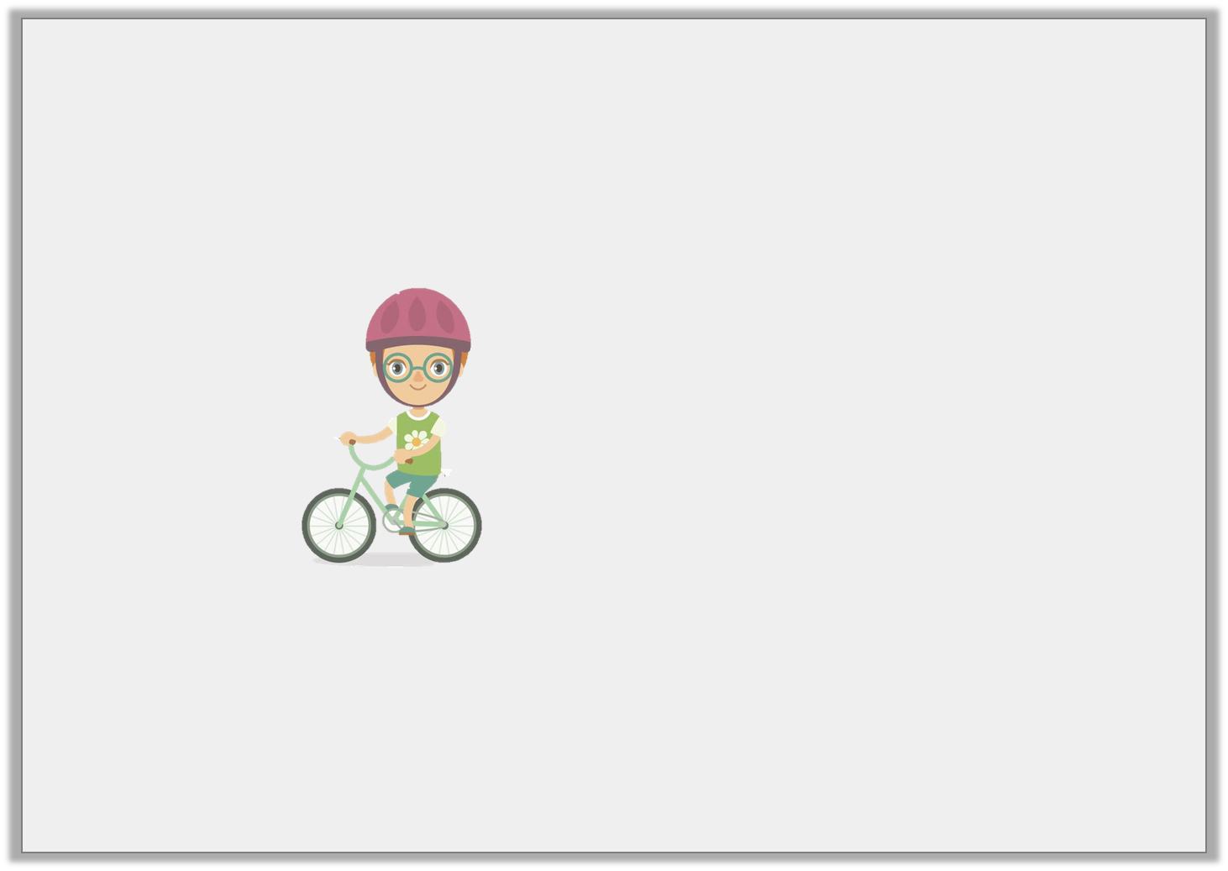
Application 1
Change the speech bubble into a sentence with direct speech.
I’m going to ride to the park.
© Classroom Secrets Limited 2019

Slide 14
Application 1
Change the speech bubble into a sentence with direct speech.
Various possible answers, for example:
Freddy said, “I’m going to ride to the park.”
I’m going to ride to the park.
© Classroom Secrets Limited 2019

Slide 15
Application 2
Complete the sentences using direct speech. Make sure they are punctuated correctly.
The boy asked….
…… shouted the police officer.
The man said….
© Classroom Secrets Limited 2019

Slide 16
Application 2
Complete the sentences using direct speech. Make sure they are punctuated correctly.
Various possible answers, for example:
The boy asked, “Can I play out?”
“STOP!” shouted the police officer.
The man said, “I’m going to buy a newspaper.”
© Classroom Secrets Limited 2019

Slide 17
Reasoning 1
Amy has written a sentence. Is it correct? Explain your answer.
Tom said “I must read my book before I go to bed.
© Classroom Secrets Limited 2019

Slide 18
Reasoning 1
Amy has written a sentence. Is it correct? Explain your answer.
Tom said “I must read my book before I go to bed.
It is not correct because…
© Classroom Secrets Limited 2019

Slide 19
Reasoning 1
Amy has written a sentence. Is it correct? Explain your answer.
Tom said, “I must read my book before I go to bed.”
It is not correct because:
the comma after the reporting clause is missing
the inverted commas to mark the end of the direct speech are missing
© Classroom Secrets Limited 2019

