Slide 1
Reception Maths
Monday
We are learning to talk
I am learning to talk about size to compare quantities and objects and solve problems objects to solve problems

Slide 2
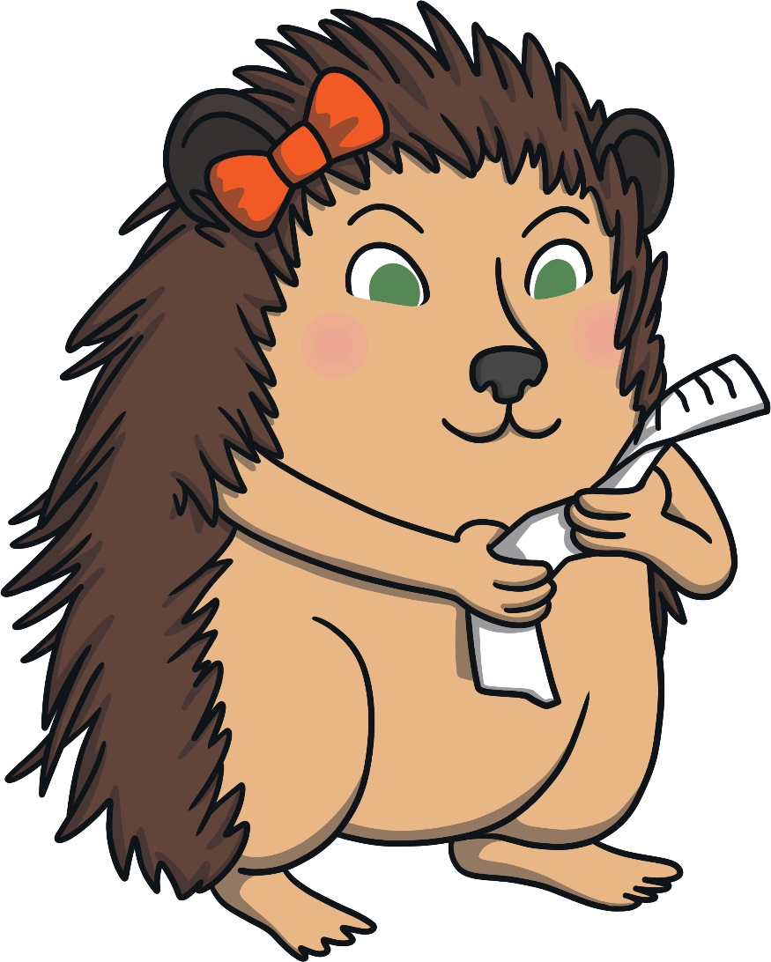
Holly Hedgehog is going on a nature trail. She has written a list of all the things she hopes to find.
Can you help her?
Go!

Slide 3
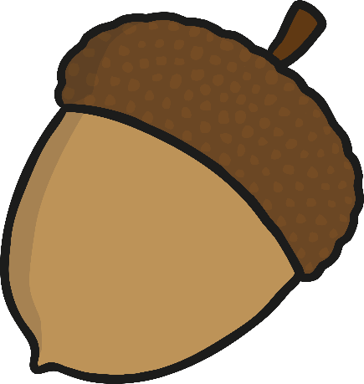
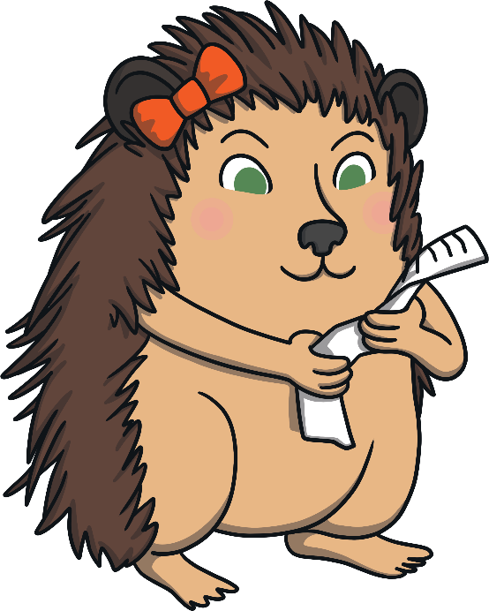
The first thing on Holly’s list is something big.
Which acorn should I pick? Which one is big?
Well done! You picked the big acorn.
Try again
Correct!

Slide 4
The next thing on Holly’s list is something small.
Great job! You picked the small leaf.
Which leaf is small? Which one should I pick?
Try again
Correct!

Slide 5
Holly has found two wiggly worms.
I love wiggly worms. Which one of these worms is long?
Well done! This is the long worm.
Try again
Correct!

Slide 6
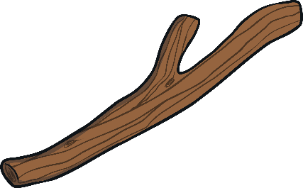
Holly is nearly at the end of her nature trail. Before she goes home, can you help her to find something short?
Which one of these sticks is short?
You are a star! Thank you for finding the short stick.
Try again
Correct!

Slide 7
Today’s challenge:
I want you with the help of a grown up measure out cereal for daddy (big bowl), mummy (medium bowl), child (small bowl). Put the correct spoon with the correct bowl.
I would like you to write labels on each: small, medium, big.
Please take photos.

