Slide 1
Reception Writing
Monday

Slide 2
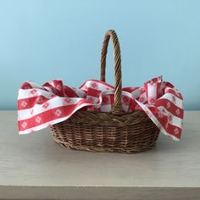
Make a basket for Little Red Riding Hood and then make a list
What materials could you use?
Do you have a picnic basket at home? Perhaps you could decorate it and make a picnic with your mums and dads.
Have fun ☺

Slide 3
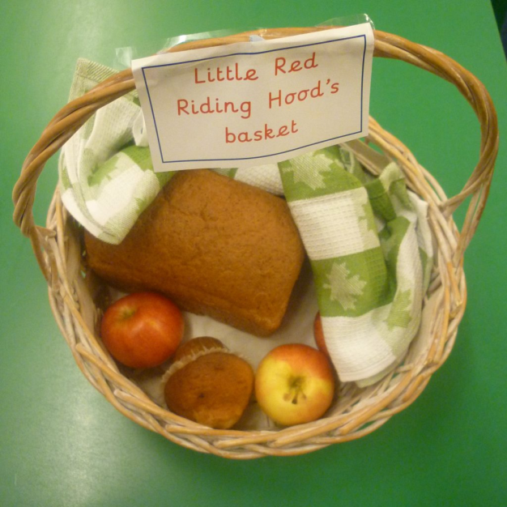
Can you write a list?
What’s inside Little Red Riding Hood’s basket for her Grandma?
1.Muffins
2. Apples
3. bread
4.jam
5. sandwich

