Slide 1
RE
Friendship
What does a good friend look like?

Slide 2
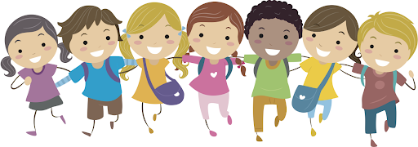
Do you think you need friends?
Why?

Slide 3
We are going to think about what a good friend does and does not do.
I am going to show you some pictures on the next few slides
Decide if what they are doing is being a good friend or not being a good friend

Slide 4
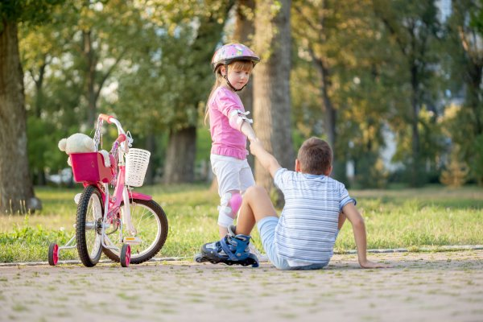
Does a good friend help you?

Slide 5
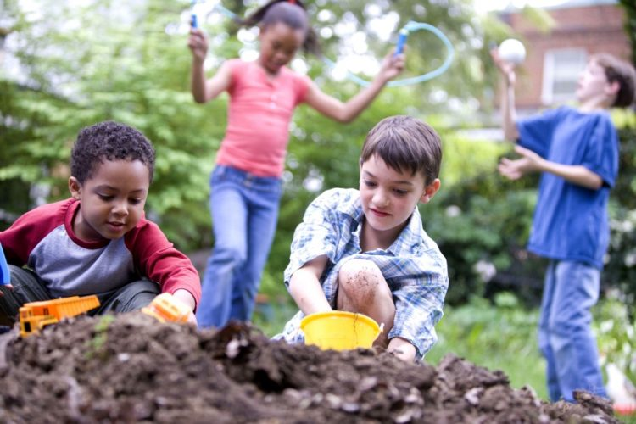
Does a good friend play with you?

Slide 6
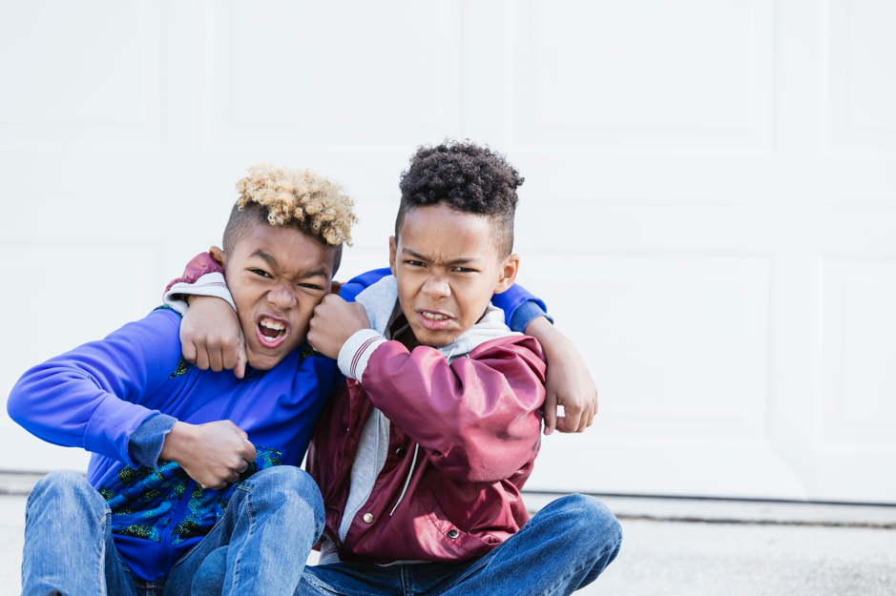
Does a good friend hurt you?

Slide 7
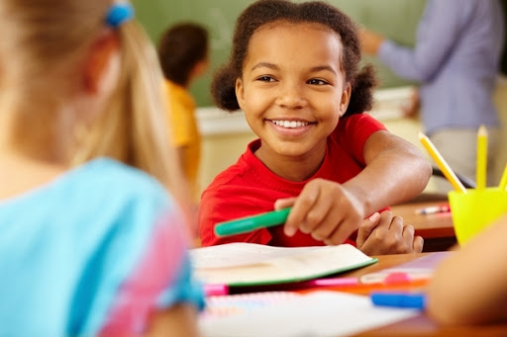
Does a good friend share with you?

Slide 8
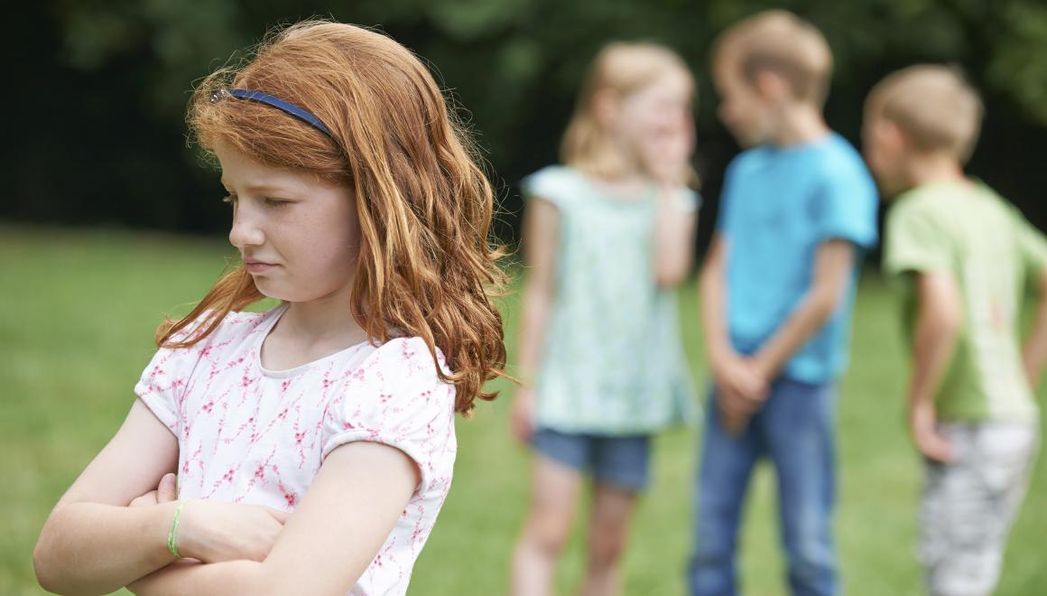
Does a good friend leave you out?

Slide 9
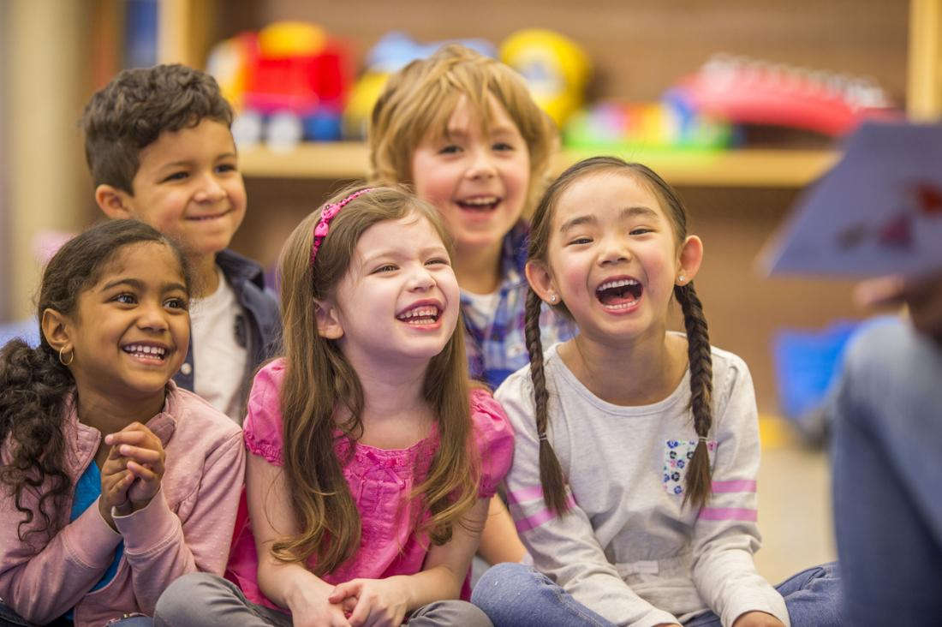
Does a good friend make you happy?

Slide 10
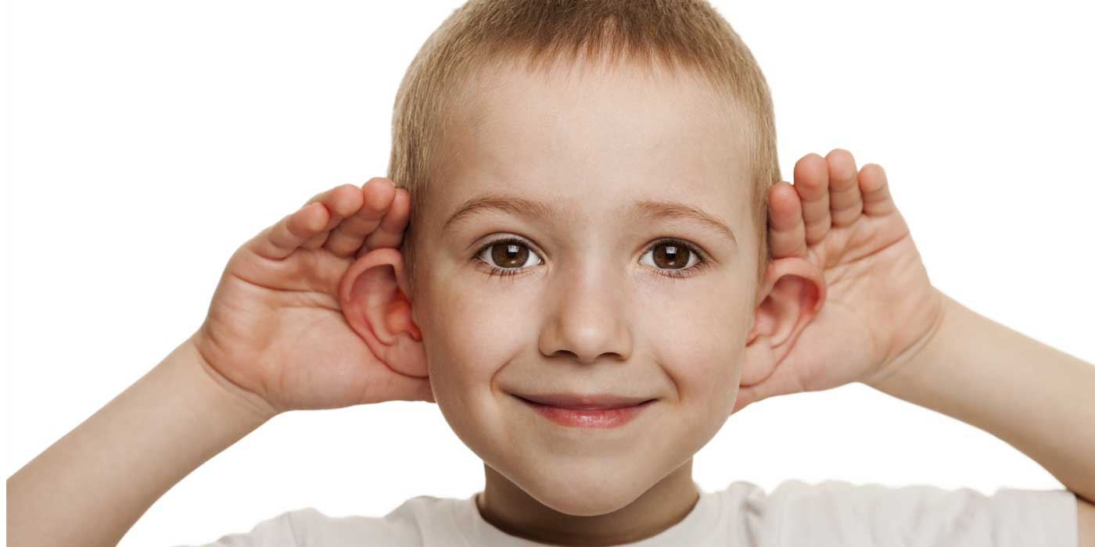
Does a good friend listen to you?

Slide 11
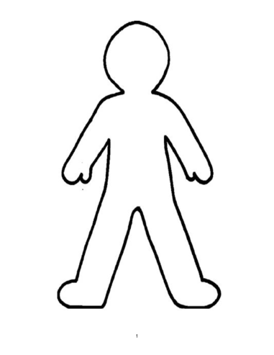
Task
I would like you to use my ‘person’ template or create your own.
You are going to make yourself and think of one way you are going to be a good friend.
I would like you to write your idea on your ‘person’ template
Eg “I will listen to my friends”
“I will look after my friends if they are hurt”

