Slide 1
Sarah Storey
Paralympian

Slide 2
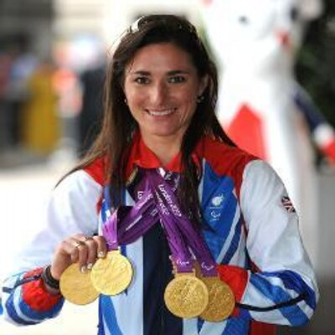

Slide 3
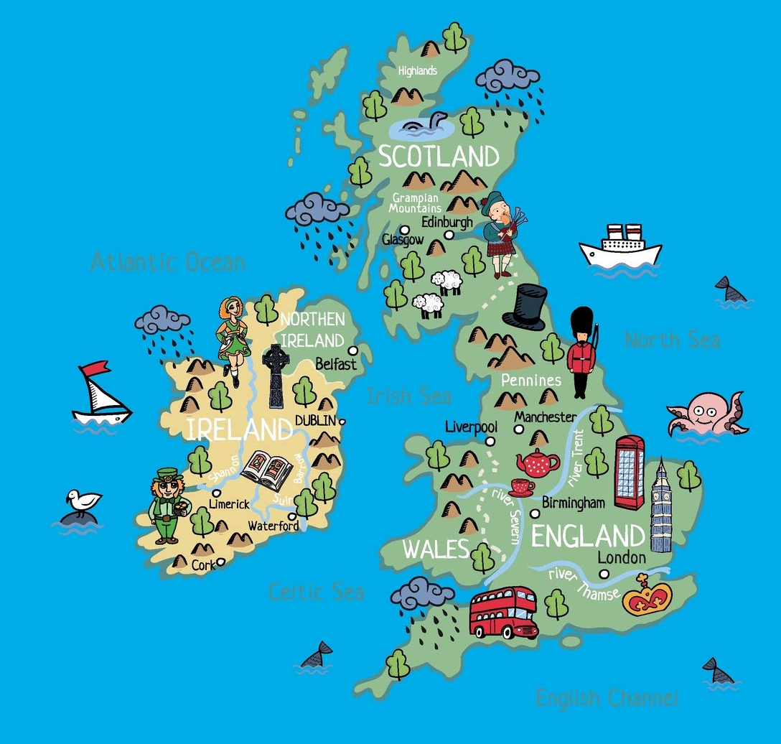
Sarah Joanne Storey
Sarah Storey was born on the 26th October 1977
She was born in Manchester in the UK
When Sarah was born she was born with a left hand that did not function but she has never let that stop her from doing things!

Slide 4
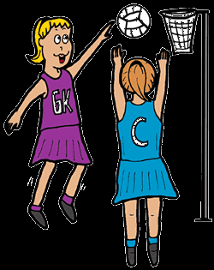
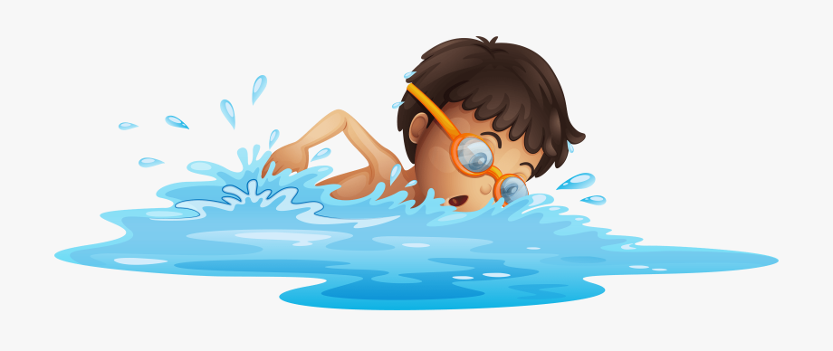
When Sarah was younger she enjoyed playing lots of sports including netball, table tennis and swimming!
Do you enjoy playing sport? What sports do you like to play?

Slide 5
Swimming
Sarah began her Paralympian career as a professional swimmer.
She competed in her first Paralympic Games when she was only 14 years old!
She competed at 4 different Paralympic Games as a swimmer and won a total of 5 Gold medals, 8 Silver medals and 3 Bronze medals.

Slide 6
Cycling
Sarah changed from being a professional swimmer to a professional cyclist when she 27 years old.
She did this because she kept getting bad ear infections from swimming!
Since then she has competed in 3 more Paralympics as a cyclist and has gone on to win 9 more Gold Medals!

Slide 7
Cycling
Take a look at Sarah winning her most recent Gold Medal in the Rio Paralympics:
https://www.youtube.com/watch?v=n5Xo31w7SpM
This means that with a grand total of 14 Gold medals she has become Britain's most successful female Paralympian ever!
Sarah has not stopped yet though! She is hoping to compete in the next Paralympic Games in Tokyo next year. Good Luck Sarah!

Slide 8
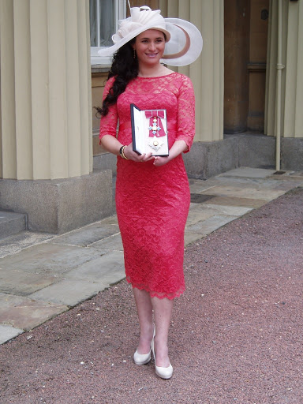
Dame Sarah Storey
To celebrate her success Sarah Storey was awarded a special OBE in 2013.
This is a special honour given to people by the Queen to recognise their contributions to the country.
This is Sarah collecting her OBE from Buckingham Palace!

Slide 9
Would you like to find out more?
If you would like to find out more about Sarah and her amazing story then you could use the following links to help you:
https://www.britishcycling.org.uk/gbcyclingteam/new/bio/Dame_Sarah_Storey_OBE
https://www.paralympic.org/sarah-storey
If you would also like to find out more about the Paralympic Games you could check out these websites:
https://kids.britannica.com/kids/article/Paralympic-Games/599583
http://news.bbc.co.uk/cbbcnews/hi/find_out/guides/sport/paralympics/newsid_3642000/3642508.stm

