Slide 1
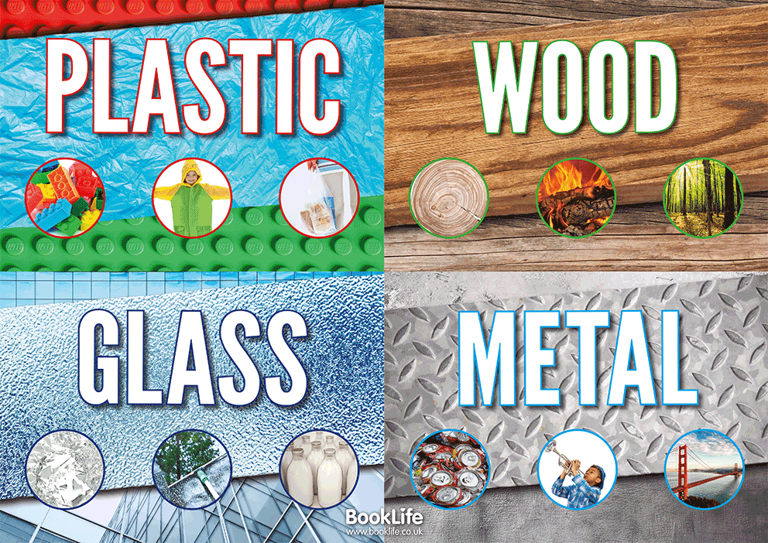
Science Lesson
Properties of materials
Describing materials

Slide 2
Materials
We have been learning about materials and have found objects made of wood, plastic, metal, glass and rock/brick.

Slide 3
Wood

Slide 4
Glass

Slide 5
Metal

Slide 6
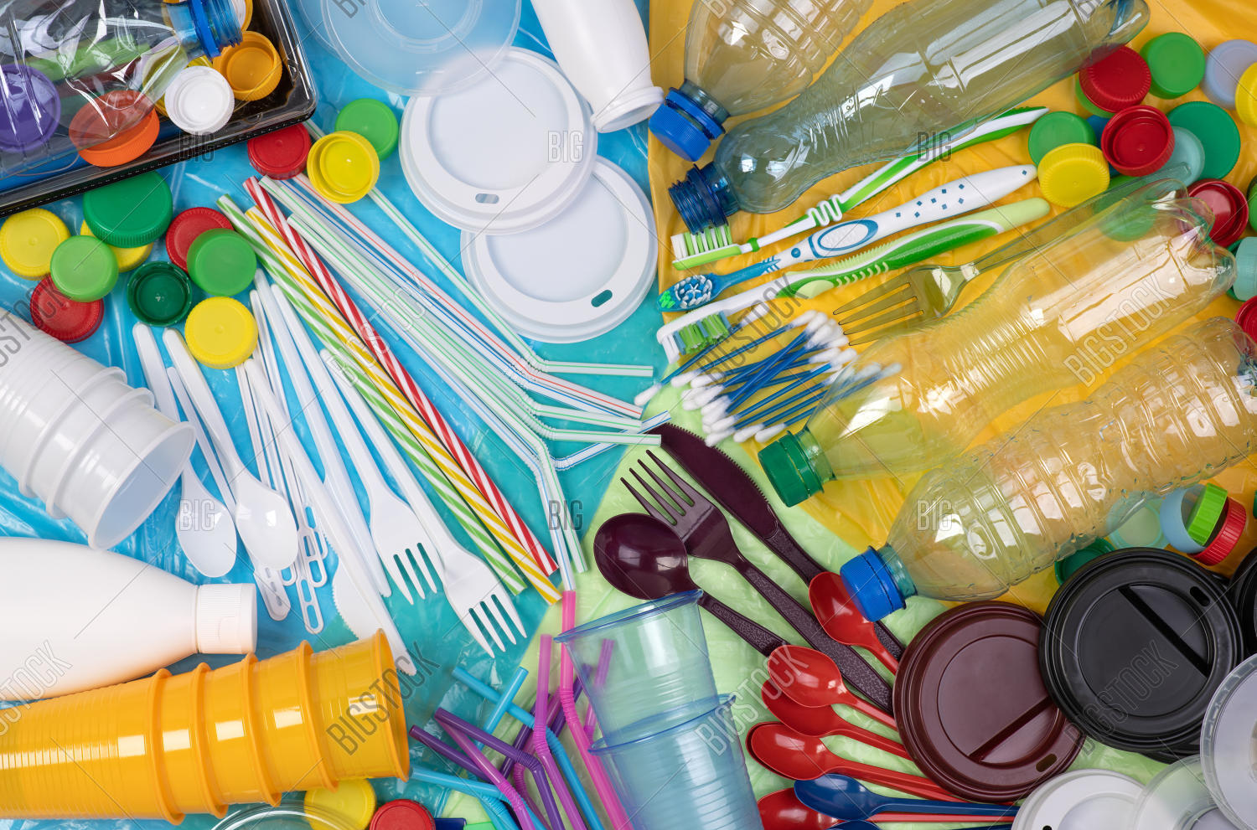
Plastic

Slide 7
Today
Today we are going to think about the properties of materials and will be describing each material
Eg You might describe wood as being
Hard, smooth etc.
I am going to give you keywords on the next slide

Slide 8
Keywords
hard
soft
stretchy
stiff
shiny
dull
rough
smooth
bendy
not bendy
waterproof
not waterproof
absorbent
not absorbent
opaque
transparent
Notes:
Click on slide to start minute timer

Slide 9
Video to watch
https://www.youtube.com/watch?v=340MmuY_osY

Slide 10
Task 1
I would like you to complete the worksheet (Science Year 1 properties of materials writing)
Come up with at least 2 key words to describe each material

Slide 11
Task 2
I would like you to think about building a house
Draw what your house will look like
Then explain which materials you would use to build your house
Eg Glass for the windows because glass is transparent
Brick for the walls because brick is strong
I look forward to seeing your houses!

