Slide 1
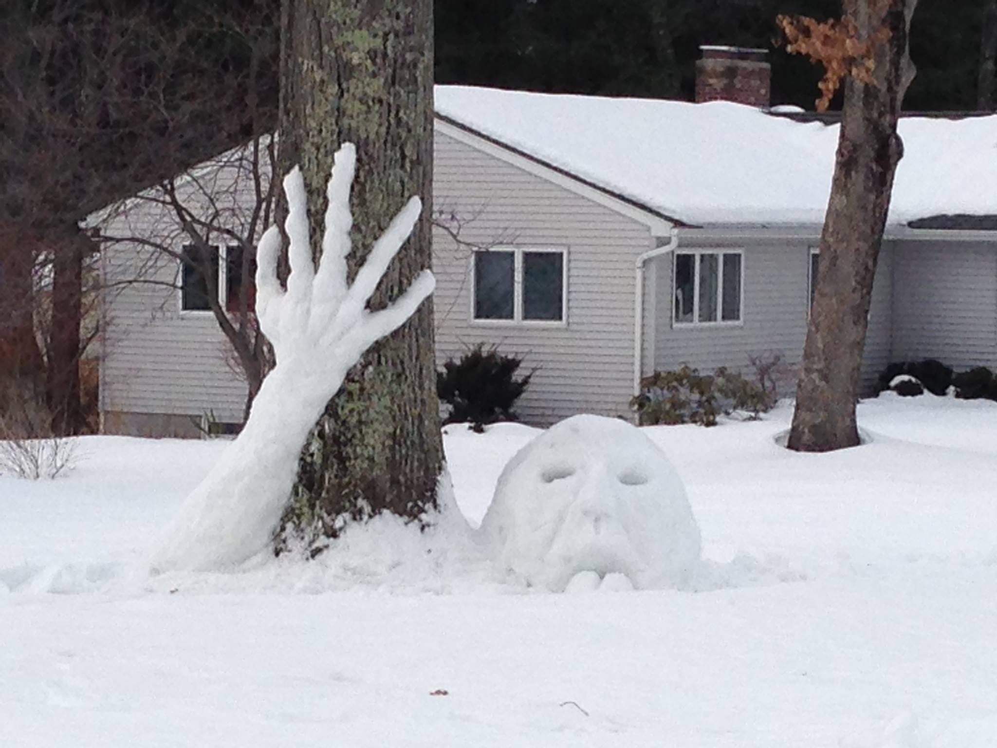
Year 4 – Spring Block 2 – Speech
WALT: Identify Direct & Indirect Speech.
© Classroom Secrets Limited 2019

Slide 2
Introduction
Add inverted commas to punctuate the direct speech.
A. Can we play on your PlayStation after tea? Jim asked enthusiastically.
B. Tom said, You can go to my house after school and play on my game console.
© Classroom Secrets Limited 2019

Slide 3
Introduction
Add inverted commas to punctuate the direct speech.
A. “Can we play on your PlayStation after tea?” Jim asked enthusiastically.
B. Tom said, “You can go to my house after school and play on my game console.”
© Classroom Secrets Limited 2019

Slide 4
Varied Fluency 1
Tick the sentence containing indirect speech.
A. | The weather presenter said it is going to snow later today.
B. | Ben shouted, “It’s snowing outside!”
© Classroom Secrets Limited 2019

Slide 5
Varied Fluency 1
Tick the sentence containing indirect speech.
A. | The weather presenter said it is going to snow later today. |  | ✓
B. | Ben shouted, “It’s snowing outside!”
© Classroom Secrets Limited 2019

Slide 6
Varied Fluency 2
True or false? The sentence below contains direct speech.
“Jacob, please can you hand out the maths books?” asked Mrs Scott.
Explain how you know.
© Classroom Secrets Limited 2019

Slide 7
Varied Fluency 2
True or false? The sentence below contains direct speech.
“Jacob, please can you hand out the maths books?” asked Mrs Scott.
Explain how you know.
True. Punctuation for speech is used and the words that Mrs Scott has spoken are repeated exactly.
© Classroom Secrets Limited 2019

Slide 8
Varied Fluency 3
Circle any errors in the sentence below containing indirect speech.
Yesterday, my friend asked me if you want to play out?
© Classroom Secrets Limited 2019

Slide 9
Varied Fluency 3
Circle any errors in the sentence below containing indirect speech.
Yesterday, my friend asked me if you want to play out?
Yesterday, my friend asked me if I wanted to play out.
© Classroom Secrets Limited 2019

Slide 10
Varied Fluency 4
Errol has tried to rewrite the speech bubble as direct speech.
The television presenter announced Betsy as the winner.
Is he correct?
Tonight’s winner is…..Betsy!
© Classroom Secrets Limited 2019

Slide 11
Varied Fluency 4
Errol has tried to rewrite the speech bubble as direct speech.
The television presenter announced Betsy as the winner.
Is he correct?
Errol is incorrect. He has written the sentence as indirect speech. The sentence should read “Tonight’s winner is…Betsy!” declared the television presenter.
Tonight’s winner is…..Betsy!
© Classroom Secrets Limited 2019

Slide 12
Application 1
Rewrite the speech bubble below as either direct or indirect speech.
Remember to use the correct punctuation.
I bought a new pet hamster at the weekend.
Amrit
© Classroom Secrets Limited 2019

Slide 13
Application 1
Rewrite the speech bubble below as either direct or indirect speech.
Remember to use the correct punctuation.
(indirect speech)
Amrit announced that he had bought a new pet hamster at the weekend.
(direct speech)
Amrit announced, “I bought a pet hamster at the weekend.”
I bought a new pet hamster at the weekend.
Amrit
© Classroom Secrets Limited 2019

Slide 14
Application 2
Complete the sentences below using direct speech with the correct punctuation.
__________________________________ ______________ _ _____ _ _ Beth explained.
Mum agreed __________________________________ ______________ _ _____ _ _
© Classroom Secrets Limited 2019

Slide 15
Application 2
Complete the sentences below using direct speech with the correct punctuation.
Various answers, for example:
“My shoes are scuffed because I tripped up,” Beth explained.
Mum agreed, “Yes, it’s about time that you got a new pair of shoes!”
© Classroom Secrets Limited 2019

Slide 16
Reasoning 1
Dennis has changed the indirect speech below into direct speech.
Jian explained that he would build a large den later on.
“I’m going to build a large den later today, explained Jian” excitedly.
Has he punctuated it correctly? Explain your answer.
© Classroom Secrets Limited 2019

Slide 17
Reasoning 1
Dennis has changed the indirect speech below into direct speech.
Jian explained that he would build a large den later on.
“I’m going to build a large den later today, explained Jian” excitedly.
Has he punctuated it correctly? Explain your answer.
Dennis hasn’t punctuated the speech correctly because…
© Classroom Secrets Limited 2019

Slide 18
Reasoning 1
Dennis has changed the indirect speech below into direct speech.
Jian explained that he would build a large den later on.
“I’m going to build a large den later today, explained Jian” excitedly.
Has he punctuated it correctly? Explain your answer.
Dennis hasn’t punctuated the speech correctly because the inverted commas should close after the comma instead. The sentence should read “I’m going to build a large den later today,” explained Jian excitedly.
© Classroom Secrets Limited 2019

