Slide 1
Year 4 – Spring Block 3 – Noun Phrases
WALT: Modify Adjectives and Nouns
A modifier is a word, phrase, or clause that describes another word, phrase, or clause.
© Classroom Secrets Limited 2019

Slide 2
Introduction
Identify the noun phrases in each of the sentences and phrases below.
The crafty raven with jet black feathers.
The tiny box beside the tree.
The scientist identified the miraculous cure after years of research.
© Classroom Secrets Limited 2019

Slide 3
Introduction
Identify the noun phrases in each of the sentences and phrases below.
The crafty raven with jet black feathers.
The tiny box beside the tree.
The scientist identified the miraculous cure after years of research.
© Classroom Secrets Limited 2019

Slide 4
Varied Fluency 1
Which modifier is the most suitable to be added to each noun in the sentence below?
The children ate the cake quickly so they could have more time on the trampoline.
huge
excited
birthday
© Classroom Secrets Limited 2019

Slide 5
Varied Fluency 1
Which modifier is the most suitable to be added to each noun in the sentence below?
The excited children ate the birthday cake quickly so they could have more time on the huge trampoline.
huge
excited
birthday
© Classroom Secrets Limited 2019

Slide 6
Varied Fluency 2
Underline three modifiers in the sentence below.
The elegant swan glided gracefully across the wide mountain lake as it waited patiently for its female mate to return.
© Classroom Secrets Limited 2019

Slide 7
Varied Fluency 2
Underline three modifiers in the sentence below.
The elegant swan glided gracefully across the wide mountain lake as it waited patiently for its female mate to return.
Any three of the following: elegant, wide, mountain, female.
© Classroom Secrets Limited 2019

Slide 8
Varied Fluency 3
Which sentence contains a modifier?
A. | After lunch, the sleepy office worker, who had got up early, dozed off in his chair.
B. | Despite the risk, the mouse crept silently around the cat in search of food.
© Classroom Secrets Limited 2019

Slide 9
Varied Fluency 3
Which sentence contains a modifier?
A. | After lunch, the sleepy office worker, who had got up early, dozed off in his chair.
B. | Despite the risk, the mouse crept silently around the cat in search of food.
© Classroom Secrets Limited 2019

Slide 10
Varied Fluency 4
What does the underlined modifier tell us about the sentence?
The efficient emergency nurse, who was on the first night shift, quickly helped the patient onto a bed.
© Classroom Secrets Limited 2019

Slide 11
Varied Fluency 4
What does the underlined modifier tell us about the sentence?
The efficient emergency nurse, who was on the first night shift, quickly helped the patient onto a bed.
Efficient tells us how good the nurse is at their job.
© Classroom Secrets Limited 2019

Slide 12
Reasoning 1
How would including the word ‘interesting’ to describe the book modify the meaning of the sentence?
After reading a chapter of his book, Riley paused to think for a while, then put the book down.
© Classroom Secrets Limited 2019

Slide 13
Reasoning 1
How would including the word ‘interesting’ to describe the book modify the meaning of the sentence?
After reading a chapter of his book, Riley paused to think for a while, then put the book down.
Various possible answers, for example: ‘Interesting’ shows us why…
© Classroom Secrets Limited 2019

Slide 14
Reasoning 1
How would including the word ‘interesting’ to describe the book modify the meaning of the sentence?
After reading a chapter of his book, Riley paused to think for a while, then put the book down.
Various answers, for example: ‘Interesting’ shows us why Riley paused to think about it.
© Classroom Secrets Limited 2019

Slide 15
Application 1
Improve the sentence below by adding two modifiers.
On Fridays, the family come over to my house and we all have a meal together.
© Classroom Secrets Limited 2019

Slide 16
Application 1
Improve the sentence below by adding two modifiers.
On Fridays, the family come over to my house and we all have a meal together.
Various possible answers using two modifiers, for example: On Fridays, the extended family come over to my house and we all have a takeaway meal together.
© Classroom Secrets Limited 2019

Slide 17
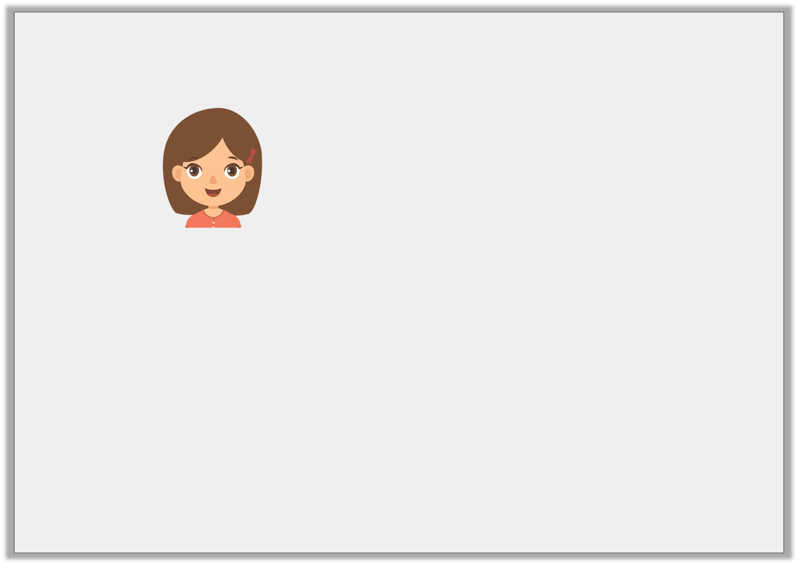
Reasoning 2
Brooke says,
The high chair, which the baby was sitting in, was decorated with pictures of rabbits and teddies and looked adorable.
Is she correct? Explain your answer.
I could add the modifier ‘short’ to the sentence below to describe the high chair.
© Classroom Secrets Limited 2019

Slide 18
Reasoning 2
Brooke says,
The high chair, which the baby was sitting in, was decorated with pictures of rabbits and teddies and looked adorable.
Is she correct? Explain your answer.
She is not correct because a high chair…
I could add the modifier ‘short’ to the sentence below to describe the high chair.
© Classroom Secrets Limited 2019

Slide 19
Reasoning 2
Brooke says,
The high chair, which the baby was sitting in, was decorated with pictures of rabbits and teddies and looked adorable.
Is she correct? Explain your answer.
She is not correct because a high chair wouldn’t be described as short.
I could add the modifier ‘short’ to the sentence below to describe the high chair.
© Classroom Secrets Limited 2019

