Slide 1
Reception Maths Thursday
I am learning to describe my position using words like ‘behind’ or ‘next to’

Slide 2
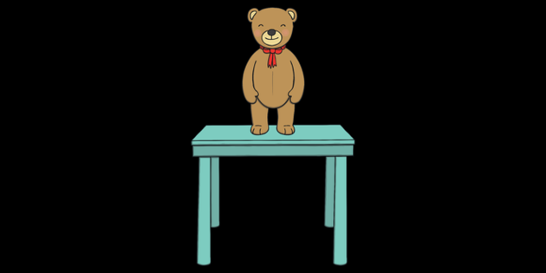
What is a position?
The position of something is where it is situated and we use special words to describe the position of something or someone. We use words like:
Behind
In front of
Next to
On top
below

Slide 3
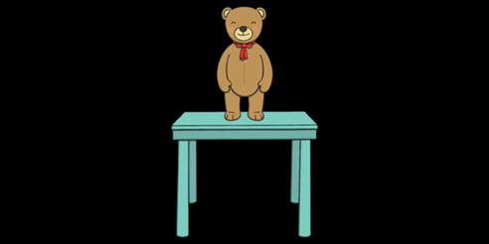
On top

Slide 4
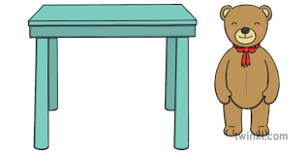
Next to

Slide 5
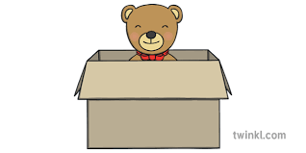
Inside

Slide 6
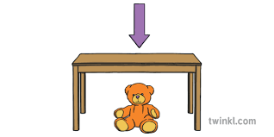
Under

Slide 7
Today’s challenge:
You are going to do an activity with your grown up using a teddy bear or your favourite toy.
You and your grown up are going to take it for a walk around the house and garden and place it in different areas such as on the bench, next to the tree. Next, your grown up will ask you where the bear/toy is and you will answer using the correct language such as:
- under
- next to
- behind
- in front of
Can you use the correct language (words) to describe their position?

