Slide 1
Thursday Maths lesson
Subtraction using Maths Frog

Slide 2
WALT: use maths frog and a number line to subtract
Watch the video from yesterday (Abacus allocation) if you need reminding of how Maths Frog helps us subtract.
Maths Frog is not scared of big numbers so we are going to use some bigger numbers today.
You will do exactly the same thing as we have always done with Maths Frog: start with the baby number, jump to the next 10 etc.

Slide 3
There are two levels of challenge. If you are not yet feeling confident or want to consolidate the work from yesterday start at the beginning of Challenge 1.
If you want a little bit more of a challenge then start at number 10; some of the calculations will cross the 100s.
If you want to push yourself a little more and use some bigger numbers and practise crossing the 100s, then have a go at Challenge 2.
You can change challenges if you want to.

Slide 4
Challenge 1:
283 – 248 =
155 – 127 =
272 – 236 =
393 – 367 =
164 – 125 =
271 – 238 =
384 – 348 =
252 – 216 =
273 – 235 =
481 – 444 =
373 – 326 =
309 – 284 =
403 – 386 =
311 – 285 =
15. There are 402 pupils in a school. On Monday only 377 children come to school. How many were away?
James had £310 before going shopping. He had £268 when he returned home. How much did he spend?

Slide 5
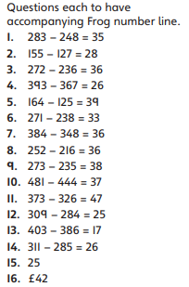
Challenge 1 answers

Slide 6
Challenge 2
10. 785 – 717 =
11. 592 – 515 =
12. 493 – 426 =
13. 381 – 318 =
14. 201 – 146 =
15. 513 – 477 =
16. 413 – 388 =
17. 234 – 187 =
18. 421 – 368 =
19. 322 – 267 =
20. 531 – 455 =
21. In the high jump Sally jumps 208 cm and Joel jumps 169cm. How much higher does Sally jump?
22. There are 412 parents in the hall to see the school play. 365 of them are women, how many are men?
23. Nisha has £278. She wants to buy a phone that costs £311. How much more money does she need?

Slide 7
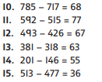
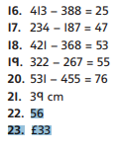
Challenge 2 answers:

