Slide 1
Thursday Maths lesson
Expanded written method
addition

Slide 2
WALT: I can add using expanded column addition

Slide 3
Here are the answers:

Slide 4
Expanded column addition
We are going to start looking at a way of adding larger numbers. It is called expanded column addition and helps us add lots of numbers or big numbers.
There is a video on your Abacus Activelearn to watch later. It is called 3.16 Pupil video expanded column addition.

Slide 5
Expanded column addition – no crossing boundaries
968
300 20 5 + 600 40 3 =
300 20 5 +
600 40 3
_________
900 60 8
9 6 8
*Always start adding with the ones column*

Slide 6
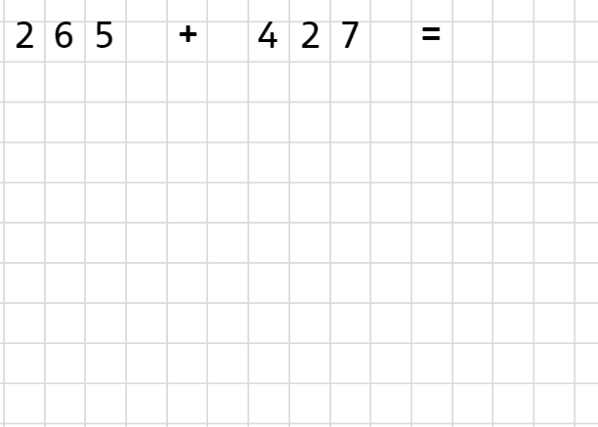
Expanded column addition – crossing boundaries
200 60 5 + 400 20 7
200 60 5 +
400 20 7
10
__________
2
600 90

Slide 7
Next:
Now watch the video to make sure you are happy with what to do.
Have a go at some of the questions. They are on Abacus if you want them a bit bigger, or I have copied them onto the next slide (answers on the slide after that.) The questions in the second column are ones that might need the crossing columns bit.

