Slide 1
Thursday English Lesson
Writing our Julia Donaldson non-fiction books

Slide 2
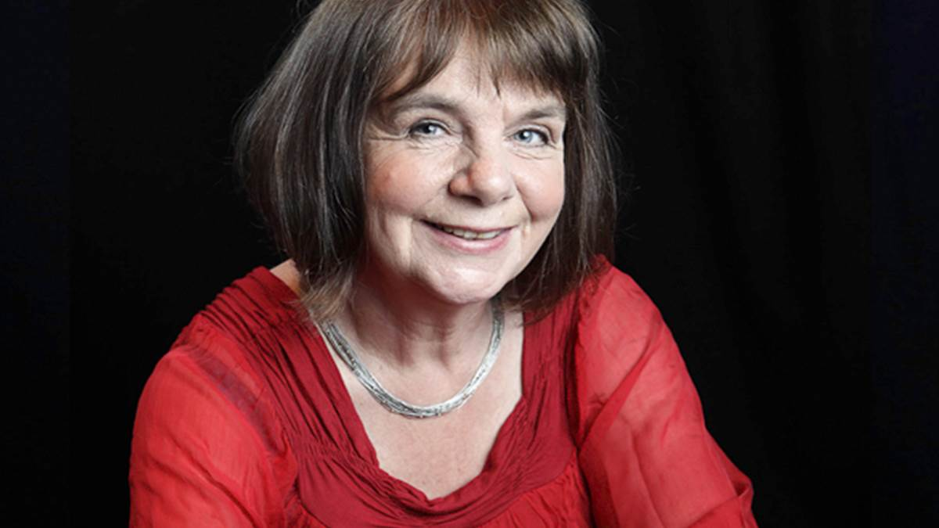
Today
Today we are going to use our plan
from yesterday to write 3
pages of our non-fiction book.

Slide 3
Each page will need
A heading
2 facts
A picture
Read your sentences to check they make sense and that you have used capital letters and full stops.

Slide 4
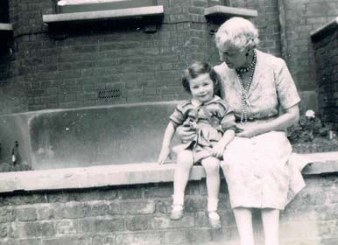
Example
Early life
Julia Donaldson was born in London. When she was growing up she had a cat called Geoffrey.
Julia Donaldson went to University to study Drama and French. She met her husband Malcom at university.

Slide 5
Checking
Once you have written your 3 pages I would like you to check:
Your sentence makes sense
You have used capital letters correctly
You have used full stops correctly
You have a picture on each page

