Slide 1
Maths
Tuesday

Slide 2
Carroll Diagrams- what do you notice about them? How do they work?

Slide 3
Look at this Carroll diagram. One of the shapes is in the wrong place. Can you work out which one?

Slide 4
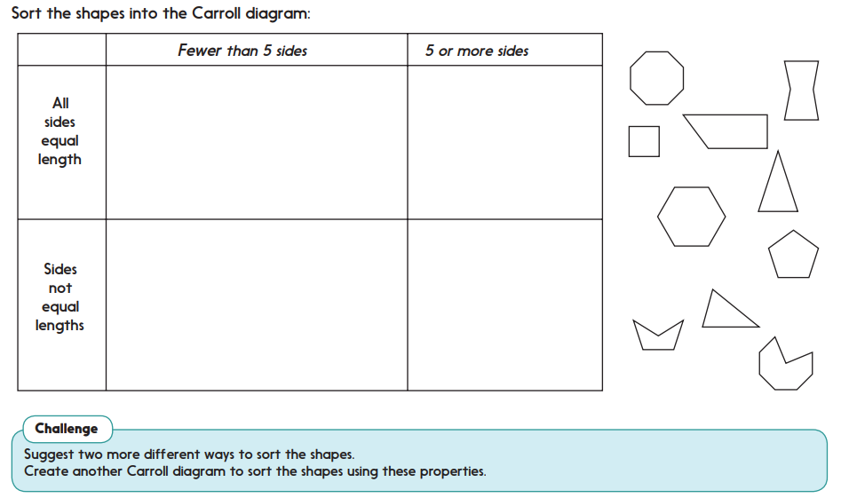
Activity-

Slide 5
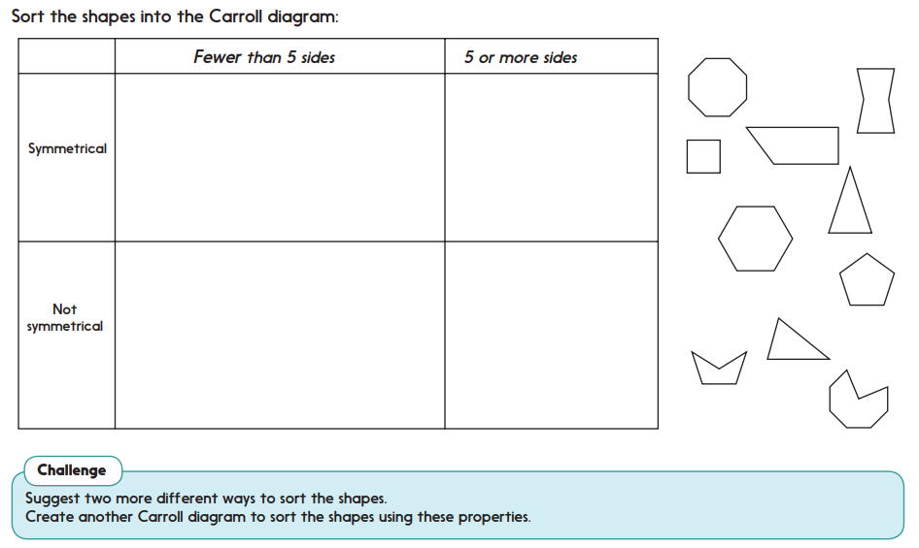
Challenge- if you are feeling confident you could try this Carroll diagram instead

