Slide 1
Lesson 3:
Computing Scheme of Work Unit 4.2 – Online Safety
Plagiarism
Notes:
Unless otherwise stated, all resources can be found on the main unit 4.2 page.
Completed Writing Template about Tim Berners Lee. This file contains two pages, the first is plagiarised, the second is not. This will be used as a whiteboard resource.
Access to Wikipedia.
Plagiarism Quiz
Print the Screen-Time Record Card. Each child will need a copy (each sheet has two record cards and can be cut in half), this is to hand out at the end of the session for children to complete over the week in preparation for the next lesson.

Slide 2
Aims
Slide 2
To understand that copying the work of others and presenting it as their own is called 'plagiarism' and to consider the consequences of plagiarism.
To identify appropriate behaviour when participating or contributing to collaborative online projects for learning.
Need more support? Contact us:
Tel: +44(0)208 203 1781 | Email: support@2simple.com | Twitter: @2simplesoftware
Notes:
Display slide 2 and outline the lesson aims.

Slide 3
Success Criteria
Slide 3
Children can determine whether activities that they undertake online, infringe another’s’ copyright.
Children know the difference between researching and using information and copying it.
Children know about citing sources that they have used.
Need more support? Contact us:
Tel: +44(0)208 203 1781 | Email: support@2simple.com | Twitter: @2simplesoftware
Notes:
Display slide 3 and outline the success criteria.

Slide 4
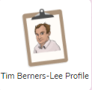
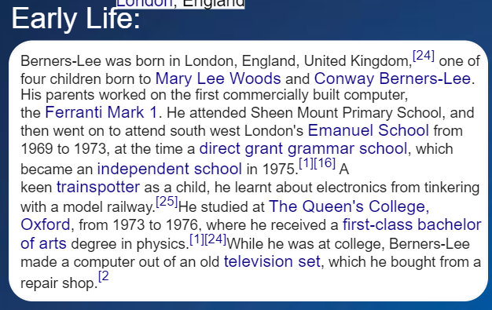
Activity 1: Investigating Plagiarism
Slide 4
Use the link to open this file on the whiteboard.
Look just at the Early Life section on the first page. You will need to zoom in using the button. What do children think of the content?
Why are there bits in different colours and numbers on it?
Look at the photo, what is the purpose of the writing on the photo? Why do you think it is there?
It is called a watermark and indicates that the picture is copyrighted.
Click on one of the links, where does it take you?
It takes you to Wikipedia. Why do you think this happens?
It looks like the author has simply copied and pasted from Wikipedia.
Notes:
Use slides 4 - 7 and Purple Mash itself as a class on the whiteboard. Click to reveal points for discussion.

Slide 5
Activity 1: Investigating Plagiarism
Slide 5
Scroll down to the second page and compare the two versions. Which is better and why?
Compare the Career sections for both. Which contains better information?
Search for Sir Tim Berners-Lee on Wikipedia in a separate tab of your browser and compare this to the two homework examples.
Did you notice that the first example is simply copied and pasted into the template whereas the second uses the information, but it is rewritten.
The first version is plagiarised from Wikipedia.
Notes:
Use slides 4 - 7 and Purple Mash itself as a class on the whiteboard. Click to reveal points for discussion.

Slide 6
Plagiarism
Slide 6
Plagiarism is when a person steals another’s work and claims that it is their own. You can copy things in some contexts, such a quoting another person or using an image or video but you must give credit to the original author: This is called ‘citation’.
There are clues that teachers use to tell whether someone has plagiarised work. The first will be to search the same theme online.
Comparing the second version about Sir Tim Berners-Lee to the Wikipedia version you can see that the writer has looked up and explained terms. For example, the meaning of ‘inaugural’ in the awards section or what MIT is. They have filtered out some of the information to make it appropriate to the reader.
In the second version, the writer has cited the sources for the image used and for the source of their information (underneath the image and at the bottom of the page).
Need more support? Contact us:
Tel: +44(0)208 203 1781 | Email: support@2simple.com | Twitter: @2simplesoftware
Notes:
Use slides 4 - 7 and Purple Mash itself as a class on the whiteboard. Click to reveal points for discussion.

Slide 7
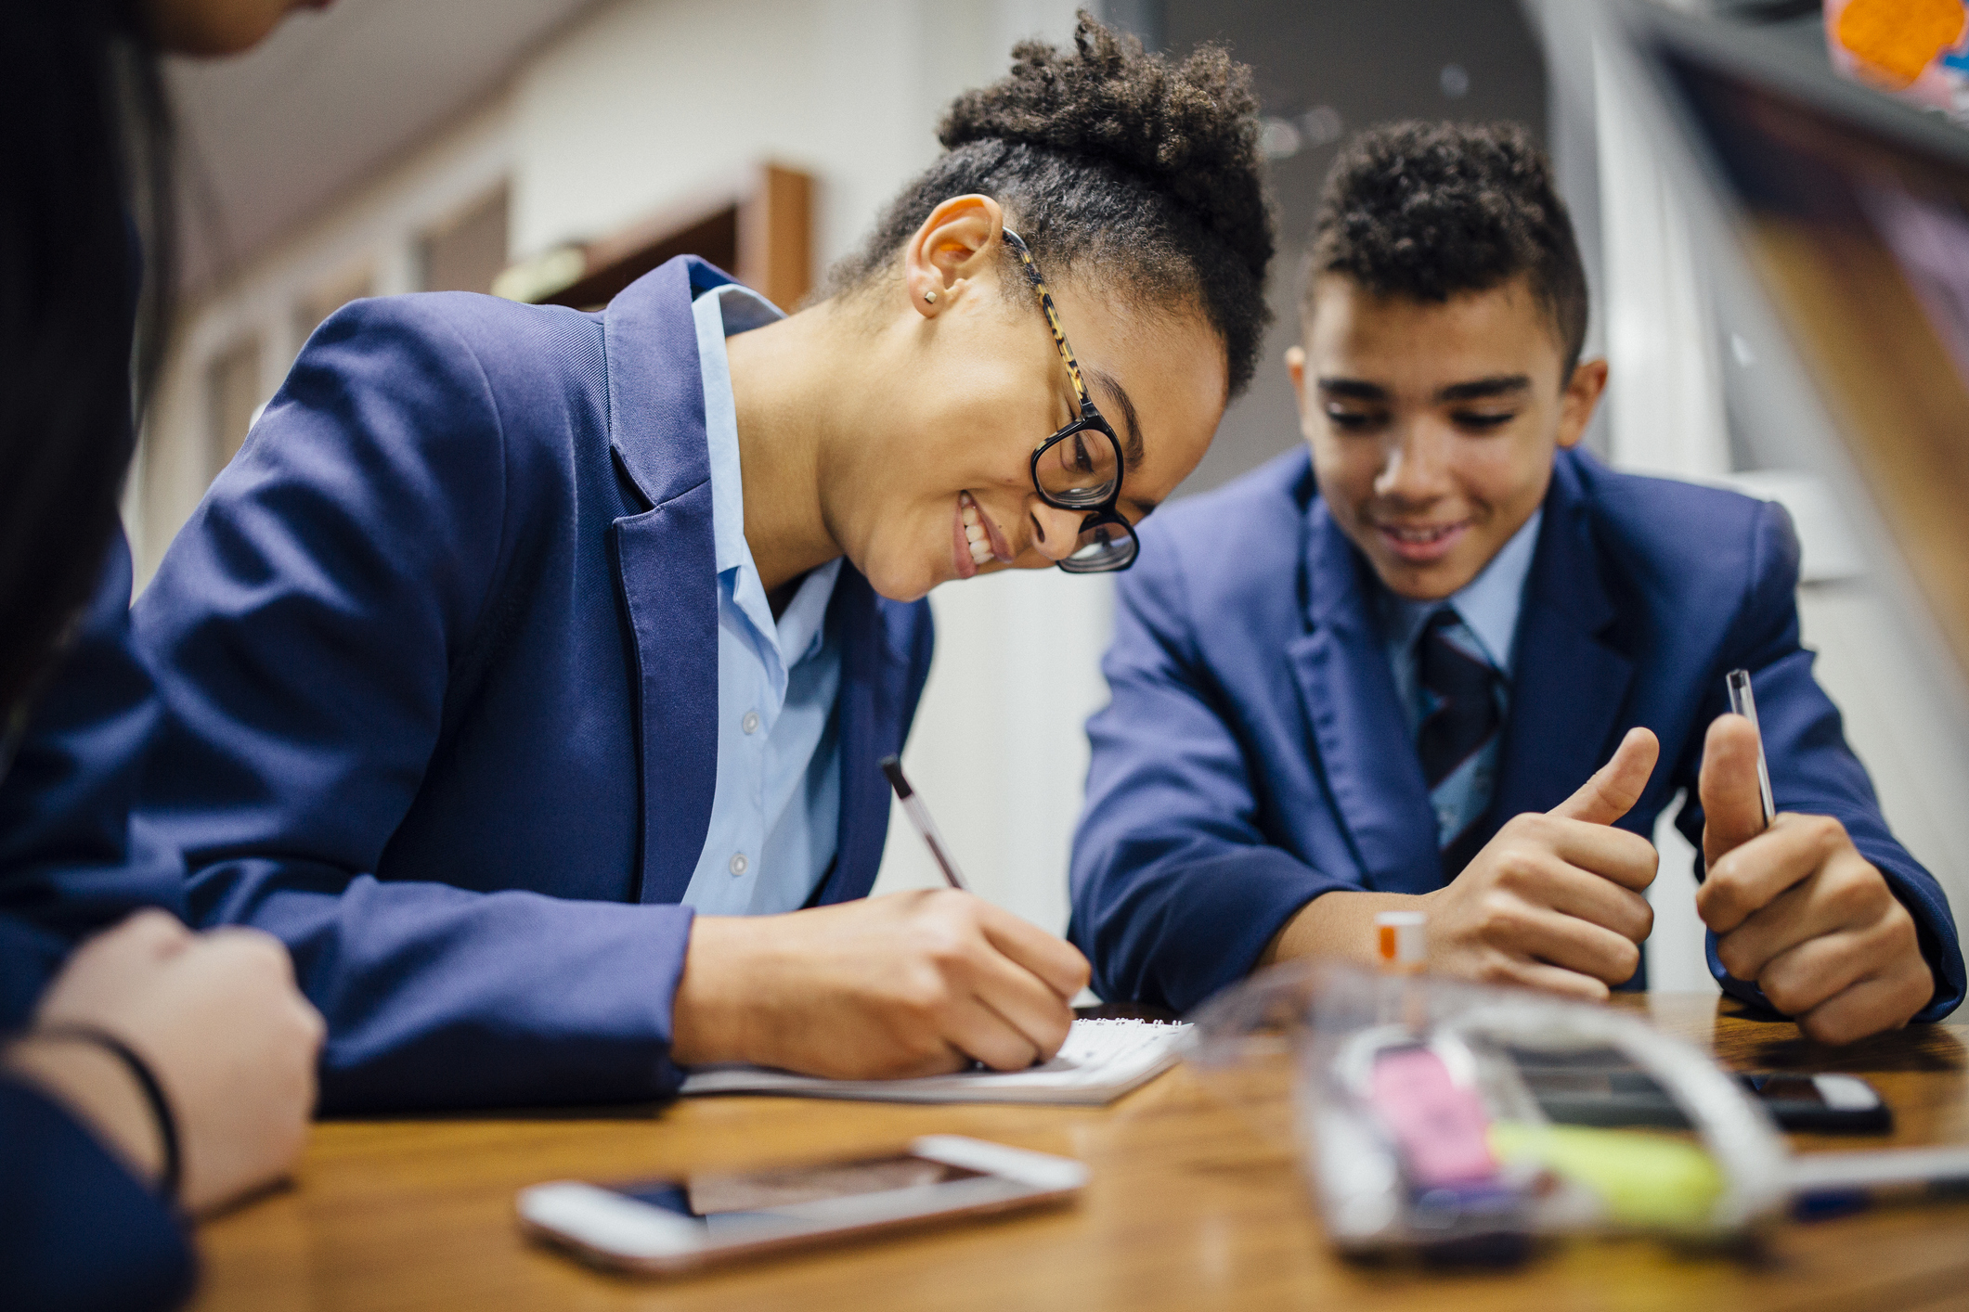
Collaborating or Copying?
Slide 7
How should a person decide if others are copying when participating or contributing to collaborative online projects for learning. Decide about the following situations:
If you share a collaborative 2Connect file, that the class made, on your own blog, what should you do?
If you and a friend create a poster, and then you enter it into a competition as your own individual work, is that correct?
If you find a piece of work in the class shared folder that you like. Can you open it, change it, and call it your own work?
Need more support? Contact us:
Tel: +44(0)208 203 1781 | Email: support@2simple.com | Twitter: @2simplesoftware
Notes:
Use slides 4 - 7 and Purple Mash itself as a class on the whiteboard. Click to reveal points for discussion.

Slide 8
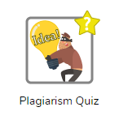
Activity 2: Plagiarism Quiz
Slide 8
It can be very confusing!
Your teacher will split the class into two or four groups.
Open the Plagiarism Quiz on the whiteboard using the link above.
If a team gets the question correct, they chose their ‘team colour’.
Select a different question for the next question (otherwise the answer is too obvious!).
Need more support? Contact us:
Tel: +44(0)208 203 1781 | Email: support@2simple.com | Twitter: @2simplesoftware
Notes:
Use slide 8 to direct the activity.

Slide 9
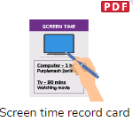
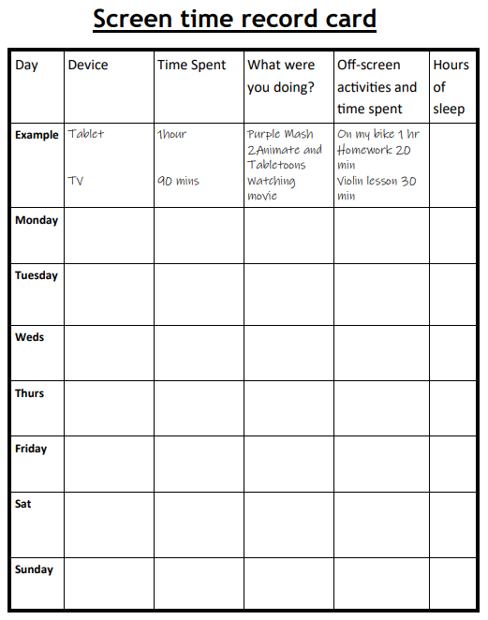
Activity 3: Home Study
Slide 9
It can be very confusing!
You are going to record the amount of screen time that you have this week.
We will use the data in the next lesson.
Need more support? Contact us:
Tel: +44(0)208 203 1781 | Email: support@2simple.com | Twitter: @2simplesoftware
Notes:
Use slide 9. Hand out the record-cards to be completed for the next lesson (ideally in a weeks’ time). Discuss how to fill in the cards. Children should record how much time they spend on screen, which device and what they were doing as well as off-screen activities that they do.

Slide 10
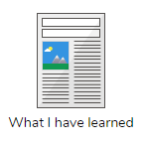
Activity 4: Extension
Slide 10
Use an online resource, such as the National Geographic for Kids website, to research the Red Panda (or a chosen subject related to a class topic).
Produce a short report about your chosen subject, whilst remembering what they have been taught about plagiarism.
Use the ‘What I have learnt’ template within 2Publish to write your report.
Can you complete the following tasks?
Paraphrase the information you have read.
Re-state the information you have read.
Leave out irrelevant information.
Cite the source of the information.
(Optional) Search for a suitable image and include it with attribution.
Need more support? Contact us:
Tel: +44(0)208 203 1781 | Email: support@2simple.com | Twitter: @2simplesoftware
Notes:
Slide 10 contains an extension.

Slide 11
Review Success Criteria
Slide 11
I can work out whether activities that I do online, infringe another person’s copyright.
I know the difference between researching and using information and copying it.
I know about citing sources that I have used.
Need more support? Contact us:
Tel: +44(0)208 203 1781 | Email: support@2simple.com | Twitter: @2simplesoftware
Notes:
Review the success criteria from slide 3. Children could rate how well they achieved this using a show of hands.

