Slide 1
Usain Bolt
Sprinter

Slide 2
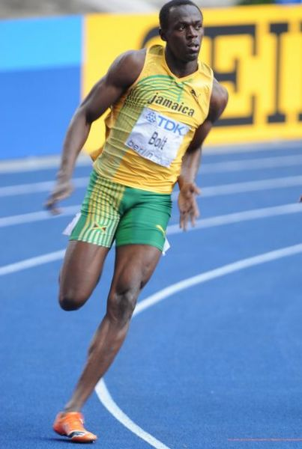
Early Years
Usain was born on the 21st August 1986
He was born in Trelawny, Jamaica

Slide 3
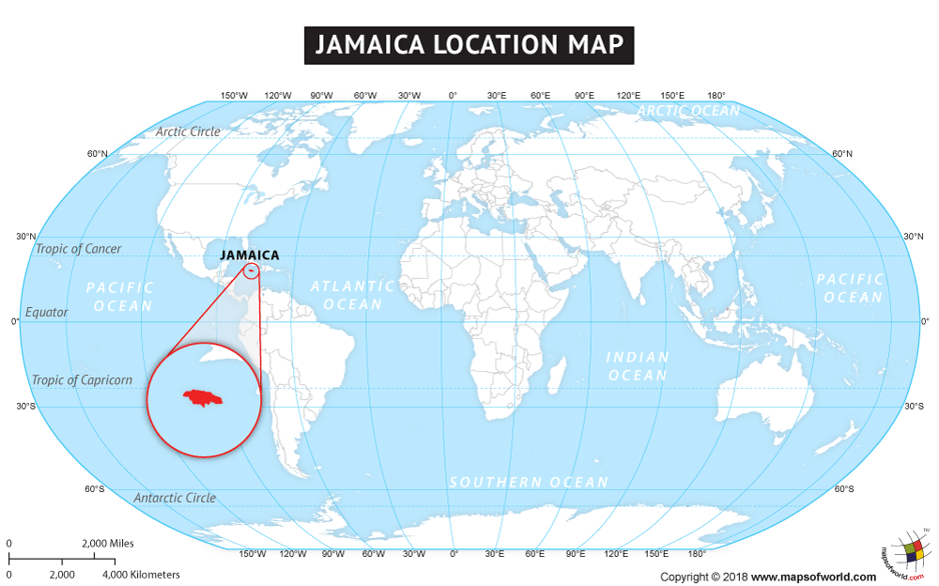

Slide 4
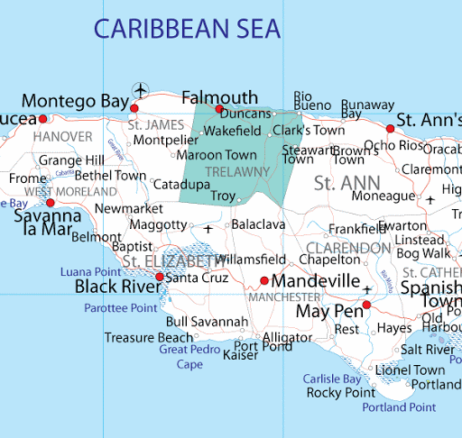
Can you spot Trelawny?

Slide 5
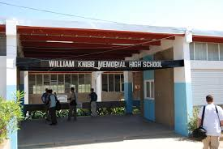
Bolt spent a lot of time when he was younger playing football and cricket out in the street with his brother. Bolt has said ‘When I was young, I did not think about anything other than sport.’ Bolt showed that he was good at sprinting when he was at school. By the age of 12 he was the school’s fastest runner over 100m!
Usain Bolt’s School in Jamaica

Slide 6
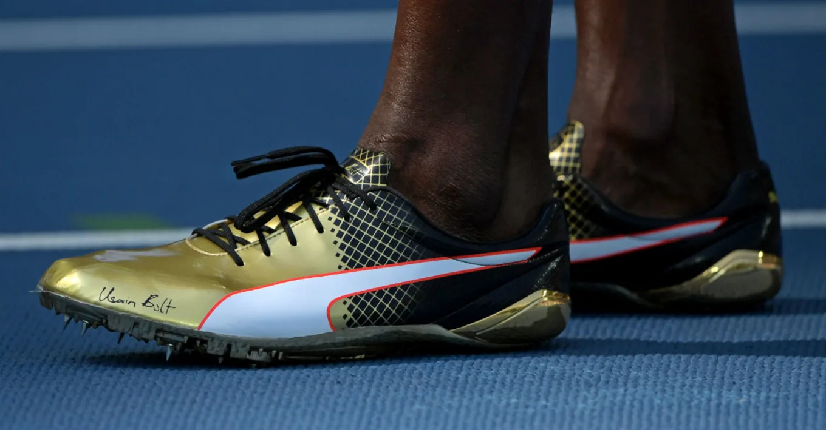
Rise to fame
In 2002, Bolt took part in the World Junior Championships which were being held in Jamaica.
Bolt won the 200m race and became the youngest person to ever win a gold medal at the World Junior Championships.
Bolt was 15 years old at the time and was very nervous before his race.
He was so nervous that he actually put his shoes on the wrong feet! Luckily he noticed just before the race started and could change them!
Have you ever felt really nervous about something?

Slide 7
World’s Fastest Man!
Usain Bolt has gone on to win 8 Olympic Gold medals
He has run 100 m in 9.58 seconds
He has run 200 m in 19.30 seconds
This means that some people have called him the World’s fastest man!
Take a look at Usain Bolt running:
https://www.youtube.com/watch?v=3nbjhpcZ9_g

Slide 8
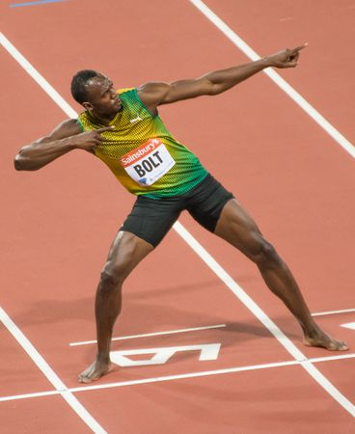
The Lightning Bolt
Usain Bolt has the nickname the lightning bolt because he is so fast
After his races he would perform a lightning bolt action to celebrate: https://www.youtube.com/watch?v=SkGzeSvcAvY
What action would you perform if you won?

Slide 9
Interested to find out more?
If you would like to learn more about Usain Bolt you could watch the following interesting video about him:
https://www.literacyshed.com/usain.html
Or you could visit the following websites:
https://kids.kiddle.co/Usain_Bolt
https://www.ducksters.com/sports/track_and_field/usain_bolt.php

