Slide 1
Wednesday English Lesson
Finding out about Julia Donaldson

Slide 2
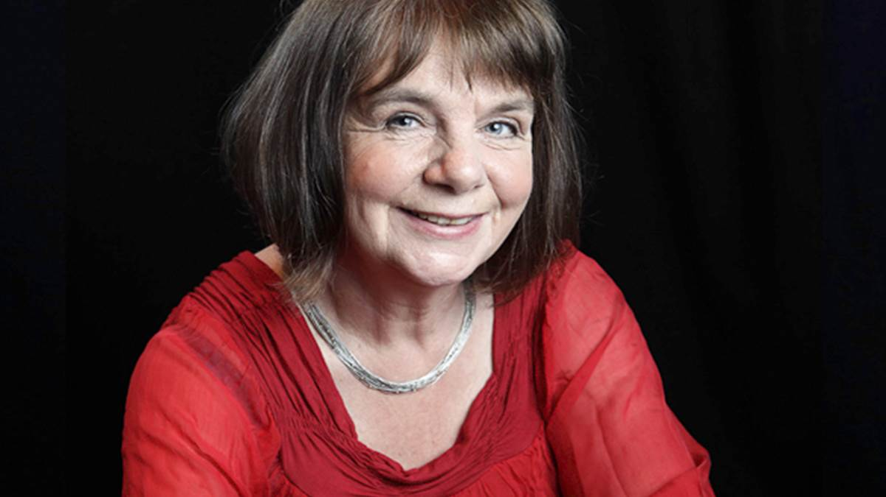
Julia Donaldson

Slide 3
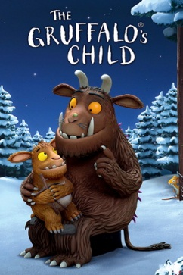
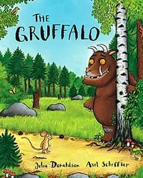
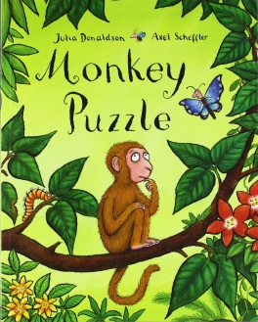
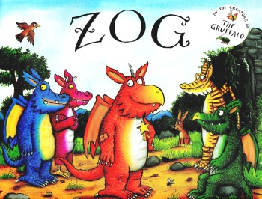
Here are some books by Julia Donaldson. Which ones have you read?

Slide 4
Today
Today we are going to be finding out about Julia Donaldson.
We are going to be writing a non-fiction book about Julia Donaldson.
Today once you have learnt about Julia Donaldson you will be planning your non-fiction book thinking about what headings and facts you want to include.

Slide 5
Links and fact cards
https://www.juliadonaldson.co.uk/about.htm
You can look on Julia Donaldson’s official website
https://www.youtube.com/watch?v=zFpWHRgDUpw
Here is an interview you can watch
I am also uploading some Julia Donaldson fact cards (Wednesday
English 2) you can read through

Slide 6
Some facts….

Slide 7
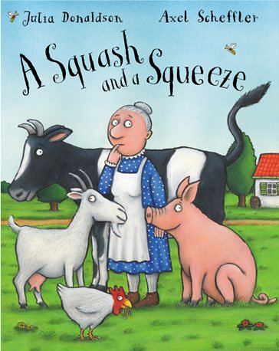
The very first book Julia wrote was ‘A Squash and a Squeeze’.

Slide 8
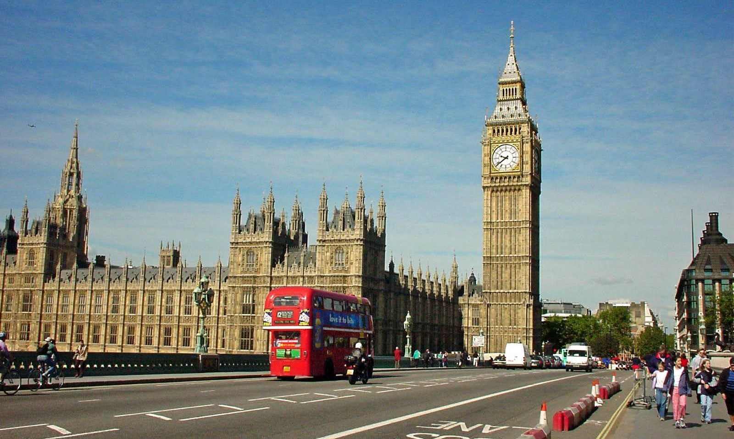
Julia was born in London.

Slide 9
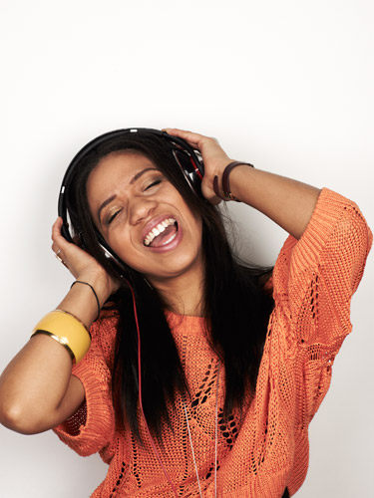
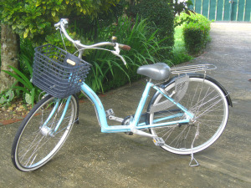
In her spare time, Julia enjoys singing and cycling.

Slide 10
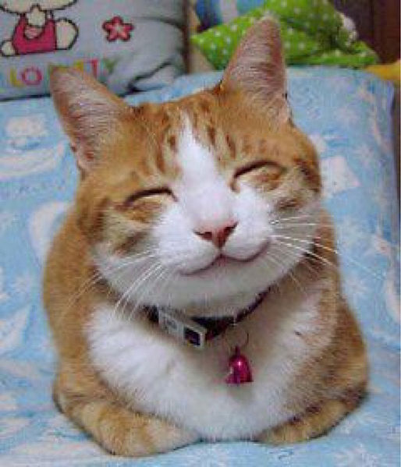
She has a pet cat called Goblin.

Slide 11
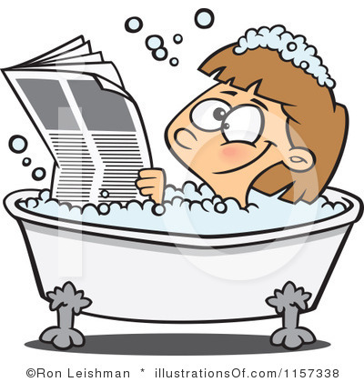
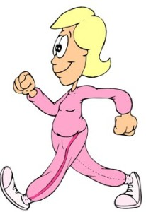
Julia thinks of ideas for her stories when she is in the bath or out walking!

Slide 12
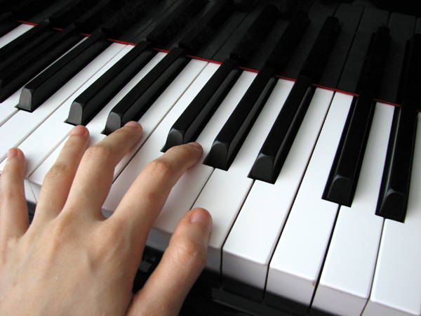
Julia can play the piano!

Slide 13
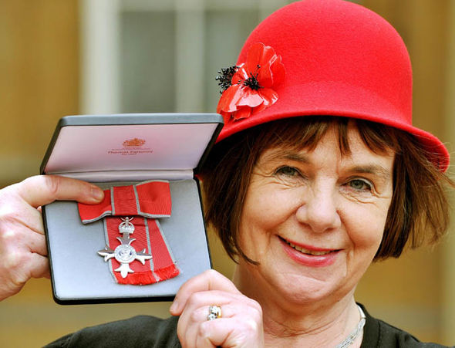
Julia was awarded an MBE in 2011.

Slide 14
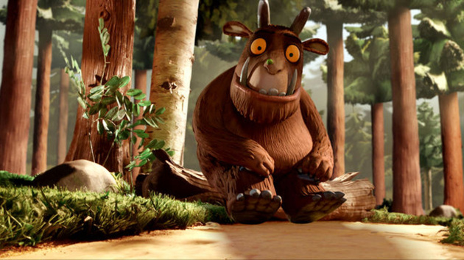
The Gruffalo was voted Great Britain’s favourite bedtime story.

Slide 15
Julia’s favourite book she has written is ‘The Snail and the Whale’…

Slide 16
Task
Now you have learnt about Julia Donaldson it is time
to plan what you are going to include in your
non-fiction book.
I have uploaded a planning template (Wednesday Year 1 English 3) you can use or you can use your own paper.
I have included some headings on my template but you can change them if you have your own ideas!
We will start writing the book tomorrow.
Headings could be:
Hobbies Interesting facts
Early life The Gruffalo
Books Awards

