Slide 1
Writing
Monday

Slide 2
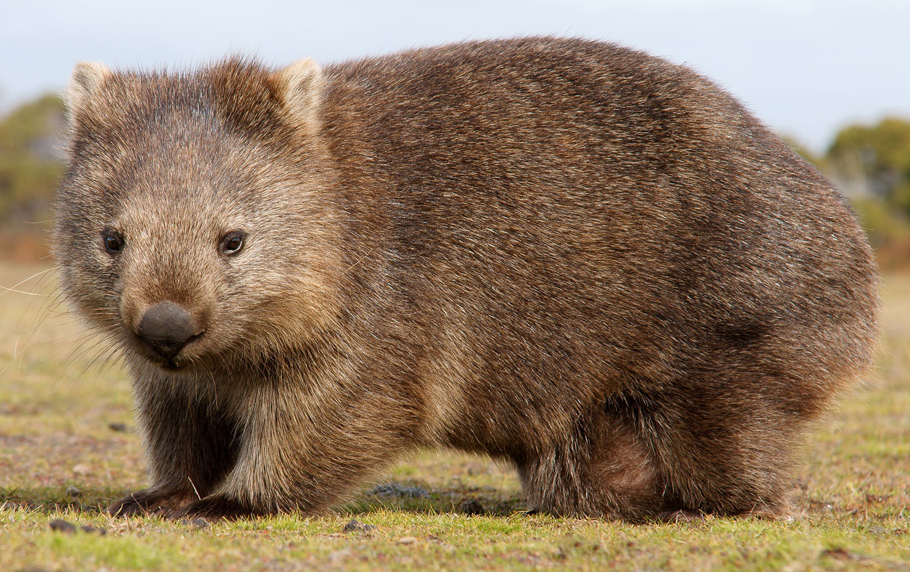
Read the fact file ‘Wombats’
What did you learn about wombats?
What do you think the most interest fact was about them?

Slide 3
Can you use the fact file to answer these questions about Wombats?
How many kilograms (kg) can a wombat weigh?
What do wombats do to stop their incisor teeth growing too long?
Do wombats eat frog, mice and big insects? True or false.
Why does the opening of a wombat’s pouch face away from its front paws?
For what reason do wombats sometimes dive into their burrows and block the entrance with their sturdy rumps?

Slide 4
Writing
Tuesday

Slide 5
Listen to the story ‘The Diary of a Wombat’
https://www.youtube.com/watch?v=7qMMhJ4iiu8
What type of writing is this?

Slide 6
This is a story and an example of a diary entry.
It is written from the point of view of the wombat.
Using the story pictures on the next slides can you write a sentence that is from the point of view of the wombat and then one that is from the point of view of the family?
Would they fell the same or different about what has happened?

Slide 10
Writing
Wednesday

Slide 13
Writing
Thursday

Slide 15
Writing
Friday

Slide 16
My example of an animal diary entry:

Slide 17
Today, you are going to use your plan to write your own diary entry for your animal. Don’t forget to include the following:
The day of your diary entry
It needs to be written from the point of view of the animal
It should include some funny things that the animal gets up to
It should be written in the past tense
I can’t wait to see some pictures of your work!

