Slide 1

Year 3 | Week 4 | Day 1

Slide 2
Year 3 | Week 4 | Day 2

Slide 3
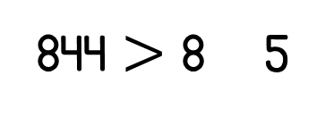
Year 3 | Week 4 | Day 3
844 $>$ 8 5

Slide 4
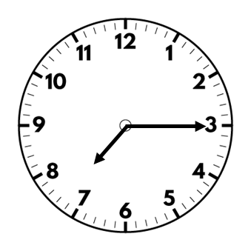
Year 3 | Week 4 | Day 4
562 , 507 , 570 , 558

Slide 5
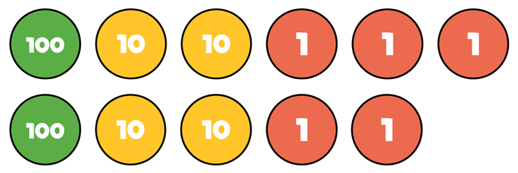

Year 3 | Week 4 | Day 5
$$+$$

Slide 6
Year 3 | Week 5 | Day 1
556
500
50

Slide 7
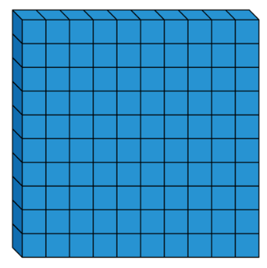
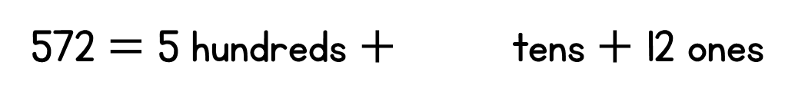

Year 3 | Week 5 | Day 2
$$+$$
572 $=$ 5 hundreds $+$ tens $+$ 12 ones

Slide 8
Year 3 | Week 5 | Day 3

Slide 9
Year 3 | Week 5 | Day 4

Slide 10
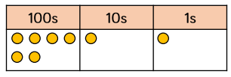

Year 3 | Week 5 | Day 5

Slide 11
Year 3 | Week 6 | Day 1

Slide 12
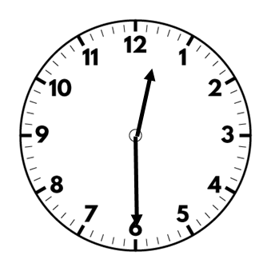
Year 3 | Week 6 | Day 2

Slide 13
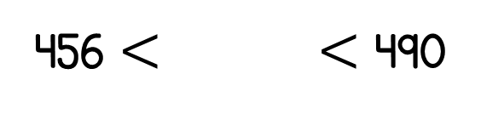
Year 3 | Week 6 | Day 3
456 $<$ $<$ 490

Slide 14
Year 3 | Week 6 | Day 4

Slide 15
Year 3 | Week 6 | Day 5

Slide 16
Year 3 | Week 7 | Day 1

Slide 17
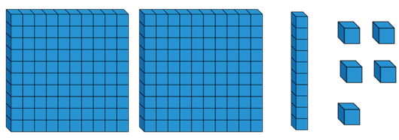
Year 3 | Week 7 | Day 2

Slide 18
Year 3 | Week 7 | Day 3

Slide 19
Year 3 | Week 7 | Day 4

Slide 20
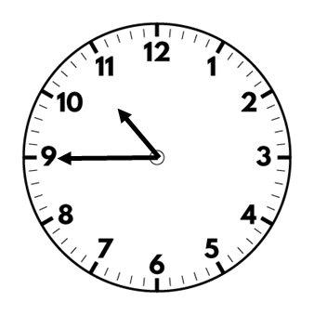
Year 3 | Week 7 | Day 5

Slide 21
Year 3 | Week 8 | Day 1

Slide 22
Year 3 | Week 8 | Day 2

Slide 23

Year 3 | Week 8 | Day 3

Slide 24

Year 3 | Week 8 | Day 4

Slide 25
Year 3 | Week 8 | Day 5

