Slide 1
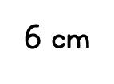
Year 3 | Week 10 | Day 1

Slide 2
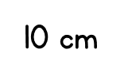
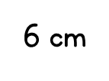
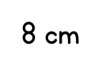
Year 3 | Week 10 | Day 2

Slide 3
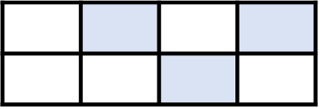
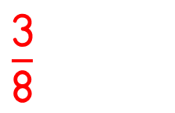
Year 3 | Week 10 | Day 3
35 mm 10 cm

Slide 4
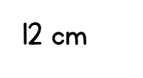
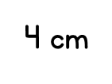
Year 3 | Week 10 | Day 4

Slide 5
Year 3 | Week 10 | Day 5

Slide 6
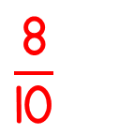
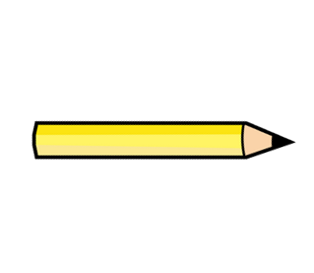
Year 3 | Week 11 | Day 1

Slide 7
Year 3 | Week 11 | Day 2

Slide 8
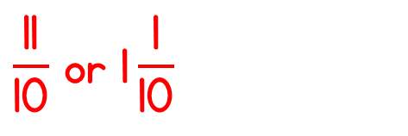
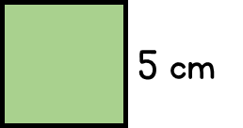
Year 3 | Week 11 | Day 3

Slide 9
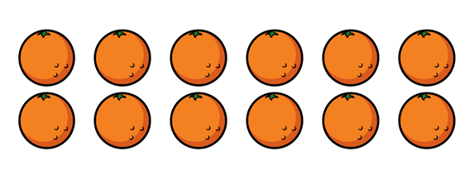
Year 3 | Week 11 | Day 4

Slide 10
Year 3 | Week 11 | Day 5

