Slide 1
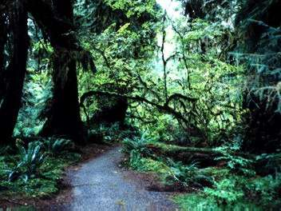
Animal Habitats

Slide 2
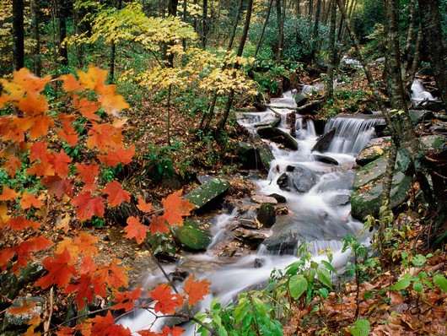
A Habitat is a special place where a plant or animal lives
Just like you have a home or place to live, so do plants and animals.

Slide 3
An animal needs 5 things to survive in it’s habitat:
Food
Water
Shelter
Air
A place to raise it’s young

Slide 4
Let’s have a look at some animal habitats and see who lives there…

Slide 5
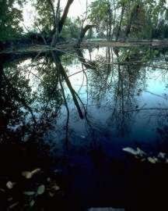
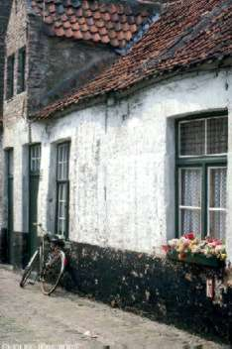
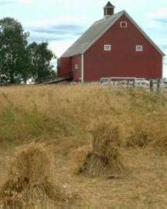
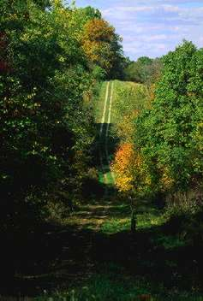
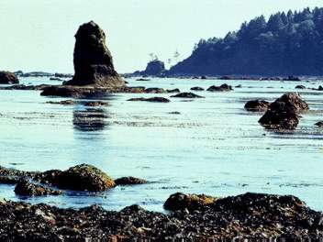
pond
house
farm
Click on a habitat to see who lives there or click here to exit.
hedge
sea
wood

Slide 6
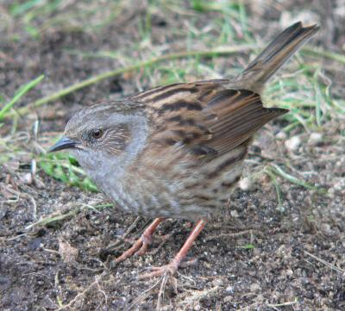
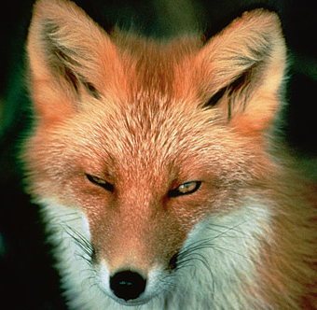
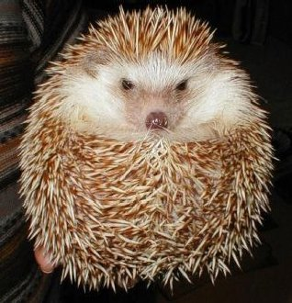
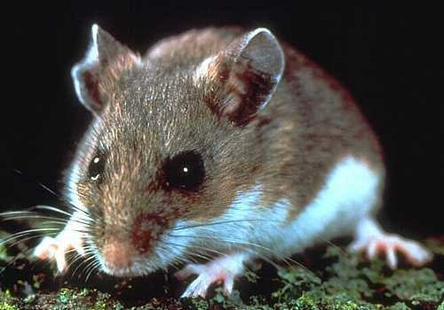
bird
mouse
fox
hedgehog
These animals live in a hedge. Can you name them?

Slide 7
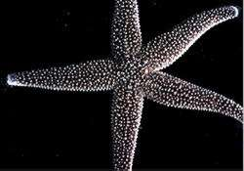
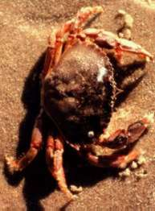
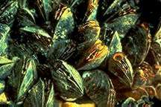
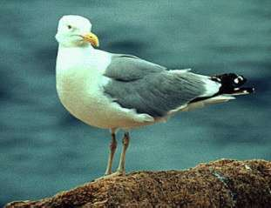
crab
starfish
mussels
seagull
These animals live in or near the sea. Can you name them?

Slide 8
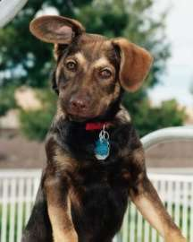
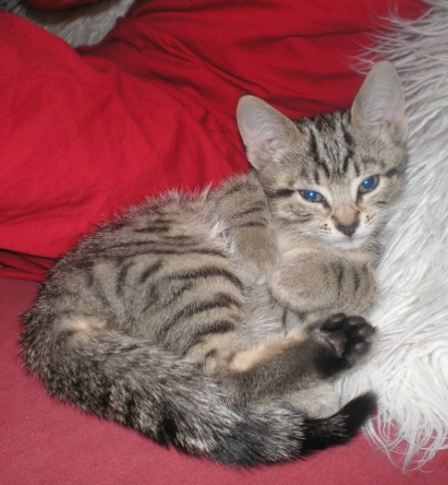
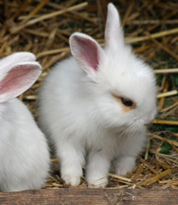
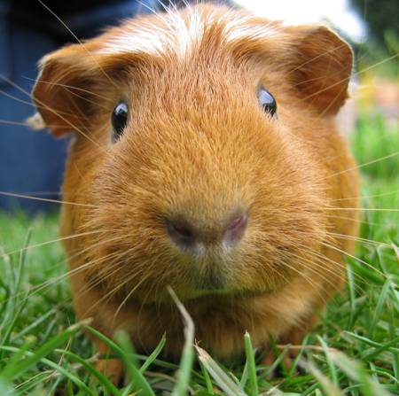
Guinea
pig
dog
cat
rabbit
These animals live in our houses. Can you name them?

Slide 9
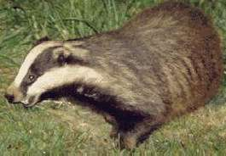
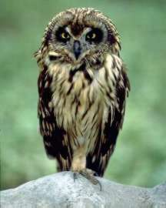
badger
fox
owl
rabbit
These animals live in a wood. Can you name them?

Slide 10
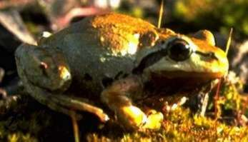
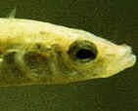
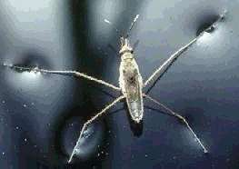
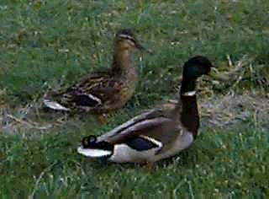
pond
skater
frog
fish
ducks
These animals live in or on a pond. Can you name them?

Slide 11
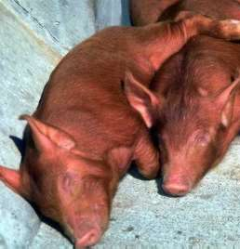
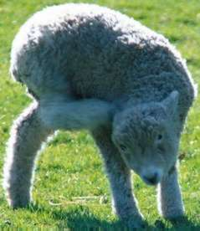
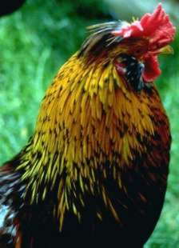
pigs
cows
lamb
cockerel
These animals live on a farm. Can you name them?

Slide 12
Why not investigate animal habitats further?
Or maybe you could try some animal habitat activities?
Have fun!

