Slide 2
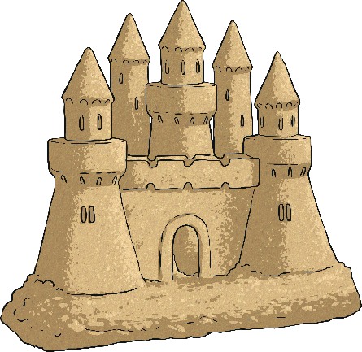
Monday
Tuesday
Wednesday
Thursday
Friday

Slide 3
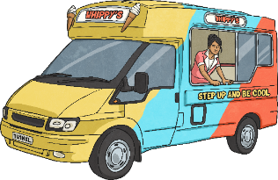
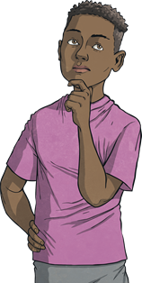
Menu
Summer 3 Monday
+ and −
Place Value
Reveal answer
2800 + 400 = 3200
Reveal answer
4036
Write four thousand and thirty-six in numbers.
6030 - 700 = 5330
Reveal answer
× and ÷
Problem Solving
Reveal answer
3 × 4 × 7 = 84
Reveal answer
Alison buys a book for £3.75 and pays with a £5 note. With which coins could she receive her change?
37 ÷ 4 =
9 remainder 1
Reveal answer
£1, 20p, 5p or any combination with a total of £1.25
Reasoning
Is my part-whole model correct?
21.4
6.7
5.6
8.1
Is Jamil correct?
Explain your reasoning.

Slide 4
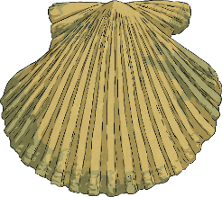
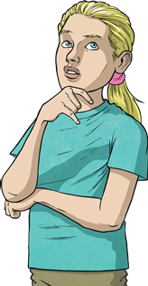
Menu
Summer 3 Tuesday
+ and −
Place Value
 |  | 3 | 1 | 2 | 8
 | + | 4 | 7 | 5 | 7
Reveal answer
Reveal answer
How many if I have one hundred less?
6903
7003
 | 7 | 8 | 8 | 5
× and ÷
Problem Solving
Reveal answer
4 × 7 × 5 = 140
How many lines of symmetry has this rectangle?
Reveal answer
25 ÷ 7 =
3 remainder 4
Reveal answer
2
Reasoning
If I count in multiples of seven I will say the number 147.
Is Alana correct?
Explain your reasoning.

Slide 5
Menu
Summer 3 Wednesday
+ and −
Place Value
Reveal answer
35 + 66 = 101
Put these numbers in order from smallest to greatest:
Reveal answer
6218
6128
6281
6182
6182
6218
6281
6128
500 - 201 = 299
Reveal answer
× and ÷
Problem Solving
9 × 5 × 8 = 360
Reveal answer
Find three different ways to complete this part whole model.
17.5
30 ÷ 4 =
7 remainder 2
Reveal answer
Reasoning
I have drawn a line of symmetry on this triangle.
Is Jamil correct?
Explain your reasoning.

Slide 6
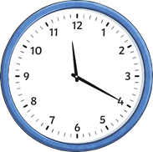
Menu
Summer 3 Thursday
+ and −
Place Value
 |  | 2 | 5 | 7 | 1
 | - | 1 | 2 | 5 | 4
Reveal answer
Reveal answer
What numbers are hidden on the number line?
2078
2088
2098
2108
2118
2128
 | 1 | 3 | 1 | 7
× and ÷
Problem Solving
Reveal answer
How many parts of this shape need to be coloured in to show ?
7 × 2 × 9 = 126
Reveal answer
2
3
37 ÷ 9 =
4 remainder 1
Reveal answer
10
Reasoning
In forty minutes it will be midnight.
Is Alison correct?
Explain your reasoning.

Slide 7
Menu
Summer 3 Friday
+ and −
Place Value
Reveal answer
7000 + 30 = 7030
What are the next three numbers in this sequence?
Reveal answer
75
100
125
150
175
200
4050 - 400 = 3650
Reveal answer
× and ÷
Problem Solving
Reveal answer
3 × 6 × 7 = 126
Reveal answer
Describe the translation from point A to point B.
B
39 ÷ 8 =
4 remainder 7
Reveal answer
2 right and 3 up
A
Reasoning
I need to colour in three more parts to show .
9
10
Is Jamil correct?
Explain your reasoning.

