Slide 1
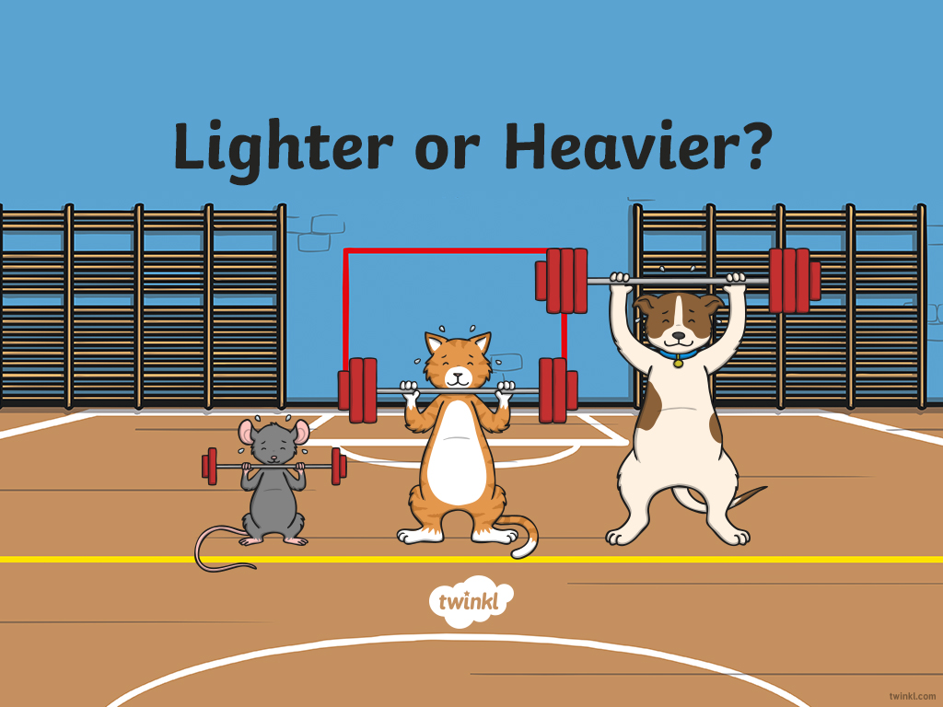
Lighter or Heavier?

Slide 2
Which is heavier?
A
the lunchbox
B
the tablespoon

Slide 3
Correct!
A
the lunchbox

Slide 4
Incorrect. Try again!
B
the tablespoon

Slide 5
Which is lighter?
A
the school shoes
B
the socks

Slide 6
Correct!
B
the socks

Slide 7
Incorrect. Try again!
A
the school shoes

Slide 8
Which is heavier?
A
the stickers
B
the basketball

Slide 9
Correct!
B
the basketball

Slide 10
Incorrect. Try again!
A
the stickers

Slide 11
Which is lighter?
A
the book
B
a piece of paper

Slide 12
Correct!
B
a piece of paper

Slide 13
Incorrect. Try again!
A
the book

Slide 14
Which is heavier?
A
the glue stick
B
the feather

Slide 15
Correct!
A
the glue stick

Slide 16
Incorrect. Try again!
B
the feather

Slide 17
Which is lighter?
A
the hat
B
the laptop

Slide 18
Correct!
A
the hat

Slide 19
Incorrect. Try again!
B
the laptop

Slide 20
Which is heavier?
A
the chair
B
the hair ribbon

Slide 21
Correct!
A
the chair

Slide 22
Incorrect. Try again!
B
the hair ribbon

Slide 23
Which is lighter?
A
the vase
B
the pencil

Slide 24
Correct!
B
the pencil

Slide 25
Incorrect. Try again!
A
the vase

Slide 26
Which is heavier?
A
the scissors
B
the tablet

Slide 27
Correct!
B
the tablet

Slide 28
Incorrect. Try again!
A
the scissors

