Slide 1
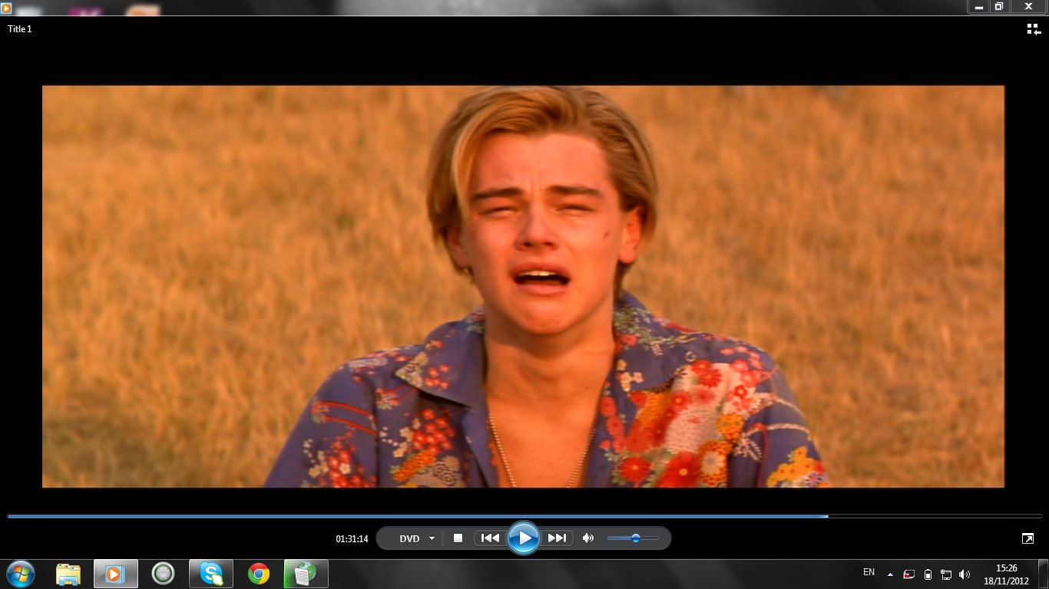

Act 3
Romeo and Juliet

Slide 2
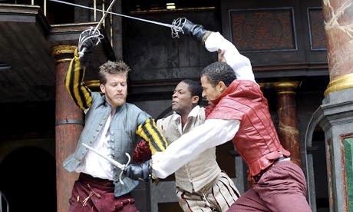
Act 3 Scene 1 Summary
Mercutio and Benvolio meet Tybalt, who is looking for Romeo.
Tybalt insults Romeo. When he does not respond, Mercutio angrily challenges Tybalt himself.
Mercutio and Tybalt fight. Mercutio is fatally wounded.
Feeling ashamed that Mercutio has died on his behalf, Romeo fights with Tybalt and kills him.
As punishment, the prince exiles Romeo from Verona.

Slide 3
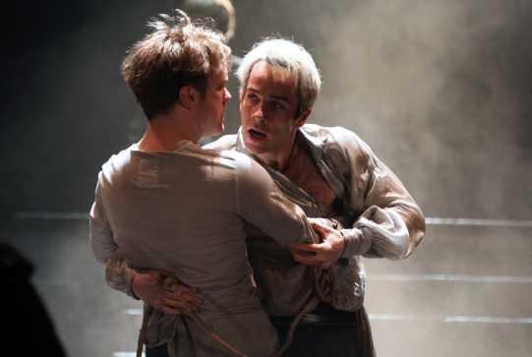
‘Ask for me tomorrow and you shall find me a grave man.’

Slide 4
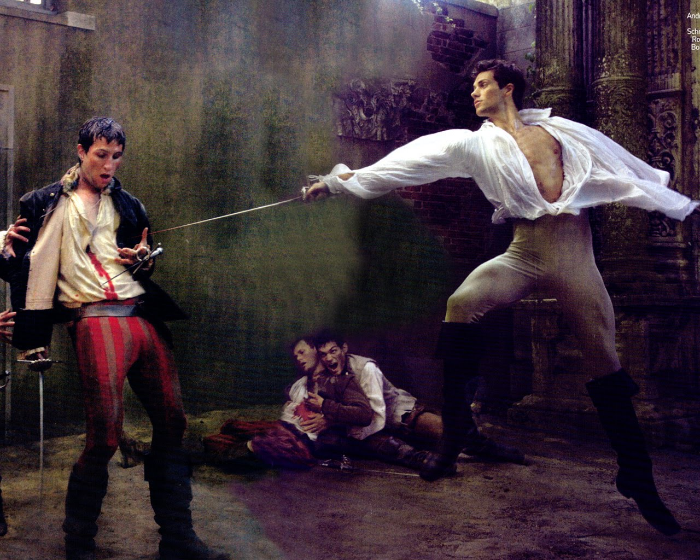

Slide 5
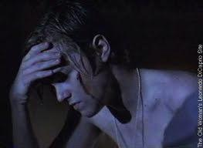

Slide 6

Performance Question
Romeo - for Mercutio’s soul
Is but a little way above our heads,
Staying for thine to keep him company.
Either thou or I, or boh, must go with him.
Tybalt Thou, wretched boy, that didst consort him here,
Shalt with him hence!
Romeo (Drawing his sword) This shall determine that.
(THEY FIGHT. ROMEO KILLS TYBALT)
Benvolio Romeo, away, be gone!
The citizens are up, and Tybalt slain.
Stand not amazed! The Price will doom thee death
If thou art taken. Hence, be gone, away!

Slide 7
Character Question
What do we learn about the character of Romeo from this scene?
Use evidence from the scene to support your answer.

Slide 8
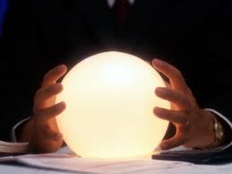
How will Juliet react to this news?

Slide 9


Slide 10


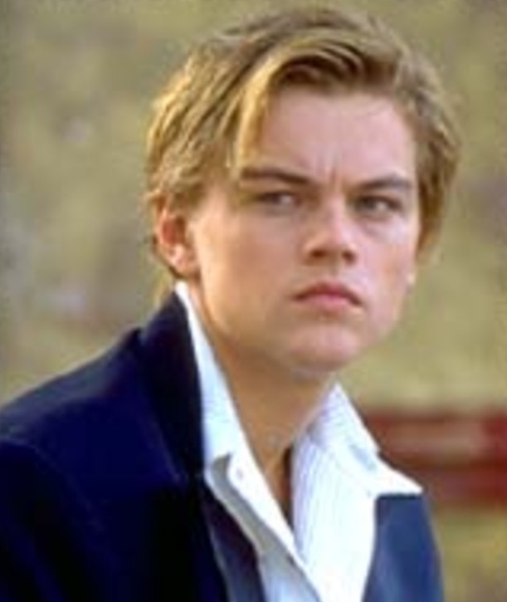
Make your own poster to show the people of Verona that Romeo has been banished.

Slide 11
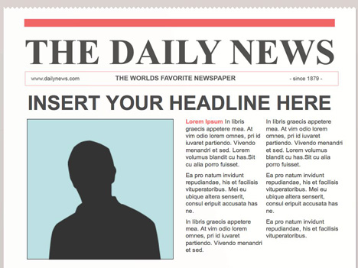
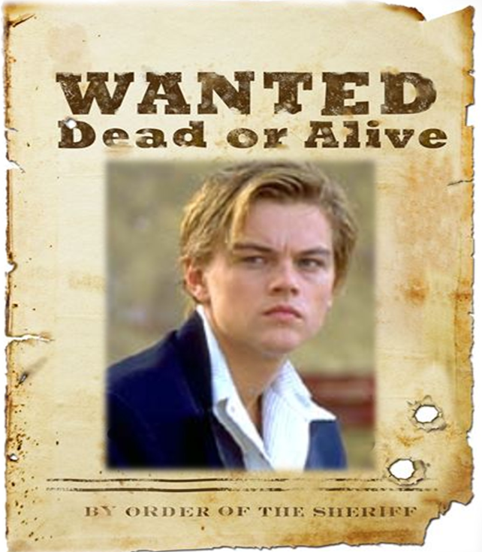
25 August 1528
Since 1412
Ruthless Romeo on the Run
Residents living in Verona were shocked following the death of two young men on Sunday morning. It is believed the deaths are linked to the on-going Capulet and Montague feud. Authorities say that Romeo Montague is now on the run after being banished by Prince Escalus.
The fighting broke out in the square just after 11am. A witness said that a man named
Mercutio was killed by Tybalt Capulet after a fencing battle went wrong. This led Romeo Montague to lose his temper and ruthlessly kill Tybalt Capulet in a ferocious rage.
One onlooker described how the killer ‘looked like a wild animal, determined to get revenge’. Officers were quickly on the scene and Prince Escalus banished Romeo Montague for his role in the violence.
Read more on page 5.

Slide 12
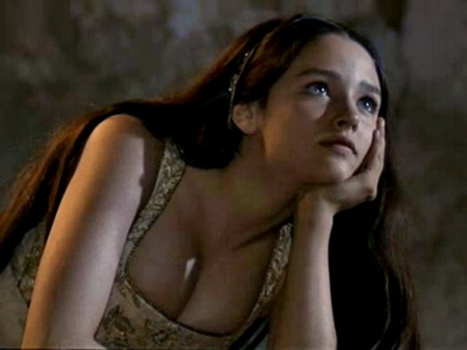

Act 3 Scene 2 Summary
Juliet is longing for night and Romeo’s arrival, when the nurse enters, grieving at Tybalt’s death.
When Juliet realises that Romeo killed Tybalt, her feelings are at first confused. Then it sinks in that Romeo is banished and she becomes desperate.
The nurse offers comfort, promising to bring Romeo to Juliet that night.

Slide 13
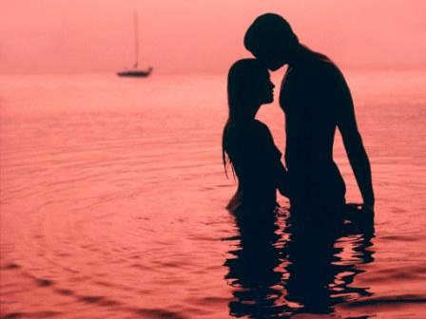
Juliet's soliloquy has erotic elements, some readers found the speech embarrassingly sexual (some productions cut the speech)
Which lines and words do you think they thought embarrassing?
Remember, the lines are spoken by a thirteen-year-old girls.

Slide 14
What is an oxymoron?
‘beautiful tyrant’ + ‘honourable villain’
Oxymoron – two words that contradict each other placed beside each other, for example ‘deafening silence’
Bitter Sweet
Act naturally
Sweet Agony
Awful Nice
Growing smaller
ANTITHESIS is where the ‘opposites’ are not immediately joined e.g. ‘O serpent heart, hid with a flow’ring face!
Antithesis?

Slide 15
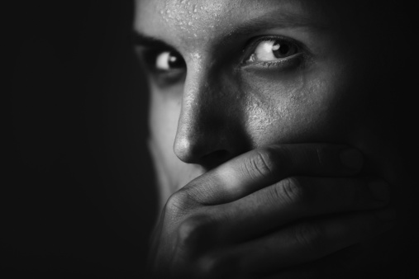
Juliet suddenly finds herself married to a man who has killed her cousin, a man who has been banished from Verona
Was ever book containing such vile matter
So fairly bound?
O serpent heart, hid with a flowering face!

Slide 16
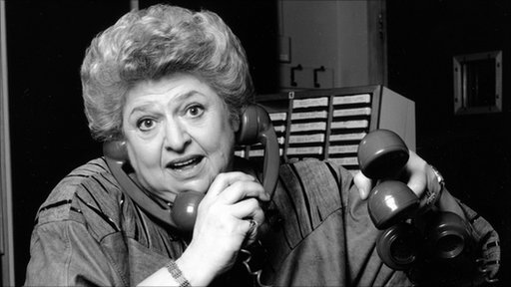
Ask the Agony Aunt……

Slide 17

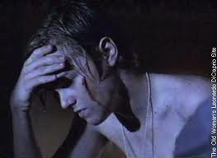
Act 3 Scene 3 Summary
Romeo is desperate when he hears that he has been banished from Verona, and the Friar cannot comfort him.
The Nurse arrives. Fearing that Juliet must now hate him and imagining her grief, Romeo threatens to kill himself, but is prevented by the Friar and the Nurse.
The Friar instructs Romeo to leave for Mantua by dawn at the latest, after he has spent the night with Juliet.

Slide 18

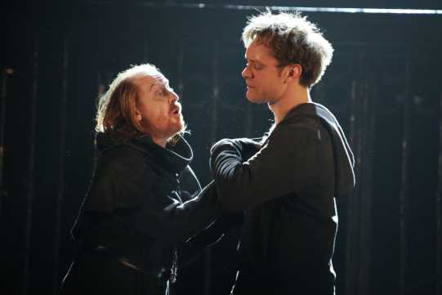

Given that Romeo expected the death sentence (line 9), why does he react so badly to the news that he is to be banished?
How sympathetic are you to his reactions here?

Slide 19
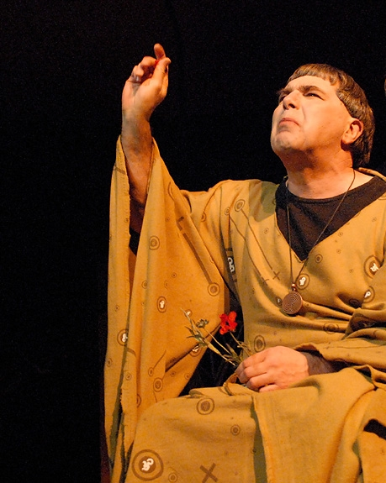
Friar Lawrence plays an important role in this scene?
What are the main points he makes in his speech to Romeo?
What is his other contribution in the play to date?
What kind of character is Friar Lawrence? What do you know about him to date?

Slide 20
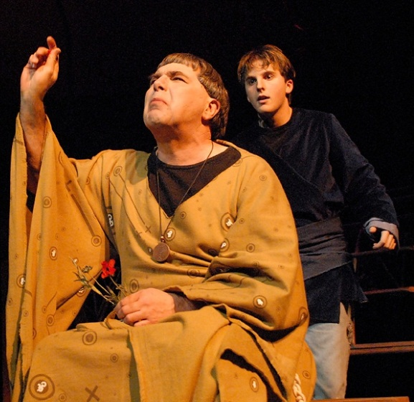
Nurse: Where’s Romeo?
Friar: There on the ground, with his own tears made drunk.
‘Oh deadly sin! O rude unthankfulness!’
‘This is dear mercy, and thou seest it not’
‘O, then I see that madmen have no ears’
‘Hold thy desperate hand!
Art thou a man? Thy form cries out thou art:
Thy tears are womanish – thy wild acts denote
The unreasonable fury of a beast!’
‘But like a misbehaved and sullen wench
Thou frown’st upon thy fortune and thy love’

Slide 21
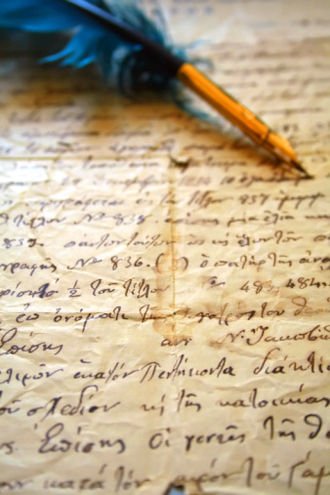

Dear diary….
Write a diary entry that Friar Lawrence wrote after Romeo has left to spend the night with Juliet .
Remember that diary entries should contain lots of feelings and emotions.
Try your best to show how he feels about Romeo’s behaviour and the mess he is now involved in.
Lets plan some ideas…

Slide 22
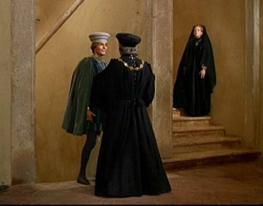

Act 3 Scene 4 Summary
Capulet arranges with Paris that his wedding to Juliet will take place in a few days’ time.
He sends Lady Capulet to inform Juliet.

Slide 23
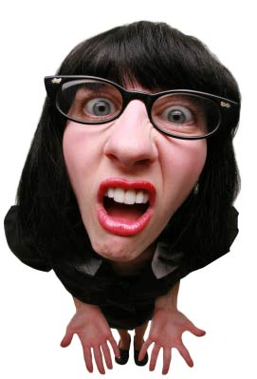

Why has Capulet suddenly changed his mind and decided that Juliet must marry Paris?
Discuss in Pairs

Slide 24
Act 3 Scene 5 Summary
Having spent the night with Juliet, Romeo leaves for Mantua.
Lady Capulet tells Juliet that she is to marry Paris, but she refuses.
Capulet is furious with Juliet for her disobedience and threatens her.
The Nurse advises Juliet to marry Paris. Juliet pretends to accept her advice, but privately plans to seek help from the Friar.

Slide 25

Performance Question
Juliet
O think’st thou we shall ever meet again?
Romeo
I doubt it not, and all these woes shall serve
For sweet discourses in our times to come.
Juliet
O God, I have an ill-divining soul!
Methinks I see thee now, thou art so low,
As one dead in the bottom of a tomb.
Either my eye sight fails, or thou look’st pale.
Romeo
And trust me, love, in my eye so do you:
Dry sorrow drinks our blood. Adieu, adieu!

Slide 26
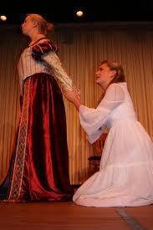
Lady Capulet tells Juliet that she is to marry Paris, but she refuses.

Slide 27
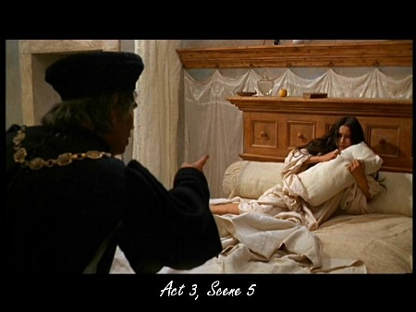

Slide 28
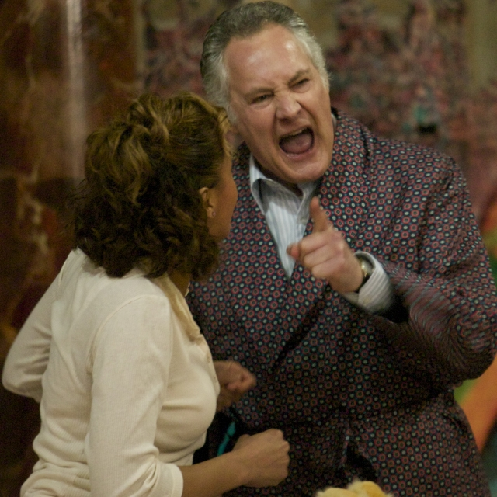
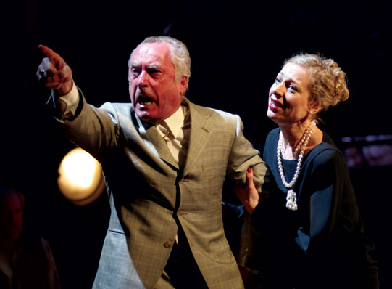
Lord Capulet asserts his control over Juliet.
This is a contrast to his earlier comments!

Slide 29
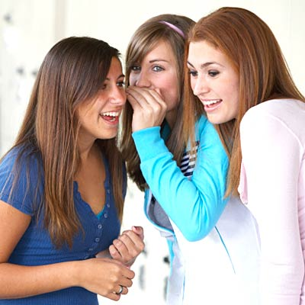

The Nurse and her big mouth!
In pairs, write a short dialogue of a conversation between the nurse and two of her friends who want to know what happened in the Capulet house that day.

Slide 30
Dear diary….
Write a diary entry that the Nurse wrote after Capulet and Lady Capulet abandoned Juliet.
Remember that diary entries should contain lots of feelings and emotions.
Try your best to show her feelings for Juliet, and her worries about the mess she is now involved in.
Plan some ideas first…

Slide 31

Soundbites are very short clips of what someone has said, broadcast on television or radio. Make up soundbites for each scene. Remember they should be concise and attention grabbing, rather like headlines.

