Slide 1
The Upton Schools
Welcome
“Belonging, Growth and Excellence”

Slide 2


Slide 3


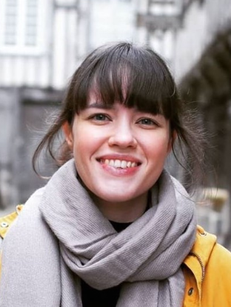
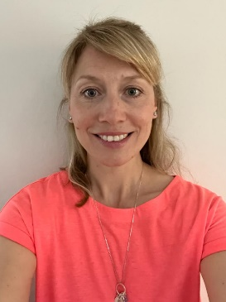

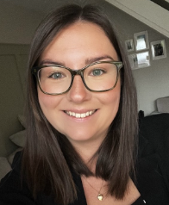


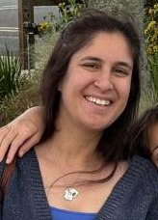
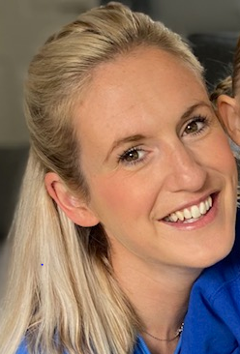
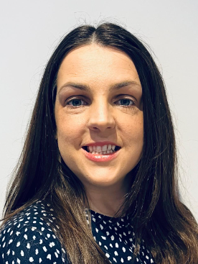
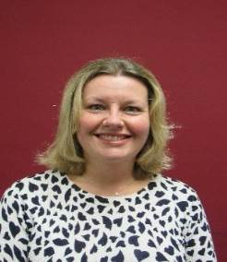









Upton Infant School
Upton Infant School
Meet the Team!
Mrs Thow
EYFS Lead
Dragonfly Class Teacher
Mon to Weds
Mrs Perryman
Dragonfly Class Teacher
Thurs and Fri
Mrs Nicklen
Dragonfly Class
Teaching Assistant (HLTA)
Mrs Baker
Ladybird Class Teacher
TBC
Ladybird Class
Teaching Assistant
Mrs Gdesis
Caterpillar Class Teacher
4 days
Mrs Edge
Caterpillar Class Teacher
1 day- Thurs
Mrs Hooper
Caterpillar Class
Teaching Assistant
(Mon-Weds)
Mrs Jones
Caterpillar Class
Teaching Assistant
(Thurs-Fri)

Slide 4



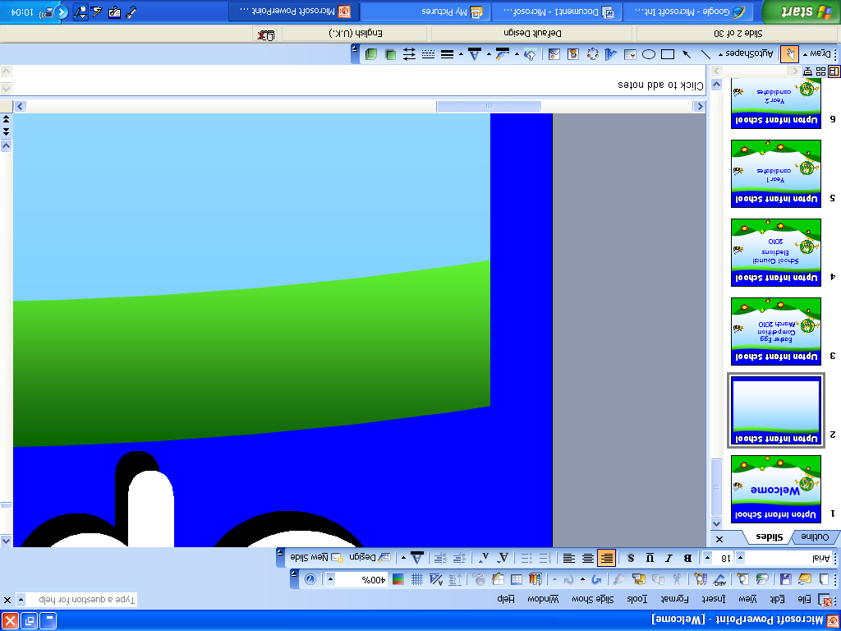

Upton Infant School
Upton Infant School
Attendance
Attendance
Good attendance is crucial to achieving socially and academically at school
Good attendance is defined as over 95%.
90% sounds good but…
90% attendance means that 20 days have been missed.
That is 20 maths lessons, 20 reading lessons, 20 writing lessons.
Term time holidays.

Slide 5
Upton Infant School
Upton Infant School
Attendance
How School Works
Breakfast club and after school club
Hot school dinners
Clubs
Bromcom-MCAS APP

Slide 6
Class lists
Admitting children from many different providers has its challenges
We gather information but it is imprecise
History and experience tells us that classes can be imbalanced.
October half term we may make some adjustments in consultation with parents.

Slide 7
EYFS Curriculum
Upton Infant School
Upton Infant School
Ethos
At Upton Infant School we understand that a child’s first year in school is one of the most important as it lays the foundations for a lifelong love of learning and will foster a positive attitude towards education.
We aim to provide every child with a broad and balanced curriculum of both adult-directed teaching and child-initiated purposeful play.
Our curriculum will be rich in exciting learning opportunities to help develop happy, confident self-motivated learners.

Slide 8
EYFS Curriculum
Upton Infant School
Upton Infant School
The curriculum we have developed has been based on the statutory requirements of the Early Years Foundation Stage (EYFS) Framework for children aged 0-5.
Our planning is flexible and takes into account the changing needs and interests of the children.
The EYFS Framework is divided into the following areas of learning and their associated Early Learning Goals:
  Communication and Language
  Physical Development
  Personal, Social and Emotional Development
  Literacy
  Maths
  Understanding the World
  Expressive Arts and Design

Slide 9

Upton Infant School
Upton Infant School
Progress
We regularly assess the children’s progress and so can easily identify children who need a boost.
We have two formal parents evenings throughout the year, where you will be told how your child is progressing in their learning and any areas they may need support with. However, we have an open-door policy, so you are welcome to come and see us at any time.
At the end of the year you will receive your child’s Early Years Foundation Stage report. This will give you information about the levels of attainment your child has achieved at the end of Reception in all areas of learning.

Slide 10
Upton Infant School
Upton Infant School
Key Person System
A key person is:
a named member of staff to build relationship with the child and parents
someone who helps the child become familiar with the provision
someone who meets children’s individual needs and care needs (e.g. dressing, toileting etc.)
someone who responds sensitively to children’s feelings, ideas and behaviour
Your child’s key person will be either the class teacher or teaching assistant. Unless you are informed otherwise, your child’s key person will be the class teacher.

Slide 11

Upton Infant School
Upton Infant School
Tapestry
An Online learning journal system.
Staff record children’s ‘wow moments’ and activities onto a secure online server.
Parents can view their child’s journal on mobile devices and on their home computers and can make observations of their own using a secure login system.
Observations are uploaded by your class teacher and TAs.
Please read and return the Tapestry user agreement– If you have any questions or queries please ask a member of the Reception Team.

Slide 12
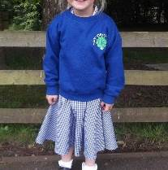

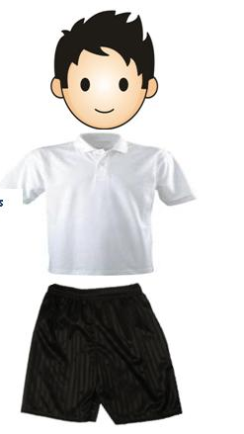
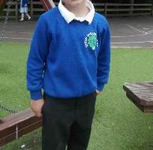
Upton Infant School
Upton Infant School
Uniform
Uniform
School Uniform
Grey trousers/skirts/pinafores
White shirt/blouse/polo shirt
U.I.S. sweatshirt / cardigan / fleece
Black, sensible shoes – no laces please ☺
Black / grey / white socks or tights
A warm weatherproof coat – Please help you child practise putting on and zipping up their new school coat.
Book bags
PE Kit
Black shorts
White, blue, red or yellow t-shirt or U.I.S. t-shirt
Trainers
Tracksuit bottoms - The children go outside in all weathers so please provide them with warm trousers to wear.
The children will come to school wearing their PE kits on the day they have PE (we will let you know in September when this will be)
Please name everything!!!

Slide 13
Upton Infant School
Upton Infant School
Snacks
A healthy snack is provided by the school for each child every day.
Snacks vary each day and include apples, pears, satsumas, tomatoes, and bananas.
The children will need to bring their own named water bottle into school every day or they can be offered milk if you have signed them up for it.
No squash please. We encourage the children to keep hydrated by drinking water throughout the day and spilt squash can be very messy and sticky on the carpet where the children play and have lessons.

Slide 14
Upton Infant School
Upton Infant School
Dropping off and collecting children
When full-time, children must be dropped off at the door to their classrooms at 8.40am. Registration is at 8.45am. Your child’s class teacher and TA will be there to welcome them in.
Once your child is in school full-time, the school day ends at 3.10pm.
While your child is part-time their drop off and pick up times will vary depending on which session they have been allocated. Drop offs and pick ups will always be from your child’s classroom door.
(please see the timetables which are in your pack)
Children will be seen out to parents or guardians one at a time by their teacher or teaching assistant.
It is important that if somebody else other than a you is collecting your child from school you must notify the school as soon as possible. If arrangements change during the day, please call school to make us aware. If we have not been made aware of any changes, we will need to phone you to verify the person’s identity before we will be able to release your child to their care.

Slide 15

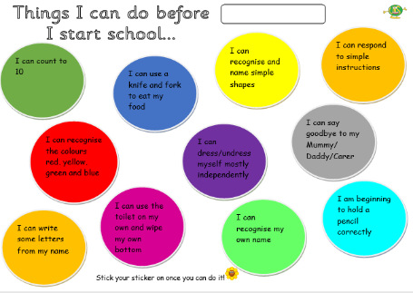
Upton Infant School
Upton Infant School
How can you help?
How can you help?
Complete the ‘All About Me’ booklet with your child ready to talk though with the teacher during the home visit.
Work through the ‘school readiness’ sheet with your child to ensure they have all the necessary basic skills to be a confident, successful, independent learner.
Talk positively about starting school in front of your child.
Read lots of stories and sing lots of Nursery rhymes together.
Practise getting changed and unchanged into school uniform.
Give time and opportunities for special time together without distractions.
Have fun, laugh and enjoy your summer together ☺

Slide 16
Upton Infant School
Upton Infant School
Dates for your diary
Summer Term
‘Meet the teacher’- Monday 15th June 3.30-4pm
(an optional and informal ‘drop in’ session for you and your child to come and meet your child’s teacher and see their new classroom)
Children’s ‘stay and play’ sessions (3.30 to 4.30pm)
Either Friday 3rd July or Friday 10th July will be allocated to you.
Details will be the pack given to you at the new parents meeting on
Wednesday 10th June.
Children stay at school for a play without their parents.
Home visits (AM / PM slots)
Thursday 3rd September, Friday 4th September
or Monday 7th September.
(please sign up for one of these dates on the sheets provided)

Slide 17
Upton Infant School
Upton Infant School
Dates for your diary
September 2026
(details will be emailed out)
Week 1- Staff INSET and Home visits
Week 2- Monday 7th September- Home visits
Tuesday 8th and Wednesday 9th September- Part-time
  An AM or PM slot has been allocated to you for the first two days. This is to help the children settle in on their first week with a smaller group of 15 children. Details of this are in your pack.
    Thursday 10th and Friday 11th September – whole class part-time
  Morning only (8.40am – 12pm)
Week 3- All children in full-time from Monday 14th September
  8.40am – 3.10pm

Slide 18
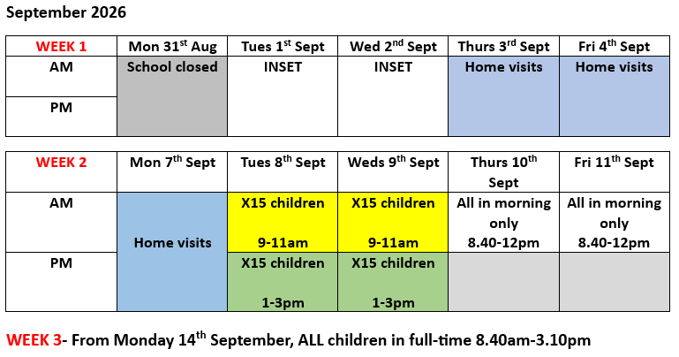
Upton Infant School
Upton Infant School

Slide 19
Upton Infant School
Upton Infant School
Next Steps…
Next Steps…
If you haven’t done so already, please complete all enrolment forms.
Purchase uniform through MCAS.
Make a note of all the dates coming up this half term and in September.

Slide 20
Upton Infant School
Upton Infant School
Thank you for coming.
If you have any questions, please do not hesitate to get in touch.

